Slide 1

Argumentative Research

Slide 2
This tutorial will take you through the steps of doing research using the ebooks and databases available through the Kilgore College Library.

Slide 3
Accessing from Off Campus
When you access ebooks or databases from off campus, a screen will appear asking for your username and password.
Username is a combination of the first four letters of your last name, first four letters of your first name, and the last four digits of your KC ID.
Password is the word Student and your 4-digit month and day of birth.

Slide 4
Example
So if your name is Jamie Cruze, your KC ID is 123456789, and you were born on November 27, you would enter the following:
Username: cruzjami6789
Password: Student1127

Slide 5
Finding Books
Go to the KC Library web site at https://library.kilgore.edu
Enter your term(s)
Search
Review the results

Slide 6
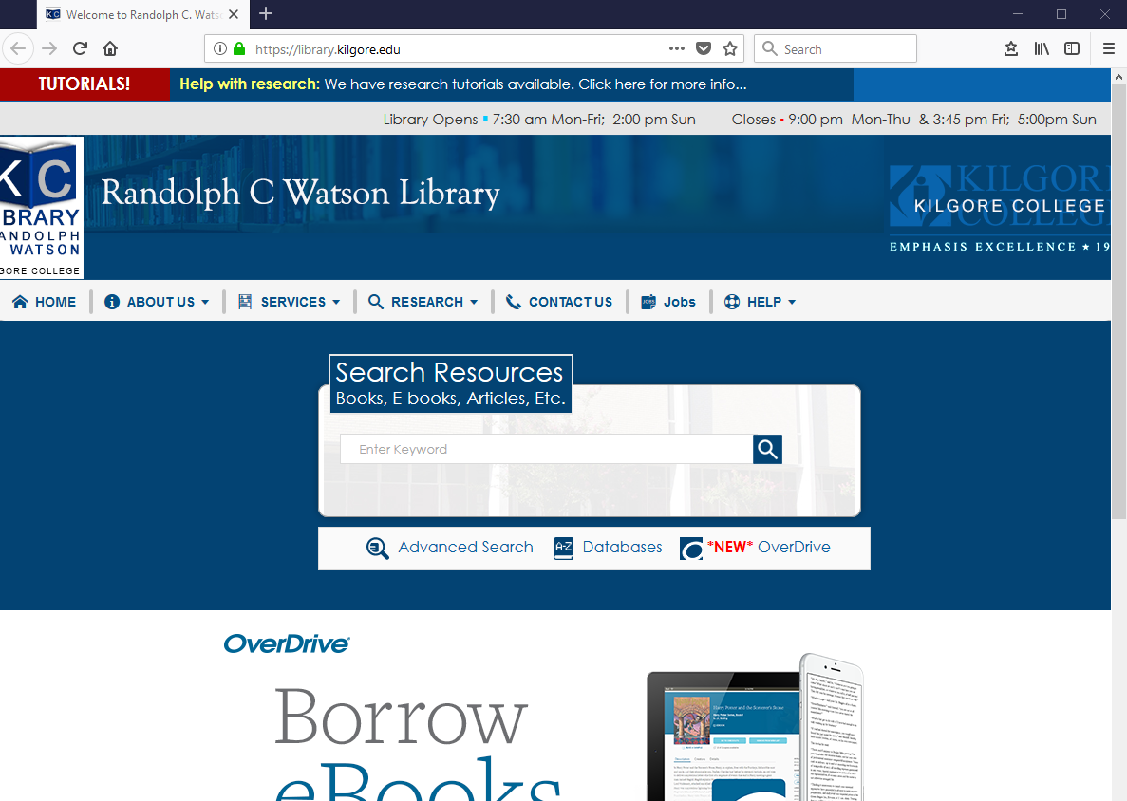
https://library.kilgore.edu

Slide 7
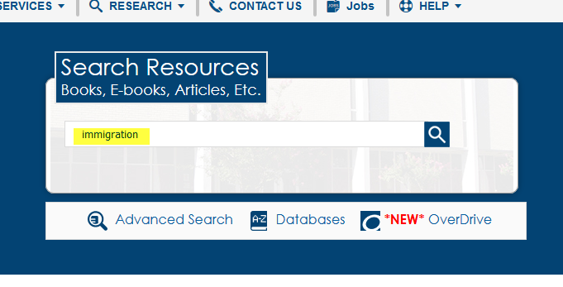
Enter search terms in the search box. Search.
Enter search terms here

Slide 8
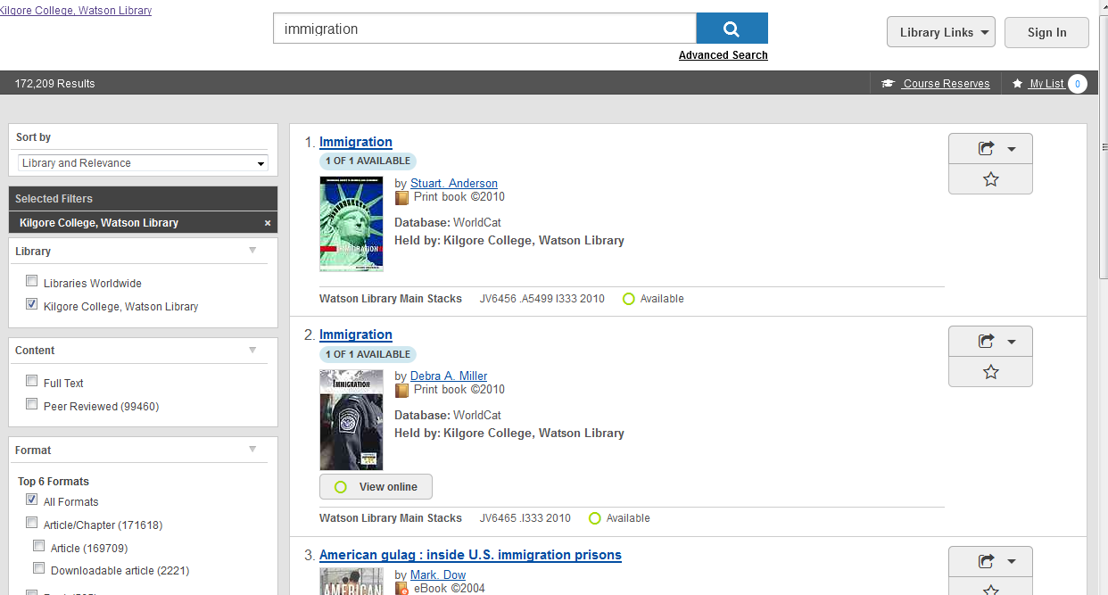
Review the results
That’s a lot of results!
Click here to narrow results

Slide 9
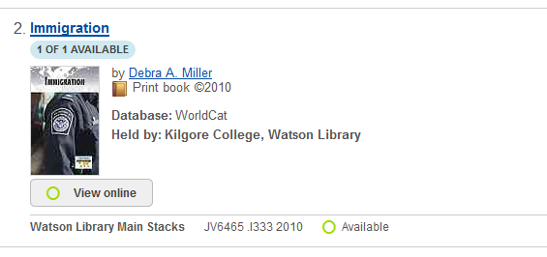
The Call Number tells you where to find the book on the shelf
This is a print book
Call Number

Slide 10
eBooks
Electronic format
Can be viewed from any computer connected to the Internet
Can search for content within the book

Slide 11
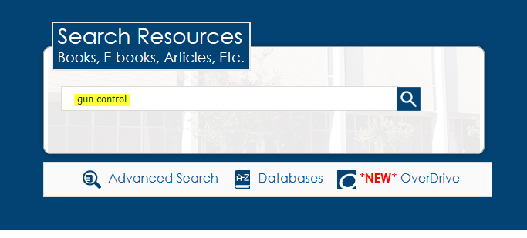
Search the same way you would for a print book
Enter search terms here

Slide 12
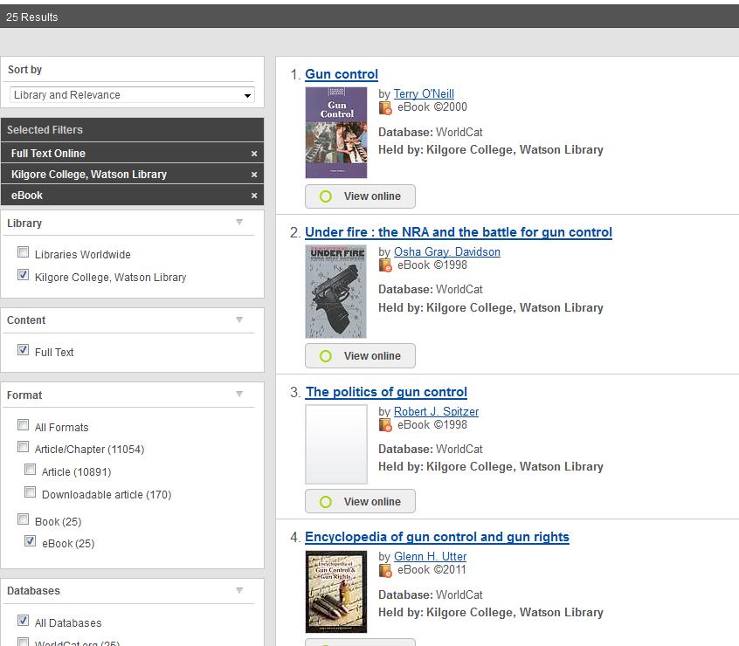
Narrow the search
Click here
Click here

Slide 13
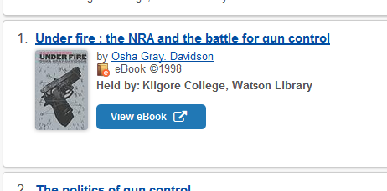
Click View eBook
Click here

Slide 14
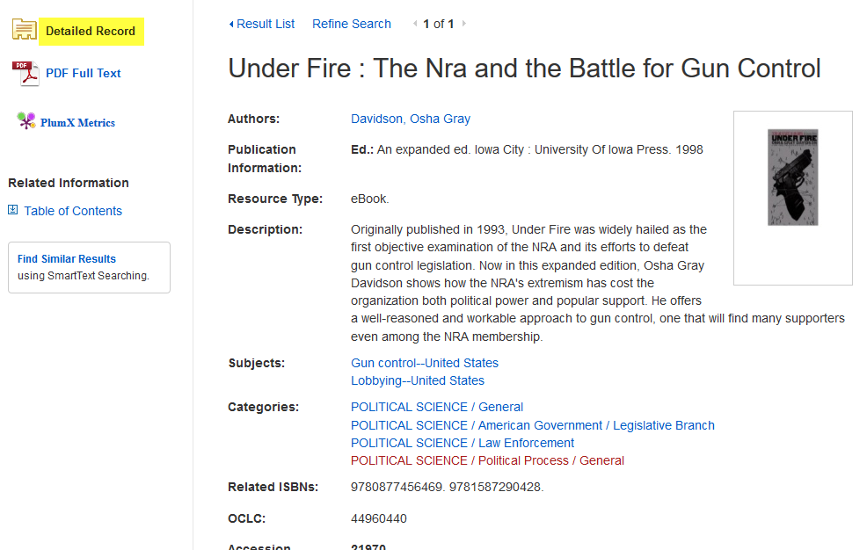
English: Get the Detailed Record
You can use this information to create your citation

Slide 15
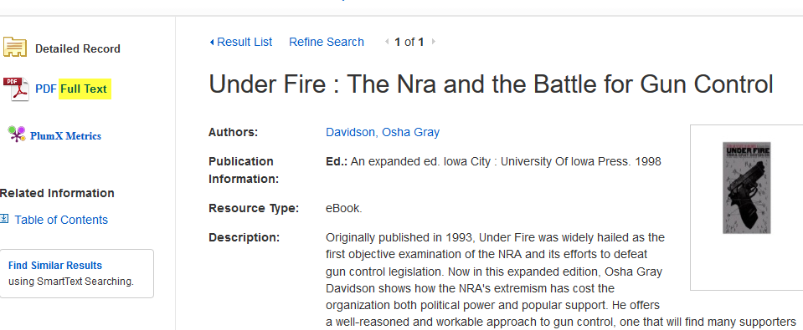
Click on Full Text to open the eBook
Click here

Slide 16
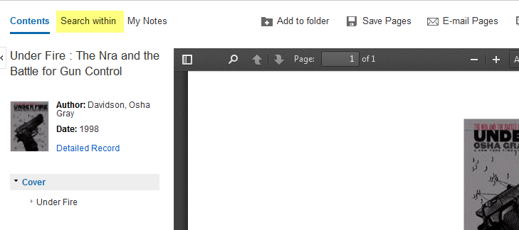
Click on Search within
Click here

Slide 17
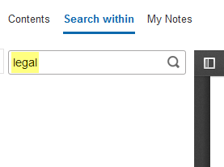
Enter your search terms and hit Enter
Click the magnifying glass or hit Enter to begin the search
Enter search terms here

Slide 18
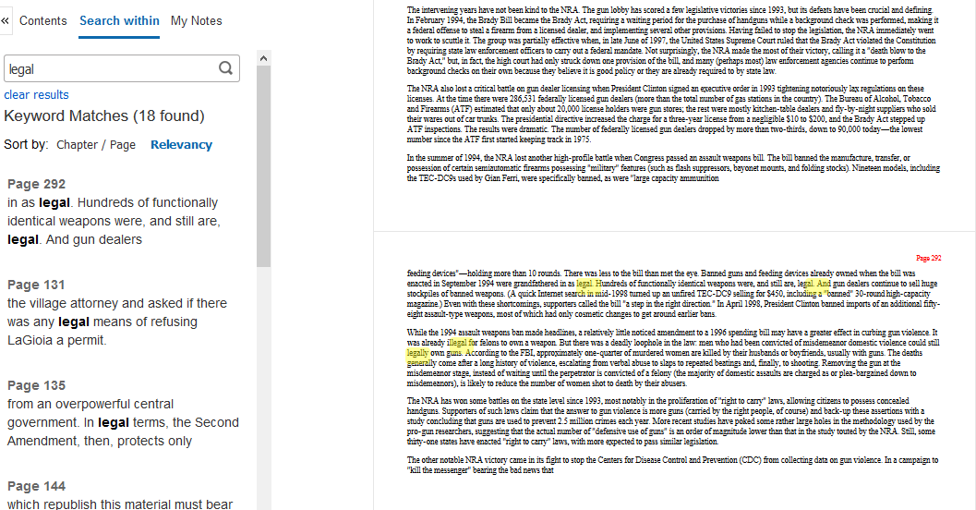
Click on a page number to go to that page
Page 292
Page 292

Slide 19
Don’t forget the citation information!
English students must create their citations using The Little Seagull Handbook.
Other classes may be allowed to use the Cite feature.
Ask your instructor which format is required for use in your class.

Slide 20
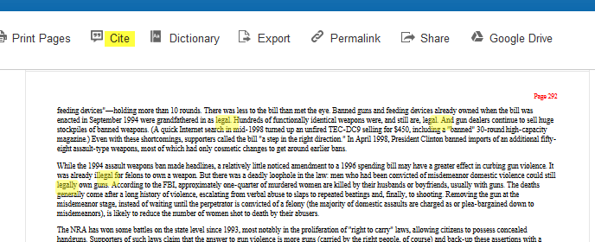
Other: Click on the Cite icon
Click here

Slide 21
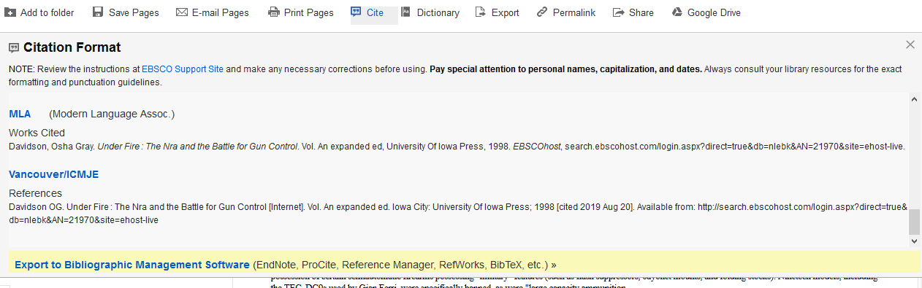
Scroll down to the designated format. Copy and paste to your citations page

Slide 22
Why should I use a database instead of the Internet?

Slide 23
Databases
Anyone can create an Internet site.
Internet sites are not always reliable.
You have to do extra checking to validate Internet sites.
Databases contain information from reliable sources.
Databases contain accurate information.

Slide 24
Databases
If your search terms are more than one word, try placing them in quotation marks so the database will search for the terms as a phrase:
“gun control”
Or, try a phrase and another term:
“gun control” AND crime

Slide 25
To keep the article:
Print it out
Save it to a flash drive
Send it to your email
Remember:
Be sure you get all of the information you will need for the bibliography!

Slide 26
Opposing Viewpoints
This database is excellent for research because it gives articles on more than one side of an issue.
In any argument, you need to know what the opposition thinks, so that you can be prepared to counter their points.

Slide 27
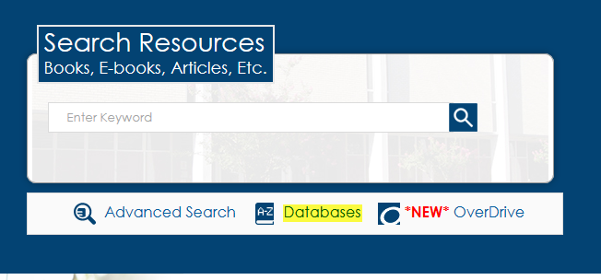
Select Databases
Click here

Slide 28
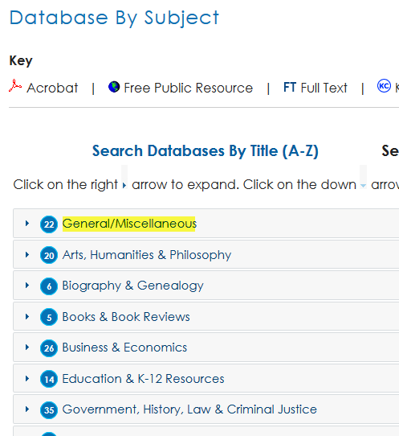
Click on a subject area
Click here

Slide 29
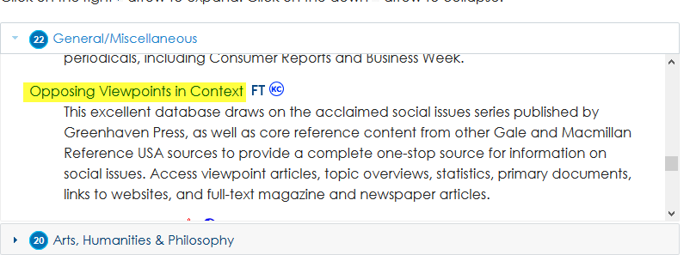
Scroll down and click on
Opposing Viewpoints
Click here
Move the gray box to scroll through the databases in the subject area

Slide 30
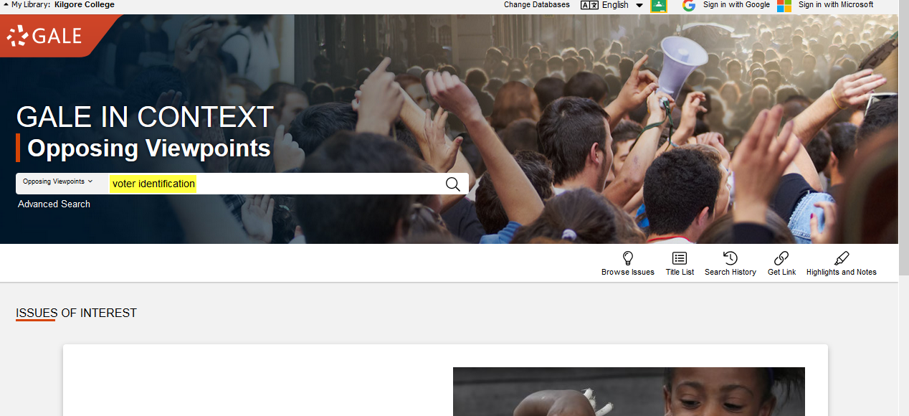
Enter Search terms. Search
Enter search terms here

Slide 31
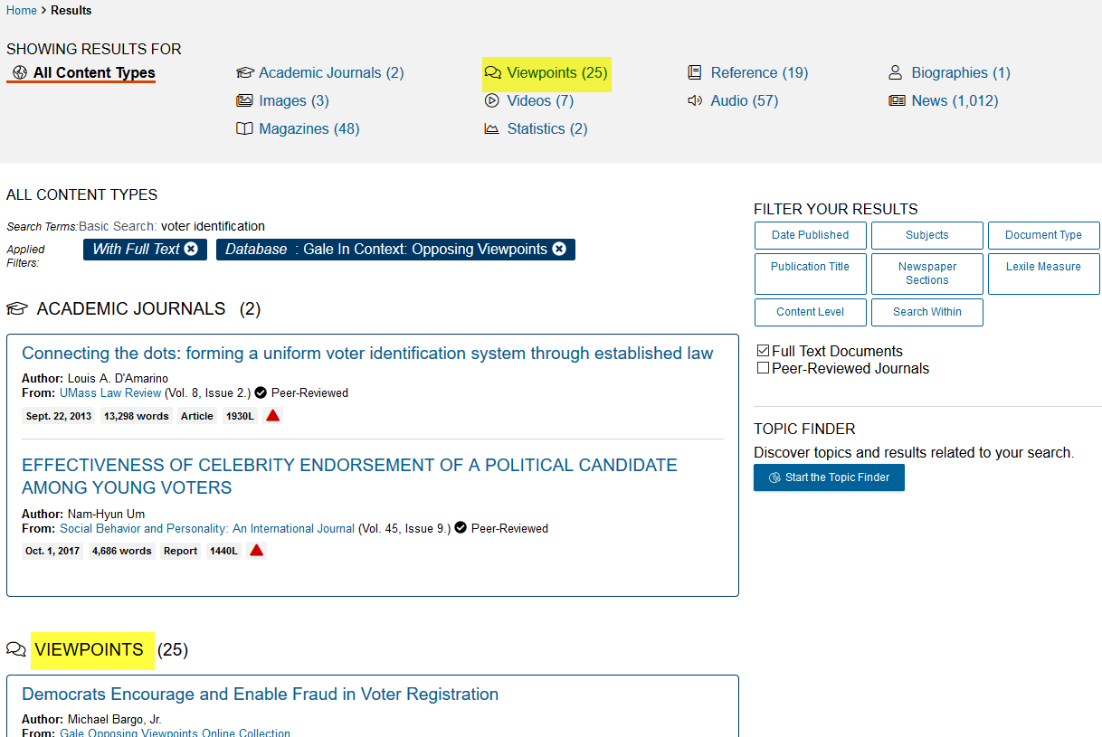
Click on an area to see all of the titles for that section
Click here
Or, Click here

Slide 32
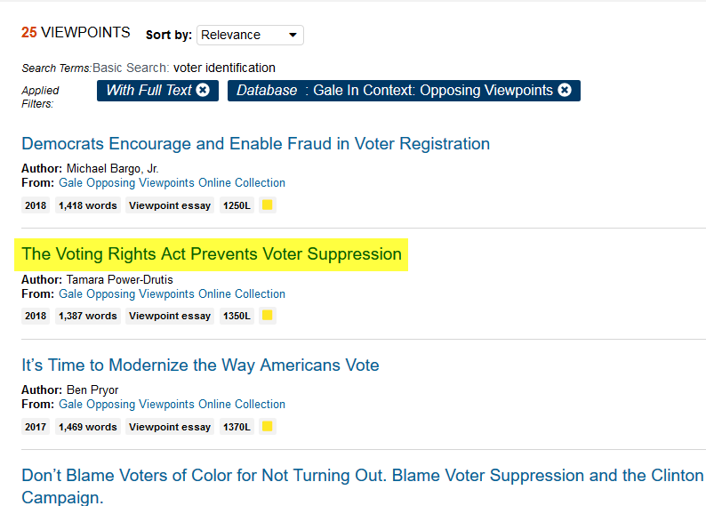
Click a title to read the article
Click on the title

Slide 33
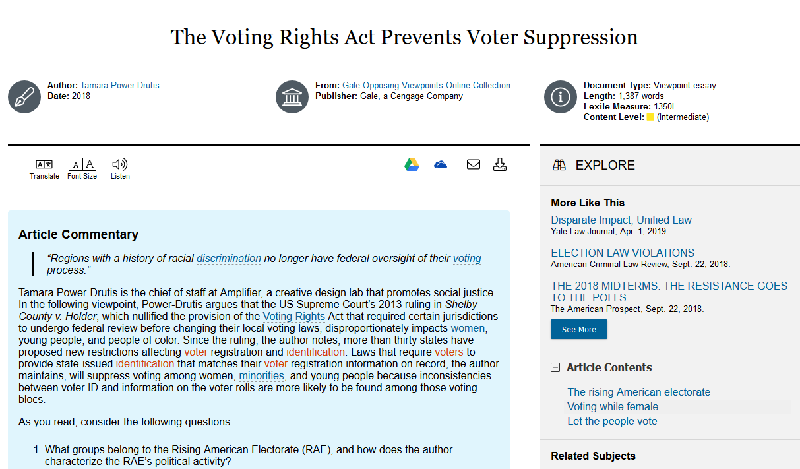
Read the article

Slide 34
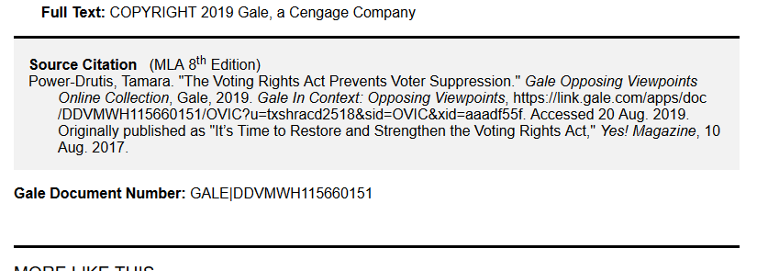
Citation information is at the bottom of the page

Slide 35
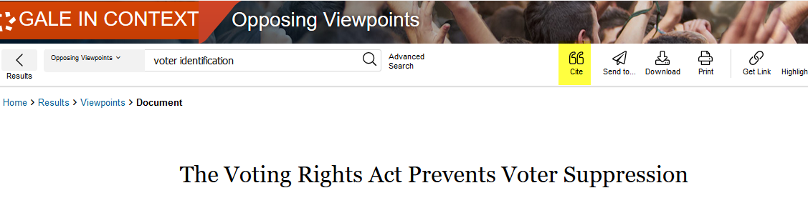
Or, click on Cite icon at the top of the page
Click here

Slide 36
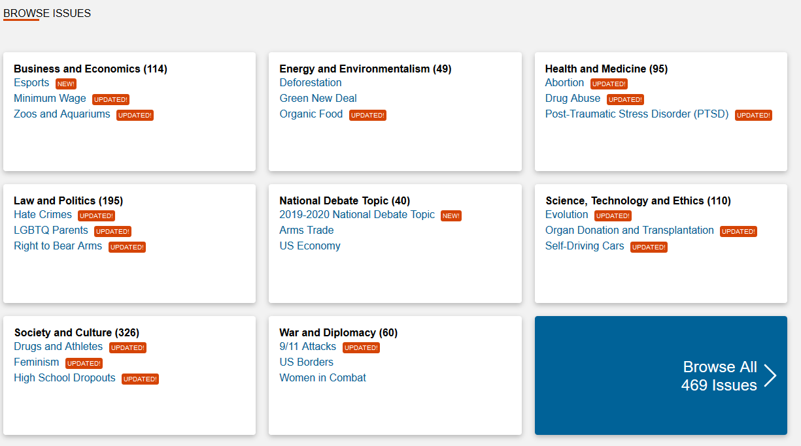
You could choose a topic from the list on the lower half of the main page

Slide 37
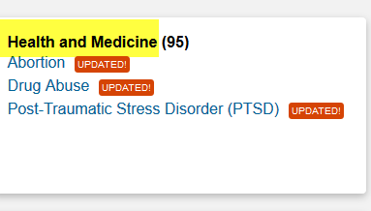
Click on a subject area to see a longer list
Click here

Slide 38
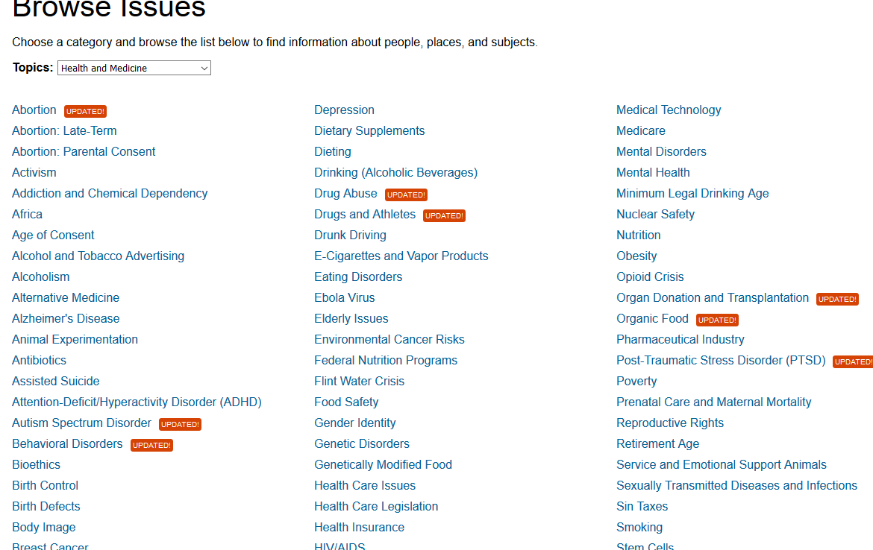
Choose a topic from the list

Slide 39
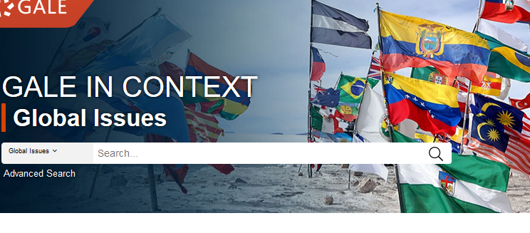
Global Issues in Context uses the same search methods as Opposing Viewpoints

Slide 40
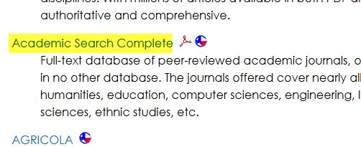
Academic Search Complete
Click here

Slide 41
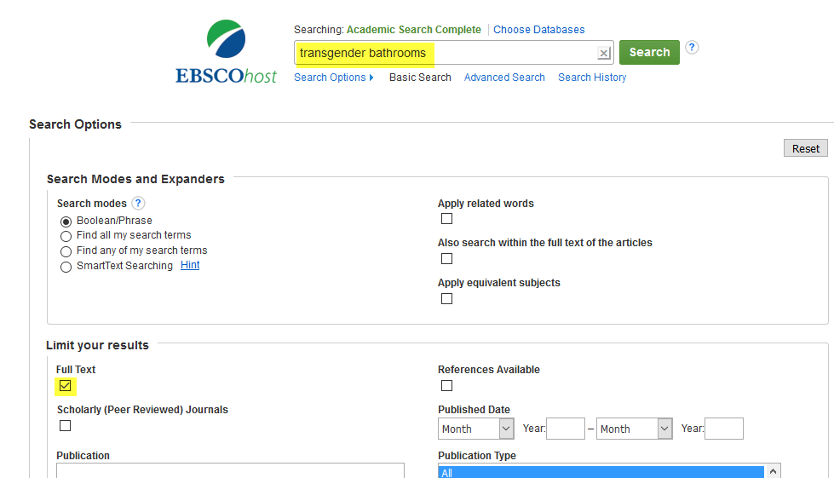
Enter search terms & click Full Text
Enter terms here
Click here

Slide 42
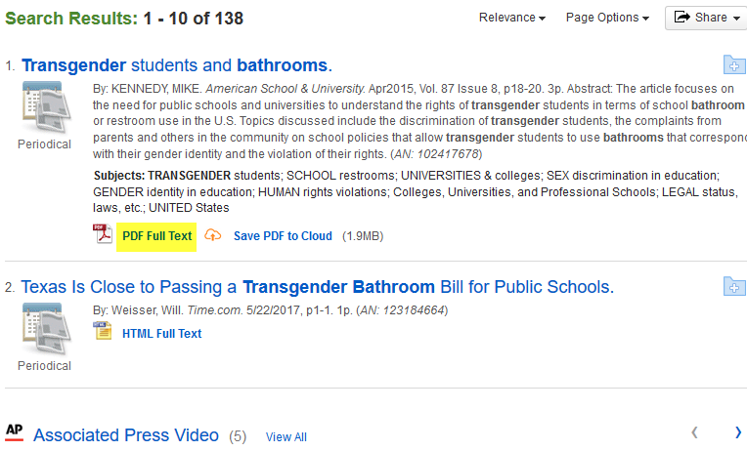
Click Full Text to view the article
Click here

Slide 43
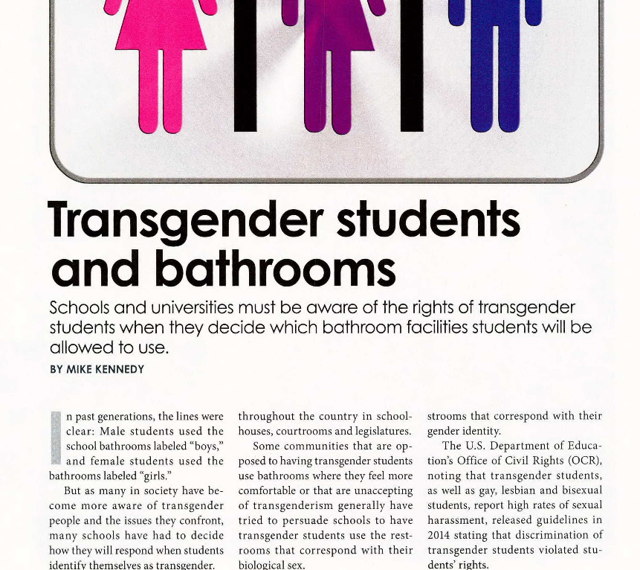
Read

Slide 44
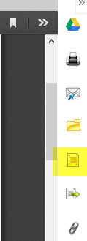
Click the Cite icon on the right side of the page to get the citation
Click here

Slide 45
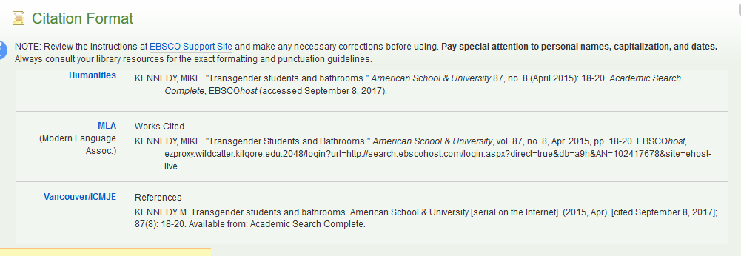
Scroll down to get the correct citation format

Slide 46
The Little Seagull Handbook
Just because the database says the citation it provides is in MLA format does not mean it is correct.
For English papers, check everything against what is in The Little Seagull Handbook.
If it doesn’t agree with what is in the handbook, it will be counted off on your grade.

Slide 47
For more help
Ask-A-Librarian: email reference service
Call the Library: 903-983-8237
Ask any librarian at the KC Library

Slide 48
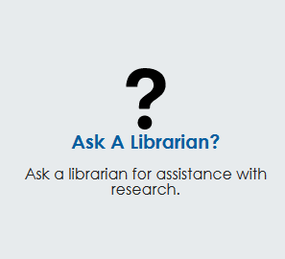
Click Ask-A-Librarian
Click here

Slide 49
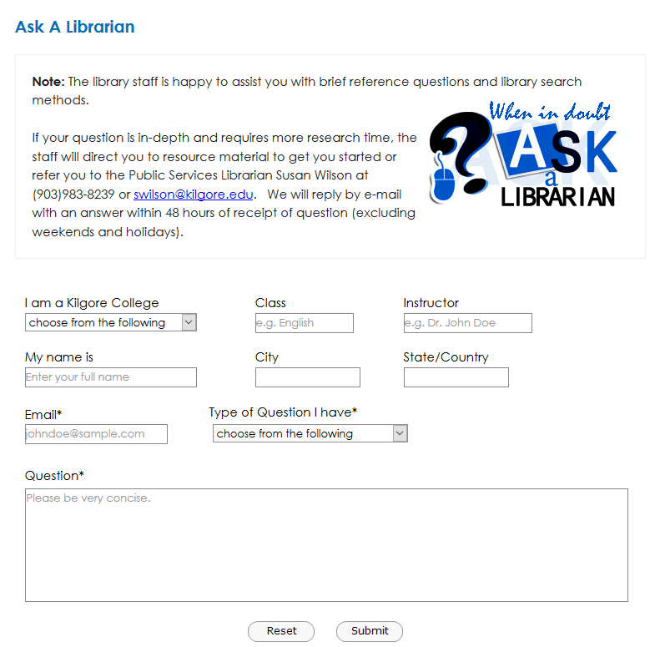
Complete the form and submit
Always make sure your email address is correct so you will get your answer

Slide 50
Ask-A-Librarian
If it is a night, weekend, or holiday, you will have to wait until the next working day to get your answer.
We won’t do the work for you, but we can point you in the right direction:
  Suggest databases to use
  Suggest how you might rephrase the search terms to get better results

Slide 51

Good Luck!

