Slide 1


Randolph C. Watson Library
Kilgore College
Literature Research
Poetry
Short Stories
Drama
Novels

Slide 2
This tutorial will show you how to find information for researching literary works for English classes.
Let’s begin on the library home page.

Slide 3
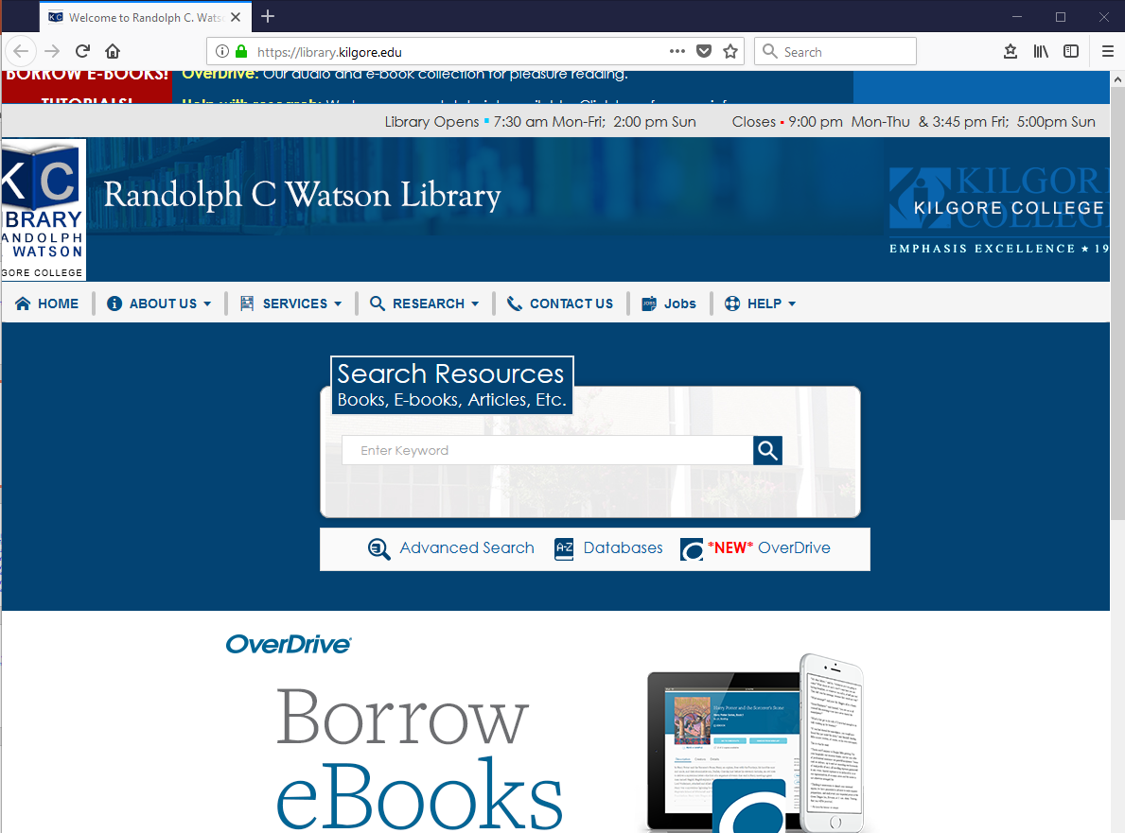
https://library.kilgore.edu

Slide 4
Accessing from Off Campus
If you are accessing the library ebooks or databases from off campus, a screen will appear asking for your username and password.
Your username is made up of the first four letters of your last name, the first four letters of your first name, and the last four digits of your KC ID.
Your password is the word Student with a capital S and your 4-digit month and date of birth.

Slide 5
Example
If your name is Kitty Sitter, your KC ID is 123456789, and you were born on May 9th, then
Username: sittkitt6789
Password: Student0509
Capitalize the S
Your four-digit month and day of birth

Slide 6
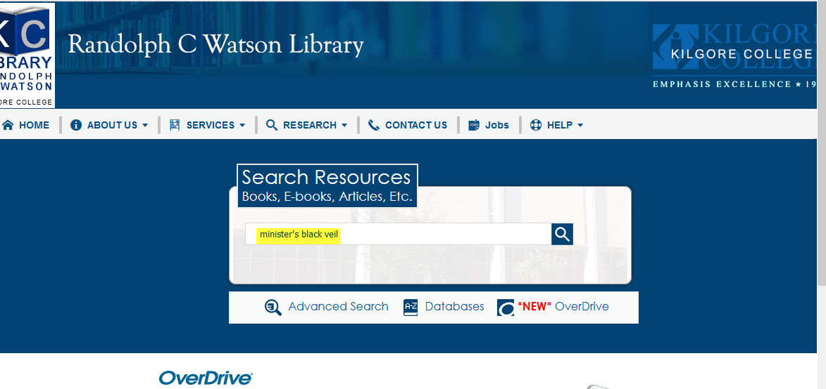
Let’s start with books and ebooks. Enter your search terms and Enter.
Enter search terms here.

Slide 7
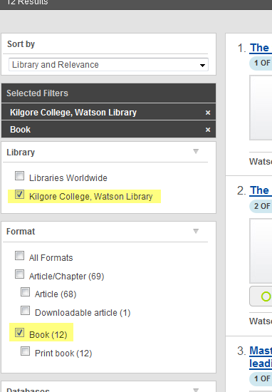
Click on Kilgore College and Books to search for books and ebooks.
Click here
Click here

Slide 8
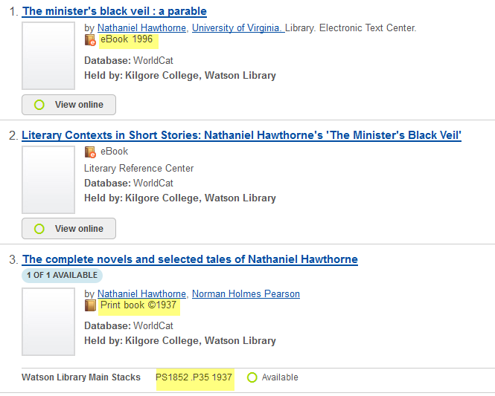
Books and eBooks
This is an eBook. Read it from your screen.
This is a print book. You can check it out at the Circulation Desk.
The call number tells you where to find the book on the shelf.

Slide 9
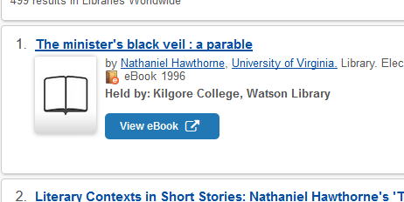
Click View eBook to go to the eBook.
Click here.

Slide 10
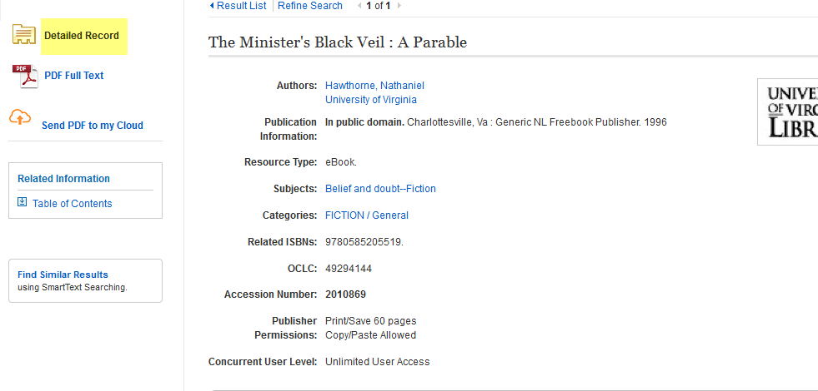
You will need the Detailed Record to create your citation.
This information will be used
to create your citation.

Slide 11
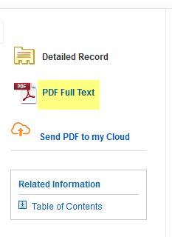
Click on Full Text to open the eBook.
Click here

Slide 12
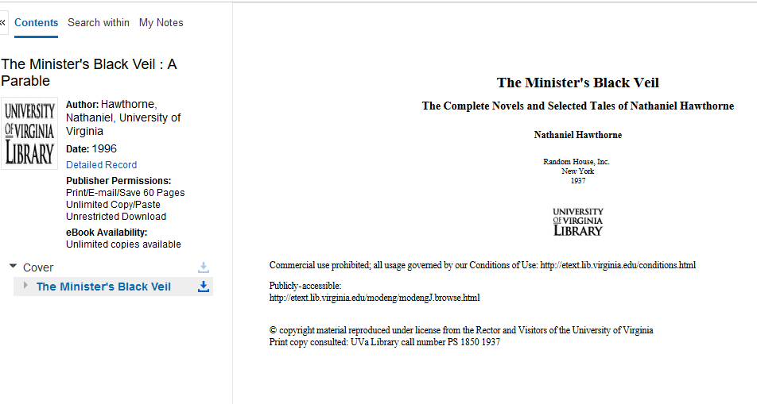
Either the cover or the title page will appear.
Title page

Slide 13
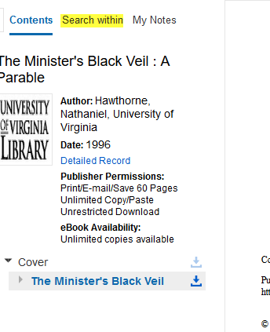
Click Search within
Click here

Slide 14
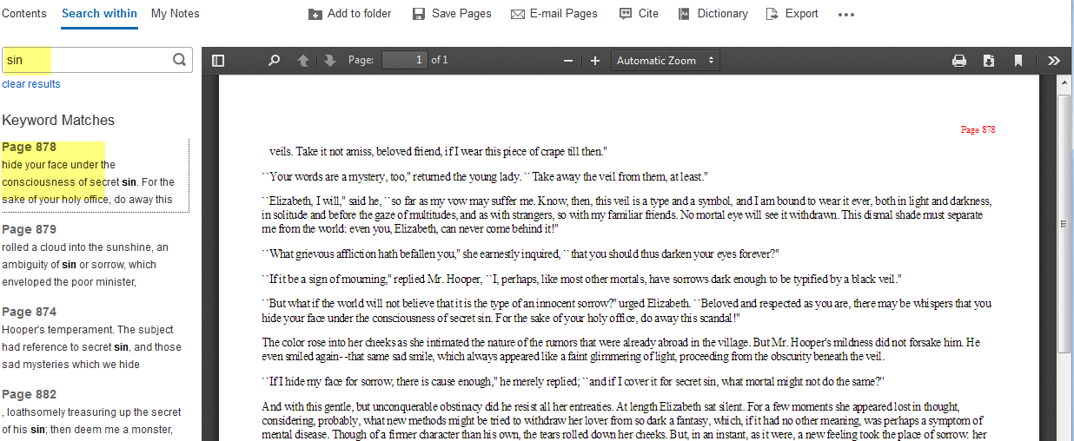
Enter your search terms and Enter. Click on the page number to go to that page.
Page 878
Page 878

Slide 15
Be sure you get the Detailed Record to create your citation.
Anytime you use someone else’s words or ideas, you must give them credit.
For this reason, you will need to provide citations.
Failure to provide proper citations results in plagiarism.
Plagiarism = Failing grade.

Slide 16
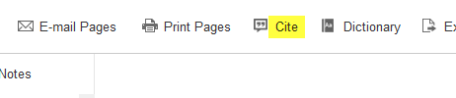
Or, click on the cite icon at the top of the page.
Click here

Slide 17
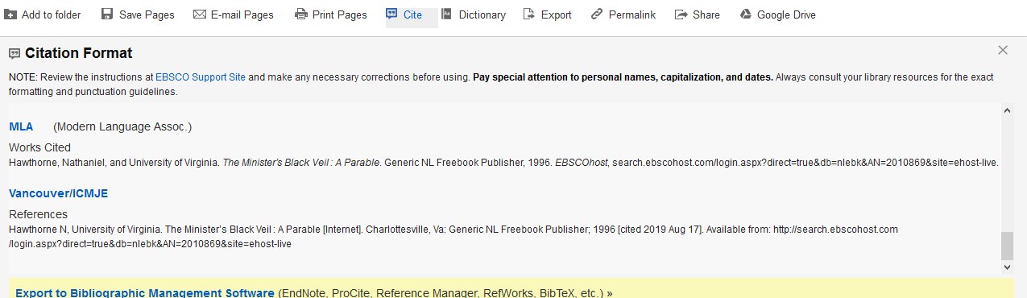
Use the format required by your instructor. Check against The Little Seagull Handbook.
Check the formatting against The Little Seagull Handbook to make sure everything is in the right place.

Slide 18
Using databases
The database you use will depend on your research topic.
Some databases are subject specific.
Recommended databases for English:
  Literary Reference Center
  Bloom’s Literature
  Jstor
  Academic Search Complete

Slide 19
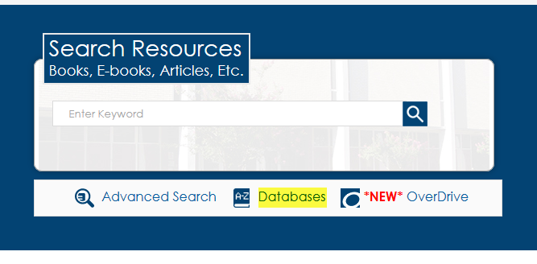
Click Databases
Click here

Slide 20
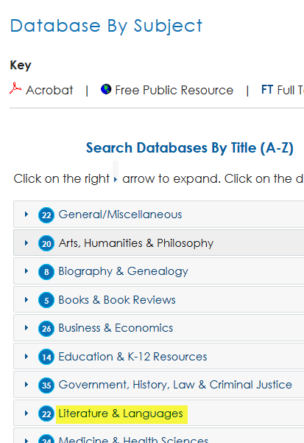
Click on Literature & Languages
Click here

Slide 21
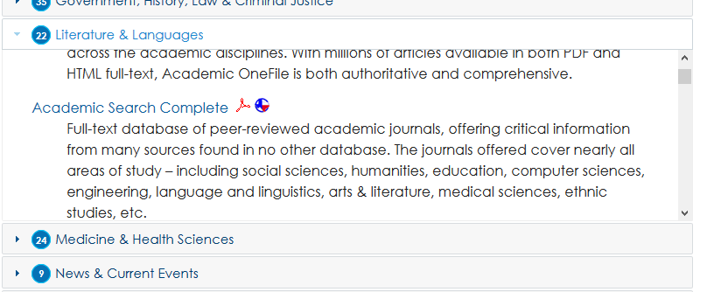
Move the shaded box to scroll through the database titles.
Scroll here.

Slide 22
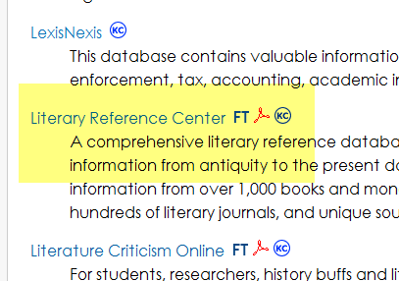
Click on Literary Reference Center
Click here

Slide 23
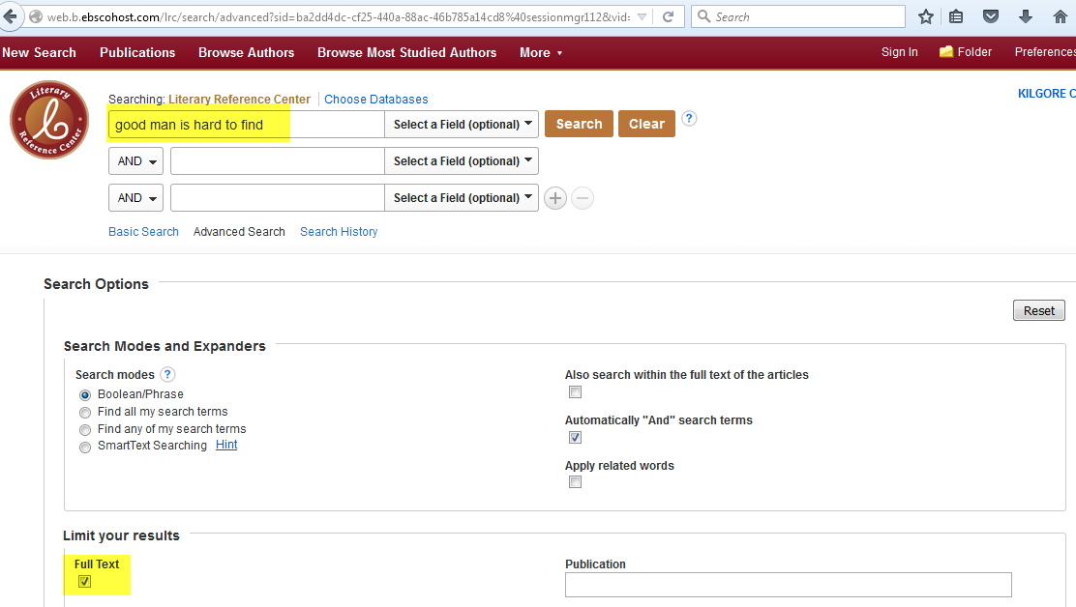
Enter the title of your literary work in the search box. Be sure to click the box for Full Text. Click Search or hit Enter.
Enter title
Click here

Slide 24
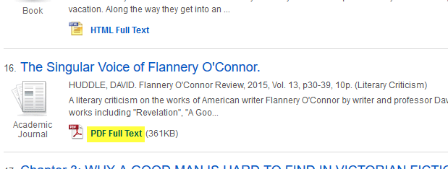
From the results, click on Full Text to view an article.
Click here

Slide 25
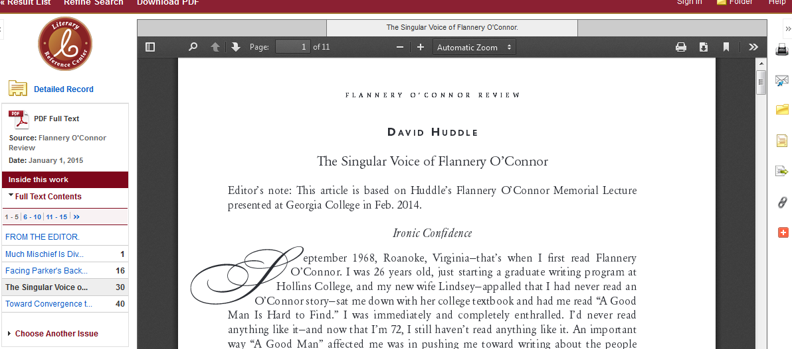
Read. If you want to use the article, you may print it out or email it to yourself.

Slide 26
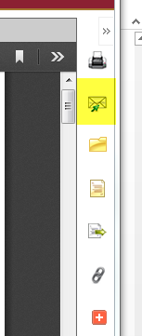
Click on the email icon.
Click here

Slide 27
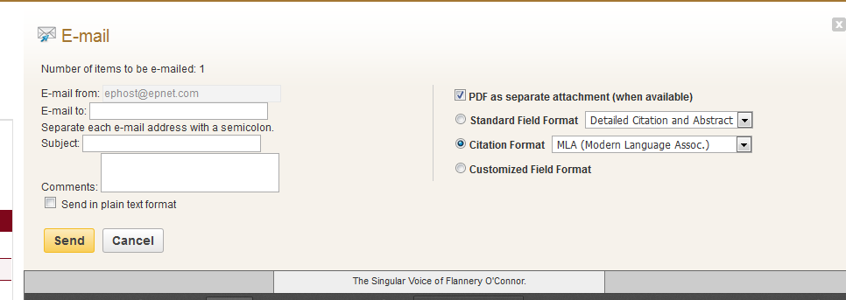
Enter your information and click Send.
Enter your email address here.
Select the citation format.
Enter info here
Click to send

Slide 28
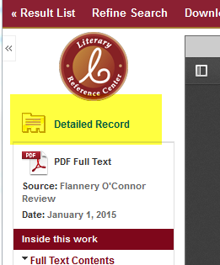
The citation information is found in the Detailed Record. Remember to get a copy!
Click here

Slide 29
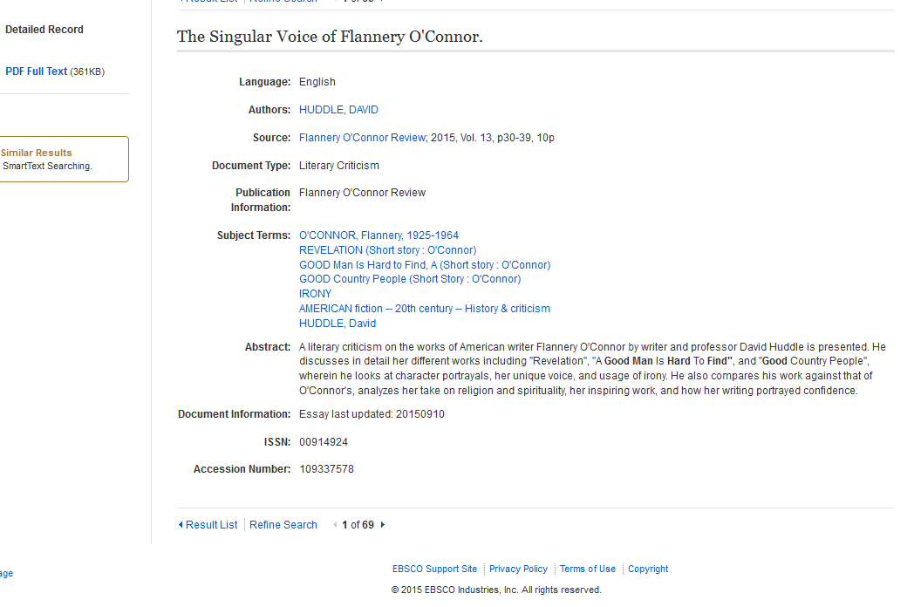
Detailed Record
Use this information to create your citation.

Slide 30

Most databases provide a citation.
Click on the citation icon or link.
Click here.

Slide 31
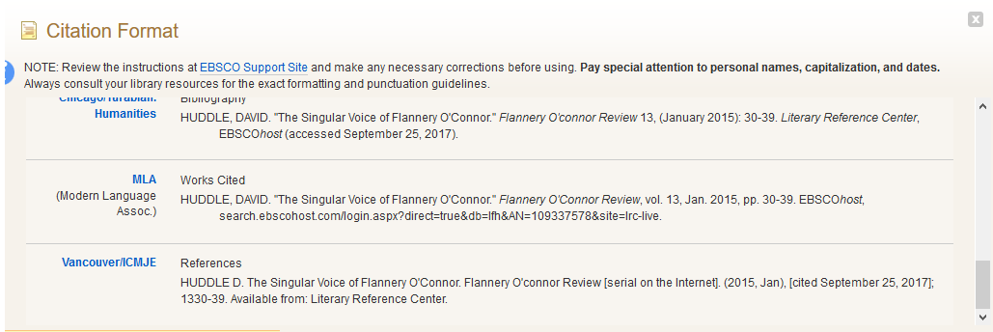
Scroll to find the correct format.

Slide 32
Check the citation against
The Little Seagull Handbook.
If it does not match the format in the Handbook, you will need to make corrections.
Failure to make corrections could result in a lower grade.

Slide 33
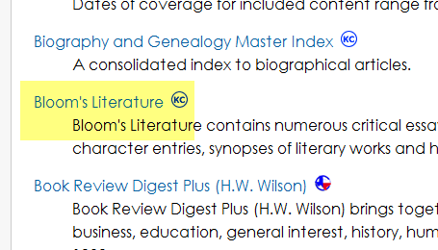
Bloom’s Literature
Click here

Slide 34
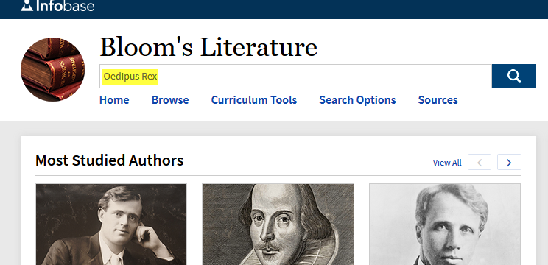
Enter the title of your literary work and hit Enter.
Enter title of your literary work here.

Slide 35
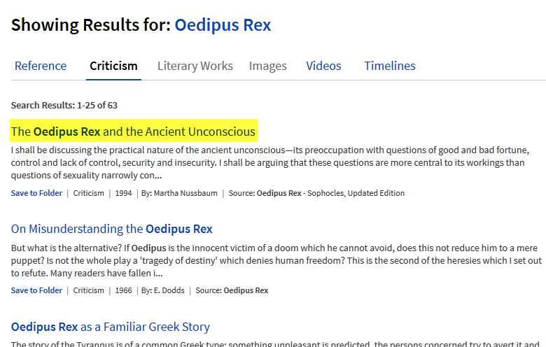
You can narrow your results by clicking on one of the tabs. Click on a title to read.
Click a tab to narrow your results.
Click title to open article.

Slide 36
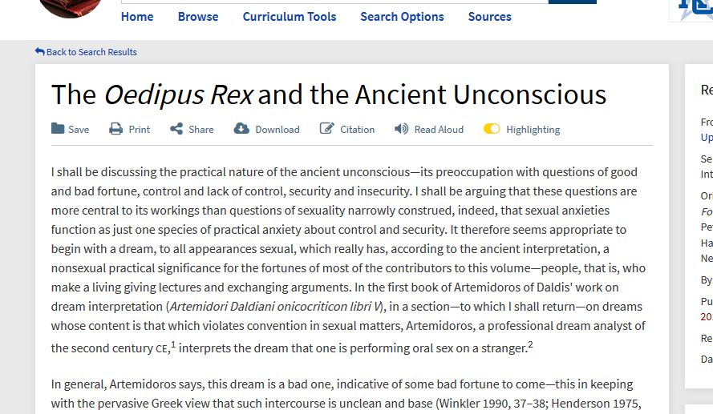
Read the article.

Slide 37
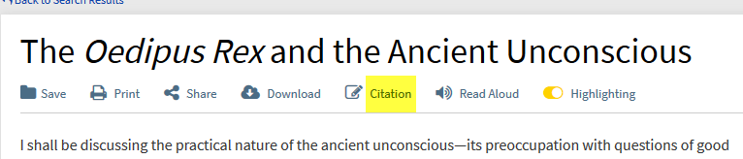
Click on Citation at the top of the article.
Click here

Slide 38
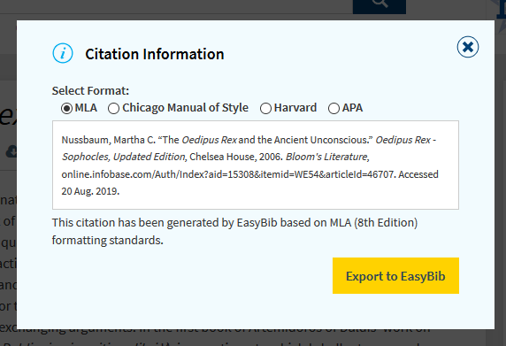
Compare citation with The Little Seagull Handbook and make changes.

Slide 39
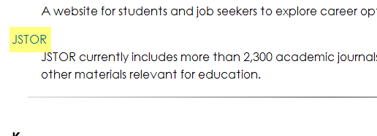
JStor
Click here

Slide 40
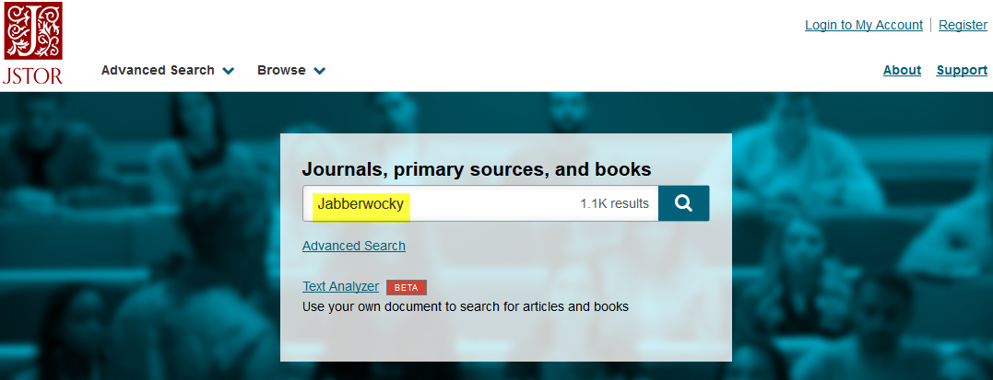
Enter the title of the literary work and hit Enter.

Slide 41
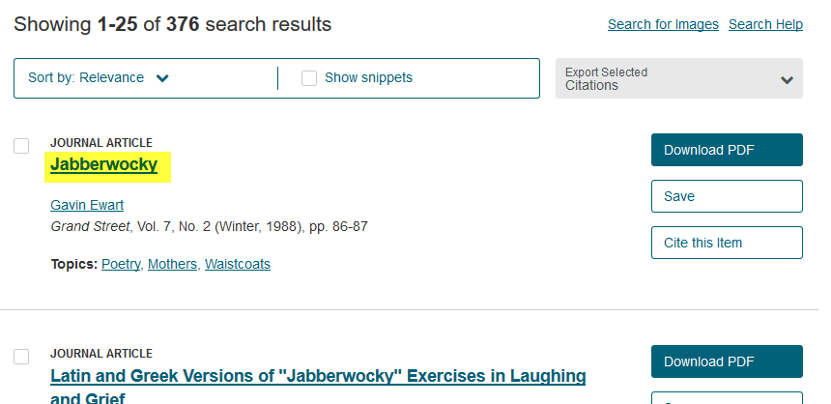
Click the title or “Download PDF” to view the article.
Click here
Click here to download.

Slide 42
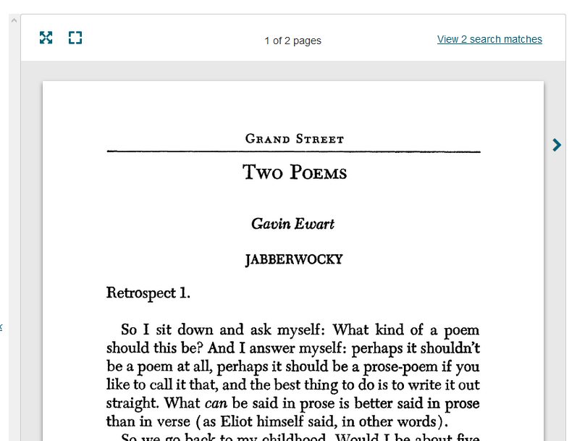
Read.

Slide 43
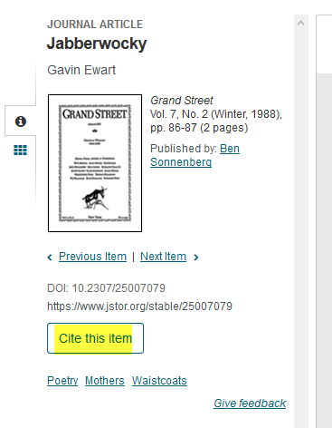
Click “Cite this item” on the left of the article.
Click here

Slide 44
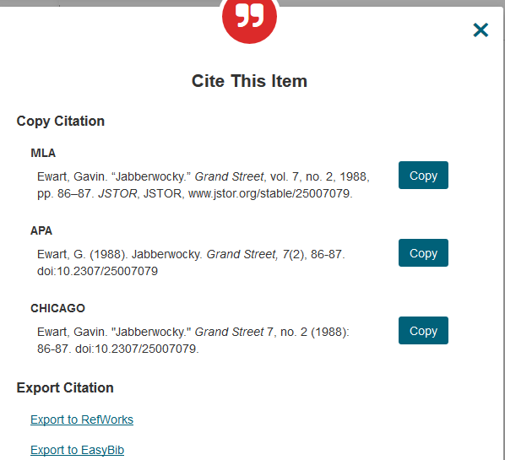
Choose the correct format. Make any changes to match The Little Seagull Handbook.

Slide 45
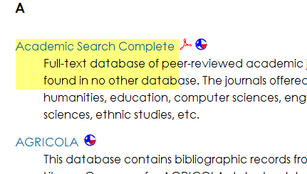
Academic Search Complete
Click here

Slide 46
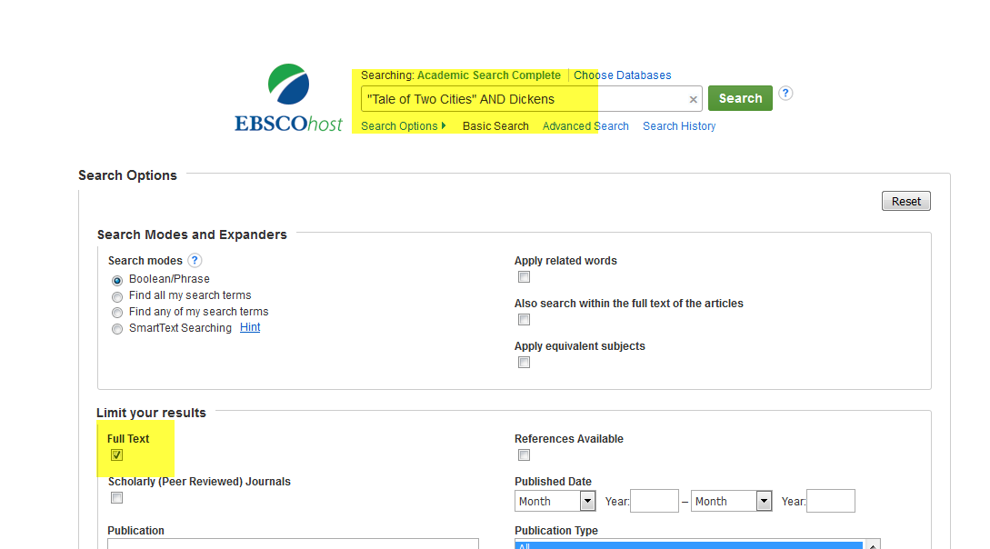
Enter the search terms and click on Full Text. Click Search or hit Enter.
Enter search terms here
Click this box

Slide 47
Notes on searching
Putting the title in quotation marks tells the database you want to see the words together as a phrase.
AND is a limiter. It tells the database you want to have the words or phrase before the limiter, as well as the words after it, in the article.
Clicking on Full Text tells the database you want to see the full text of the article; not just an abstract or a bibliography.

Slide 48
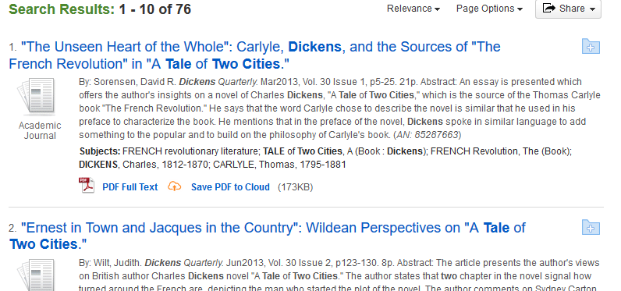
Click on Full Text to view the article.
Click here

Slide 49
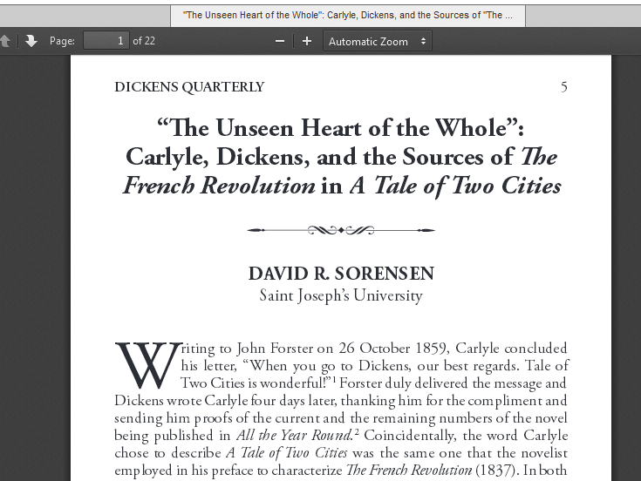
Read the article.

Slide 50
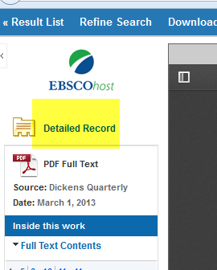
Citation information is under
Detailed Record.
Click here

Slide 51
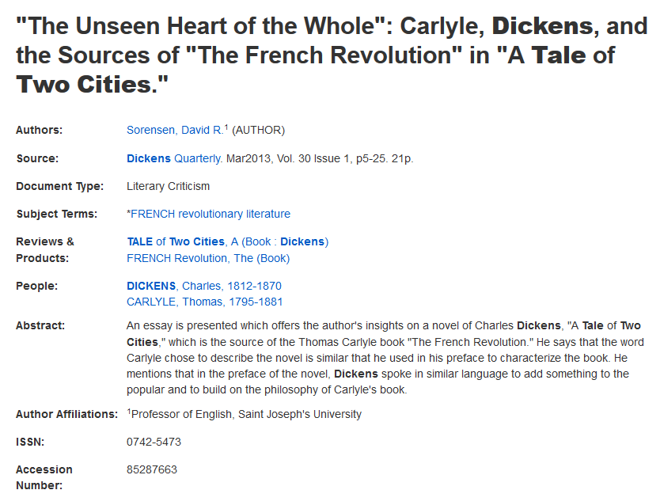
Detailed Record

Slide 52
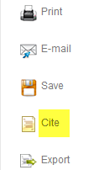
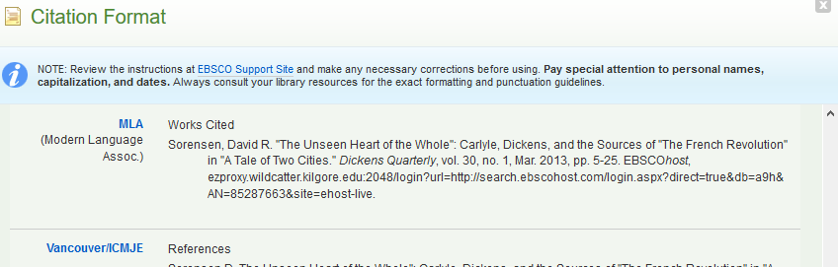
Or, use the Cite feature on the right side of the page. Select the correct format.
Select the correct format.
Click here

Slide 53
Creating citations
Use The Little Seagull Handbook.
Use the tab for MLA.
Ask your instructor if you have any questions.
Always get the citation information when you first find the article! If you don’t, you may not be able to find it, later!

Slide 54
A few hints…
If the title of your poem, short story, drama or novel begins with A, An, or The, do not use it in your search. Instead, use the next word in the title.
If your title contains the word NOT:
  NOT is a limiter. It tells the database you want everything before NOT, but nothing after NOT.
  Leave out NOT or put the title in quotation marks.
    For instance, if you are researching “The Road Not Taken,” enter your search as “Road Taken” or “Road Not Taken”

Slide 55
Ask-A-Librarian
This is an email reference service.
If you have a question, but can’t access a librarian for help, use this while you have the question on your mind.
We will not do the work for you, but we can point you in the right direction.
Ask-A-Librarian is not available during Minimester.

Slide 56
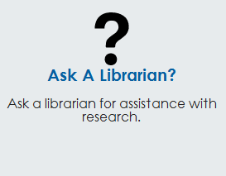
Click on Ask-A-Librarian from the Library Home Page.
Click here

Slide 57
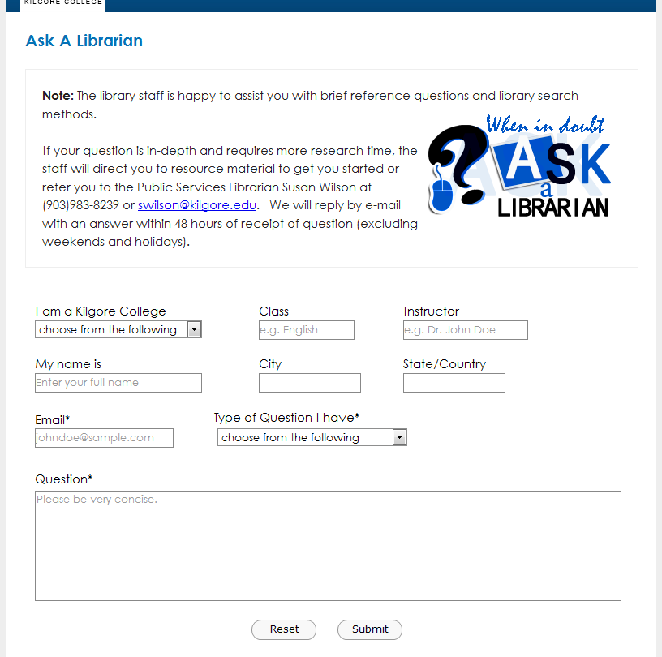
Enter your information and question. Submit.
Click here to submit question.

Slide 58
We will get back to you as quickly as possible. However, if it is an evening, weekend, or holiday, you will have to wait until the next working day.
This service is unavailable during minimester.

Slide 59

Good Luck!

