Slide 1

Using the Kilgore College Library Online Resources
Music

Slide 2
Library Access 24/7
Did you know that you can do research without actually coming to the KC Library on campus?
You have access to our databases and ebooks:
As long as you are currently enrolled at KC
As long as you have Internet access

Slide 3
Randolph C. Watson Library Homepage
https://library.kilgore.edu

Slide 4
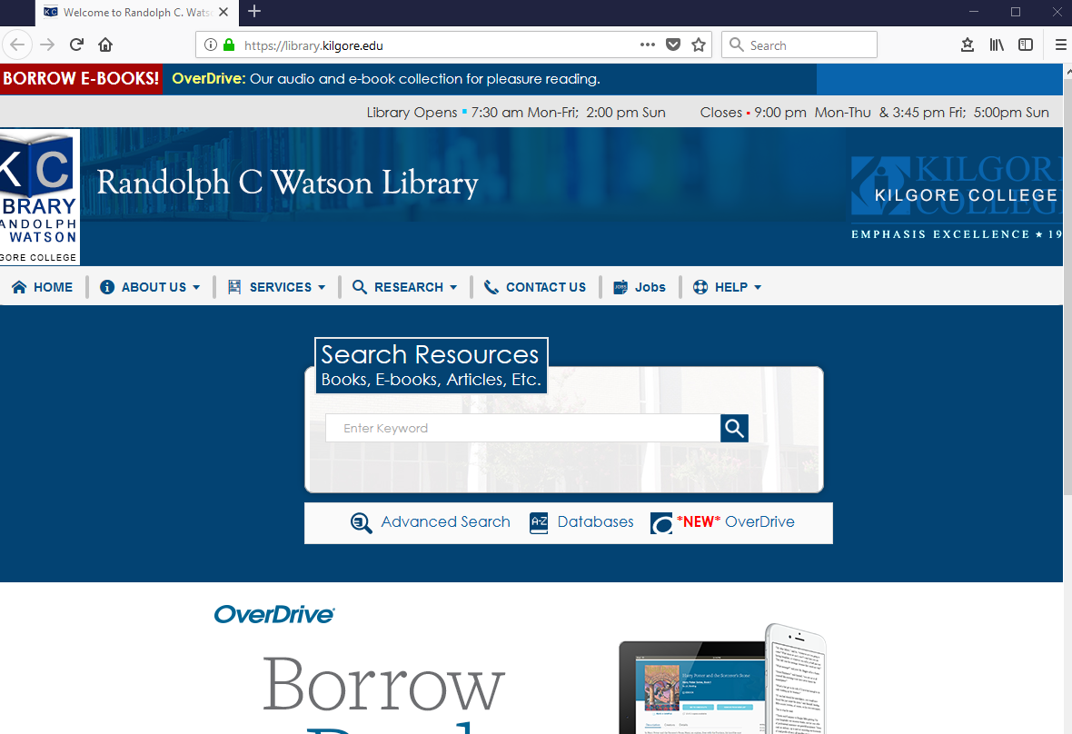
Randolph C. Watson Library Homepage

Slide 5
Logging in from Off-Campus
When logging in from off-campus, you will need a username and password.
Username: 1st four letters of your last name, 1st four letters of your first name, last four digits of your KC ID.
Password: Student and your 4-digit month and day of birth.

Slide 6
Off-Campus Log In
So, if your name is Redding Beethoven, your KC ID is 123456789, and you were born on August 12th, your login will be:
Username: beetredd6789
Password: Student0812
Capitalize the S
Your four-digit month and day of birth

Slide 7
Finding Resources
Books
Ebooks

Slide 8
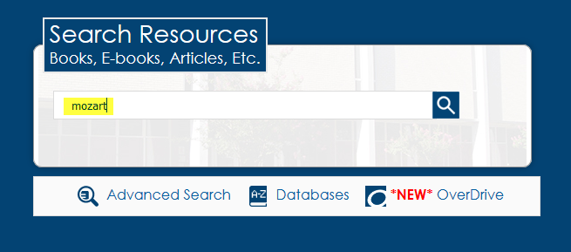
Enter search terms in the Search Resources box. Click Search.
Enter search terms here.

Slide 9
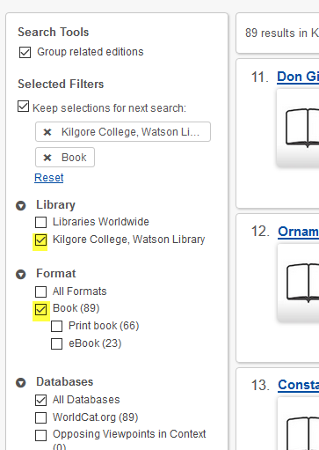
Click on Kilgore College and Book to narrow the search.
Click here
Click here

Slide 10
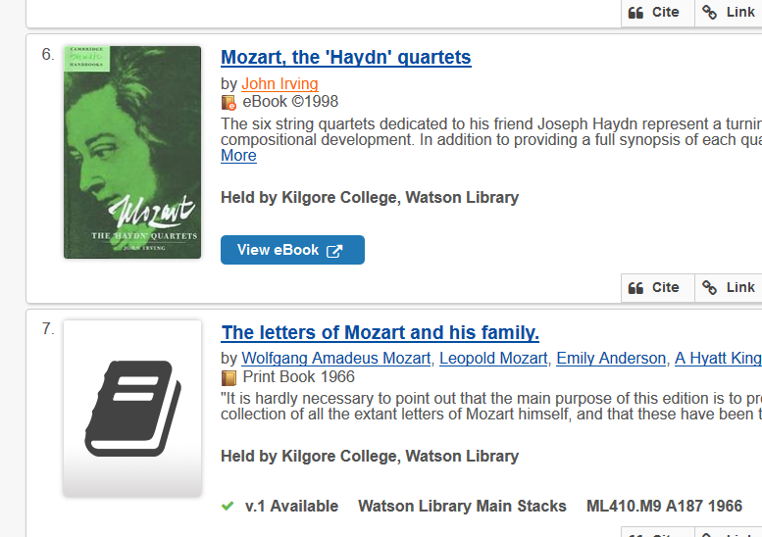
Books and eBooks
eBook
Call number tells you were to find the book on the shelf
Print book

Slide 11
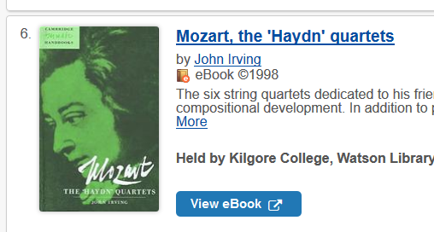
Click View eBook to read.
Click here

Slide 12
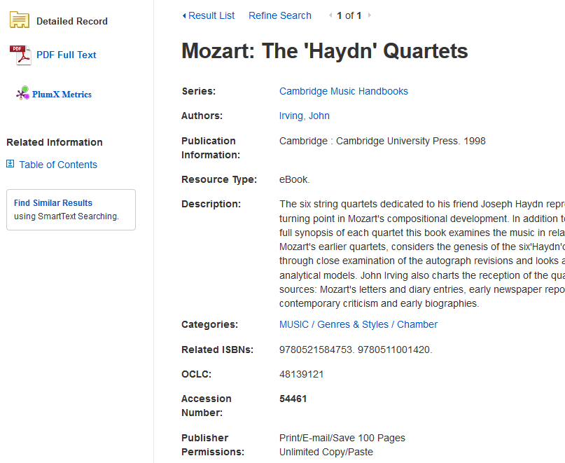
The Detailed Record can be used to create citations.
Use this info for citations.

Slide 13
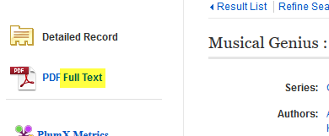
Click on Full Text to open the book.
Click here

Slide 14
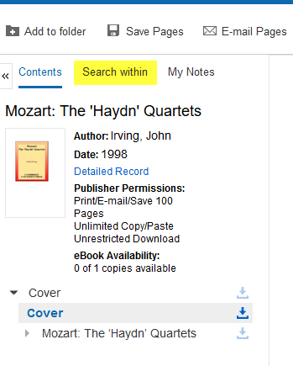
Click Search within to open the search.
Click here

Slide 15
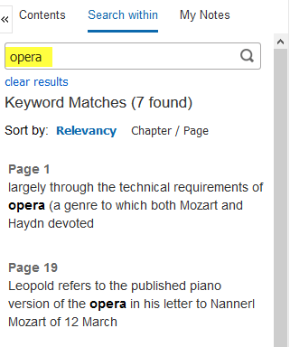
Enter search terms
Enter search terms here

Slide 16
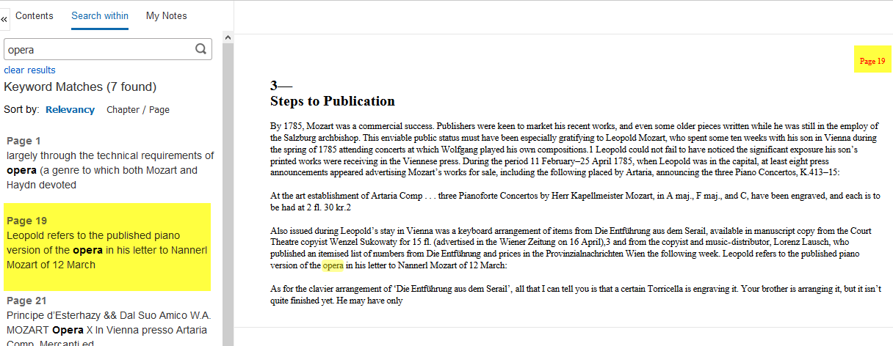
Click on a page number to go to that page. Read.
Page number matches the one you clicked on the left.
Click here

Slide 17
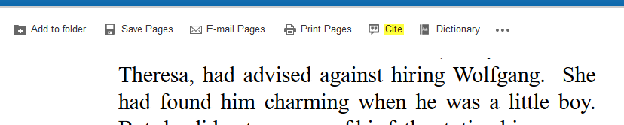
Click Cite to get the citation.
Click here

Slide 18
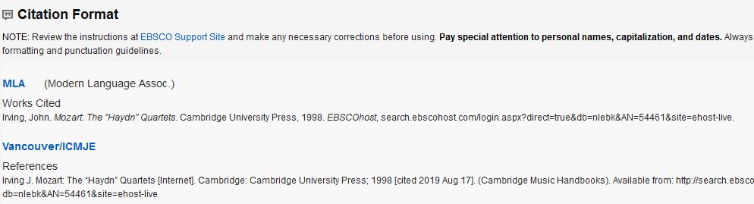
Scroll down to select the format required by your instructor.

Slide 19
Books
If you need something we do not have, you can request it through Interlibrary Loan.
Interlibrary Loan takes time, so don’t wait until the last minute!

Slide 20
Why Use a Database?
Anyone can create an internet site.
  It can be true.
  It can be fake.
  You have to verify internet information.
  Is the author an authority in the field?
  Does the site want to provide information, or sell something?
  When was the page last updated?

Slide 21
Databases
Provide thousands of articles from journals, newspapers, or books.
The information is more accurate.
Many articles are peer-reviewed.
Your instructor may prefer database articles to internet sites.

Slide 22
The Best Databases for Your Research
Oxford Music Online
Fine Arts & Music Collection
JSTOR
Also try:
  Academic Search Complete
  Academic OneFile

Slide 23
Oxford Music Online Contains:
The New Grove Dictionary of Music and Musicians
The New Grove Dictionary of Opera
The New Grove Dictionary of Jazz
The Grove Dictionary of American Music
The Grove Dictionary of Musical Instruments
The Oxford Companion to Music
The Oxford Dictionary of Music

Slide 24
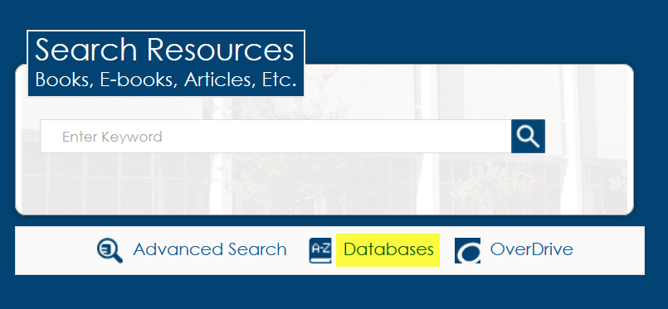
Click on Databases
Click here

Slide 25
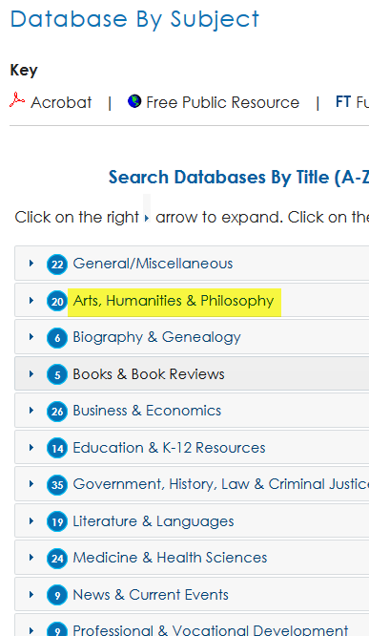
From the Subject list, select Arts, Humanities & Philosophy
Click here

Slide 26
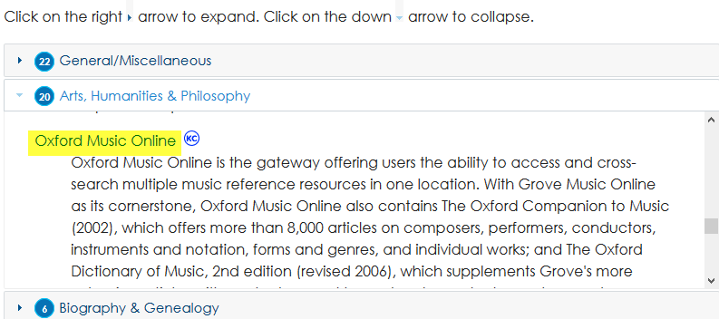
Scroll down and click
Oxford Music Online
Click here

Slide 27
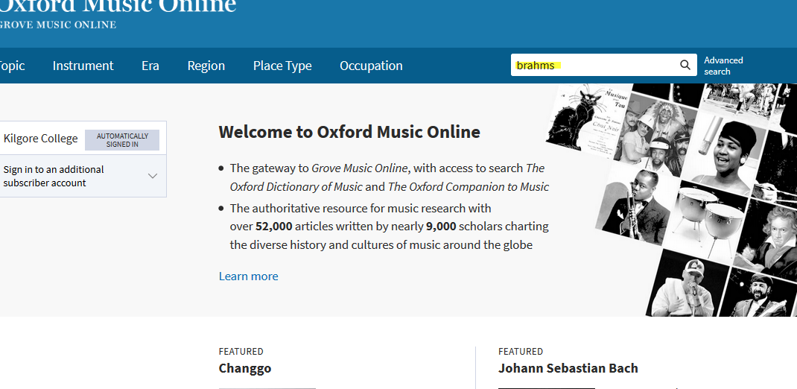
Enter search terms and hit Enter.
Enter search terms here
Click the magnifying glass or hit the Enter key

Slide 28
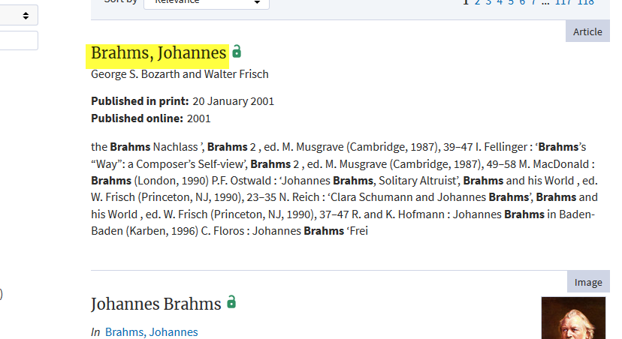
Click on a title to view.
Click here

Slide 29
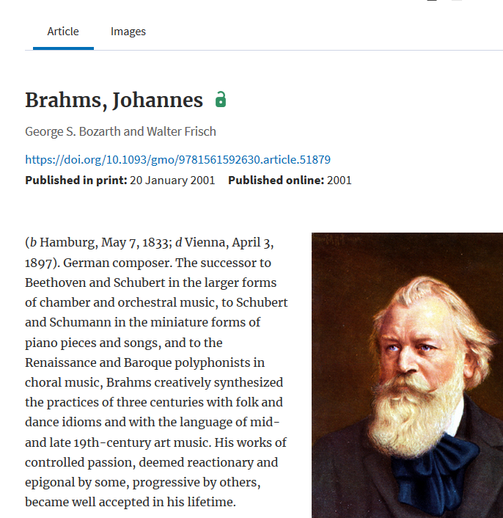
Read the article.

Slide 30
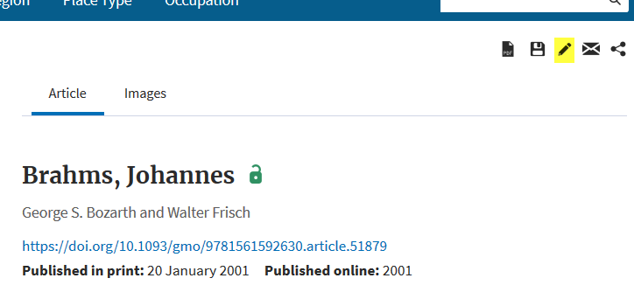
Click pencil icon to get the citation.
Click here

Slide 31
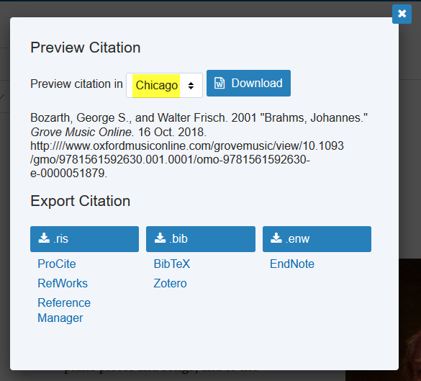
Select the format required by your instructor.
Click the arrows to select the citation format.

Slide 32
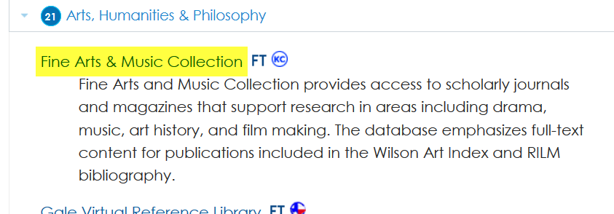
Fine Arts & Music Collection
Click here

Slide 33
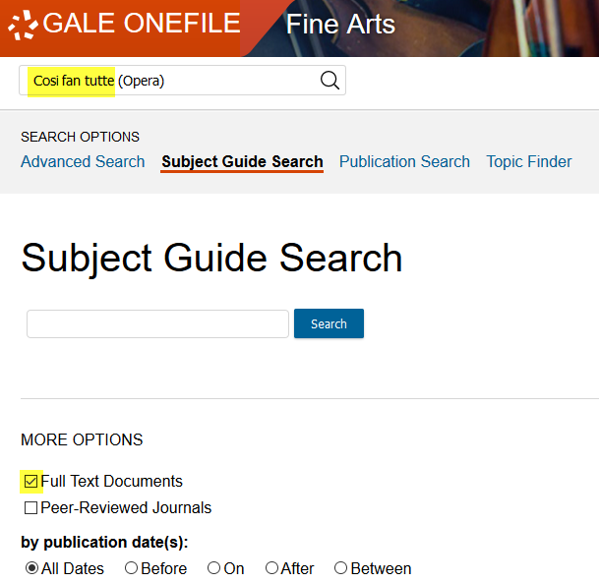
Enter search terms and hit Enter.
Enter search terms here
Click here
Click here is your instructor requires Peer-Reviewed articles

Slide 34
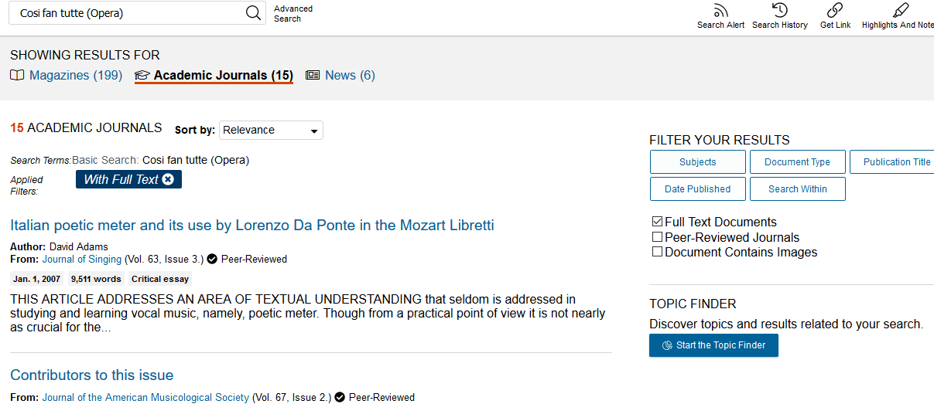
Select Academic Journals.
Click here

Slide 35
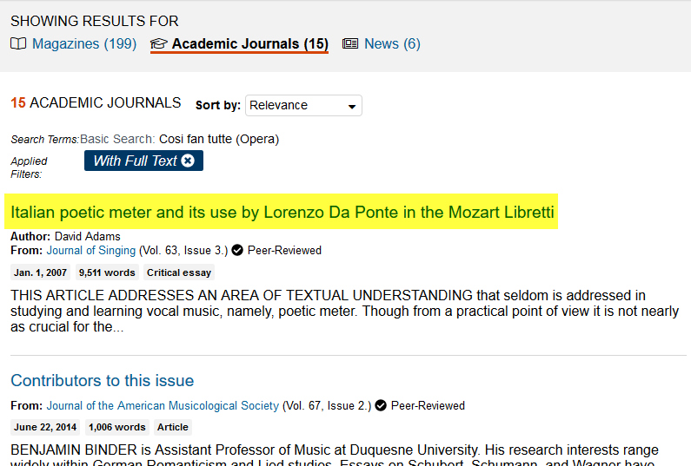
Click on a title to view
Click here

Slide 36
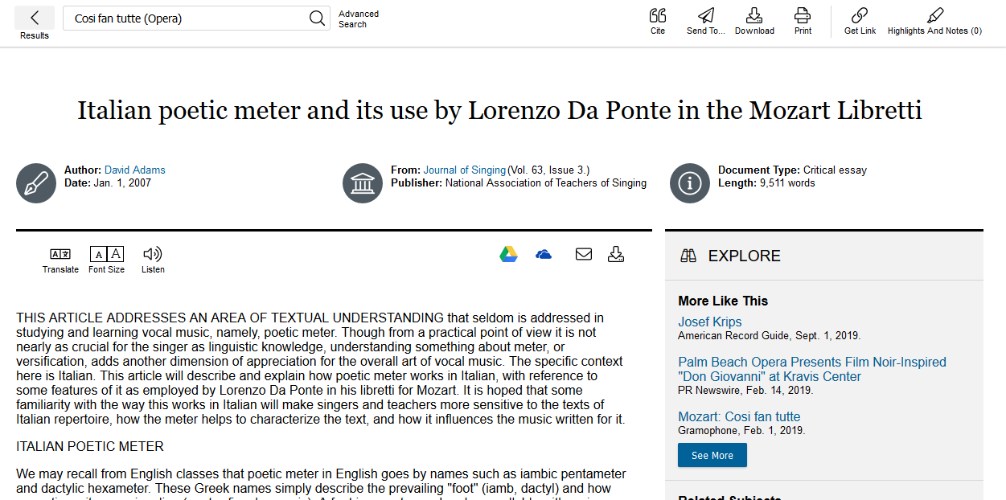
Read

Slide 37
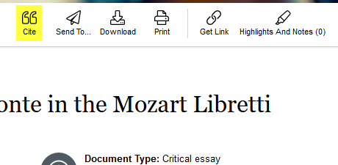
Click the Cite icon at the top of the page
Click here

Slide 38
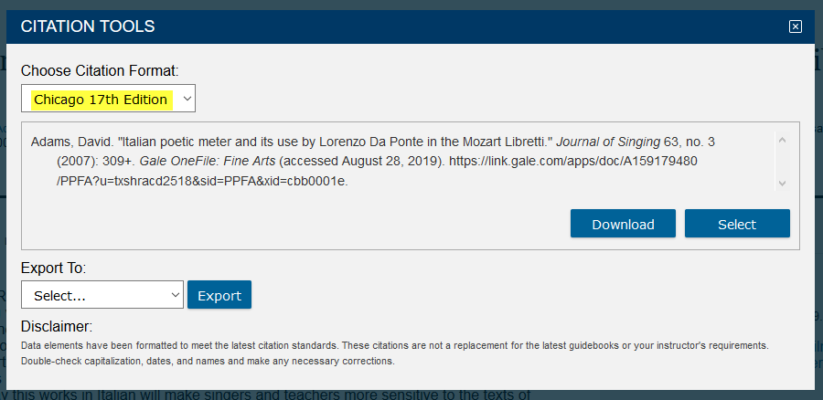
Select the citation format required by your instructor.
Click the arrow to change format

Slide 39
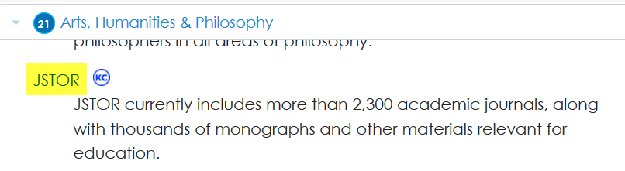
JSTOR
Click here

Slide 40
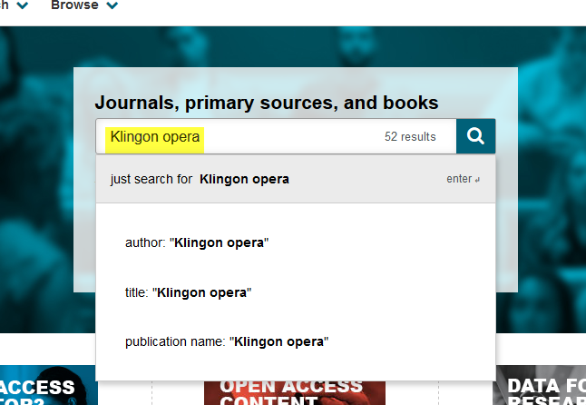
Enter search terms. Hit Enter or click on the magnifying glass.
Enter search terms here.
Click the magnifying glass or hit the Enter key

Slide 41
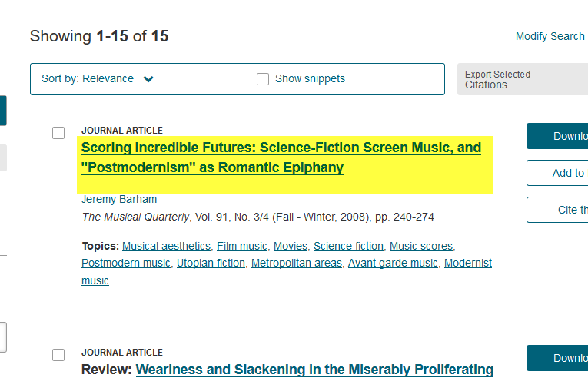
Click on a title to open the article.
Click here

Slide 42
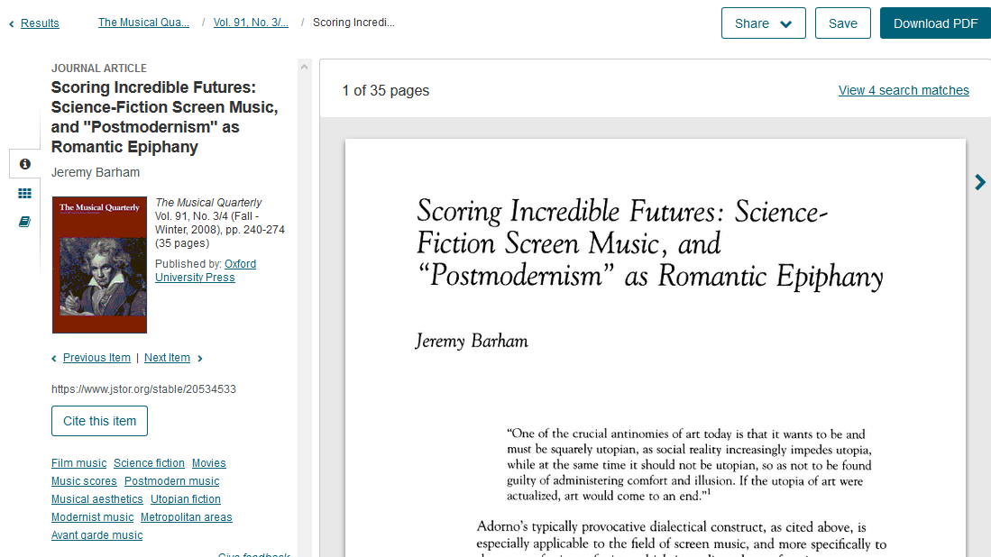
Read.

Slide 43
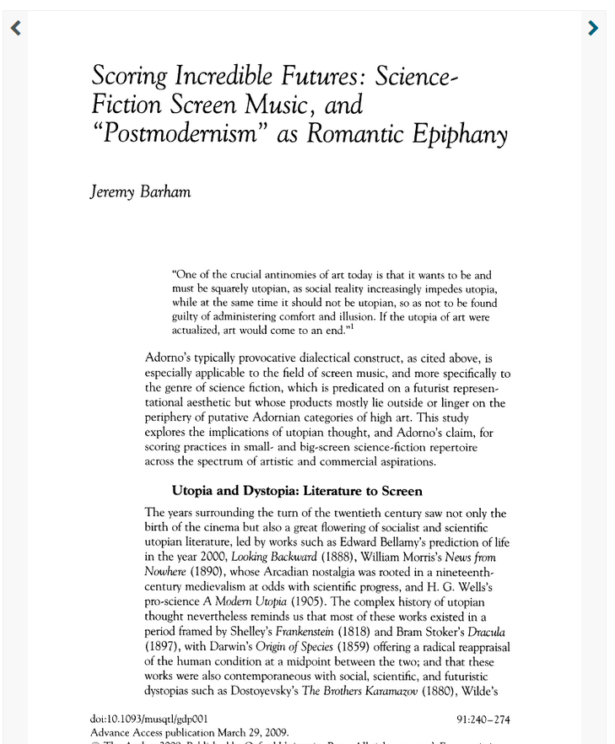
Click on an arrow to change the page.
Click the arrow to see a previous page.
Click the arrow to advance to the next page.

Slide 44
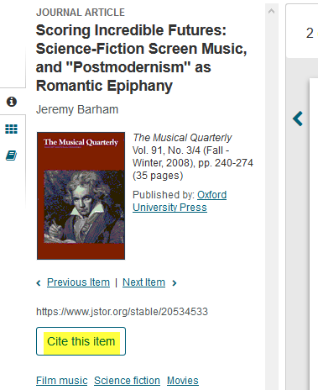
Click Cite this Item to get the citation.
Click here

Slide 45
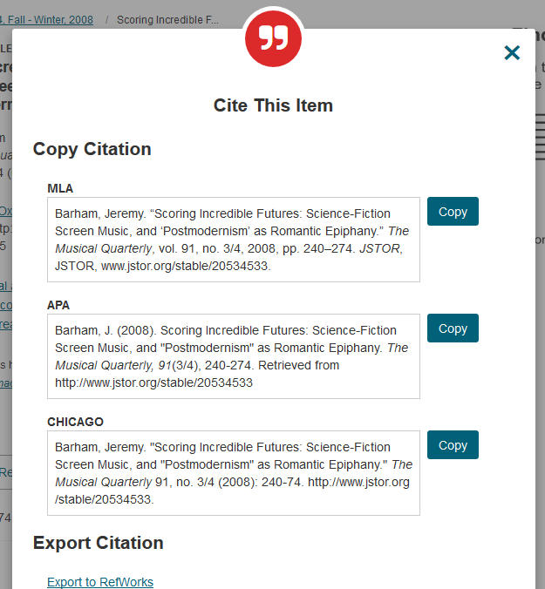
Select the format required by your instructor.

Slide 46
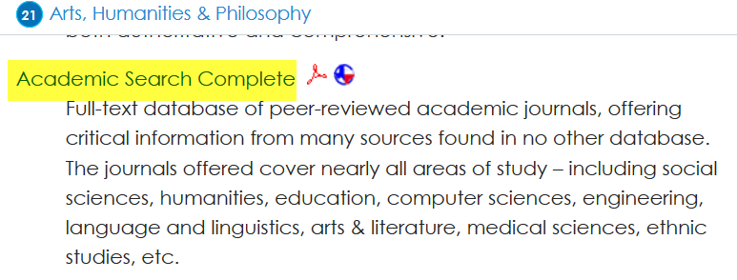
Academic Search Complete
Click here

Slide 47
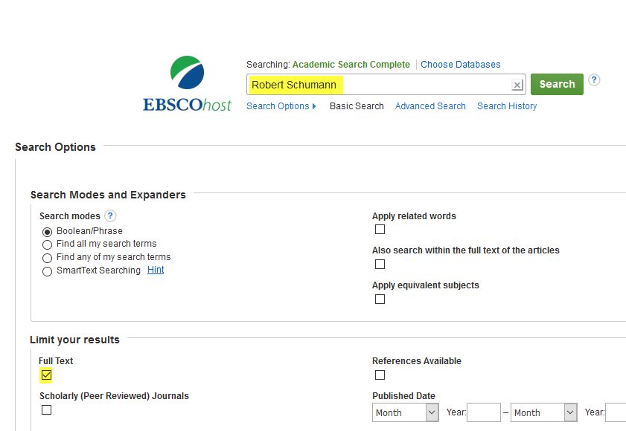
Enter search terms.
Enter search terms here.
Be sure to click here to see complete articles.
Click here if your instructor requires peer-reviewed articles

Slide 48
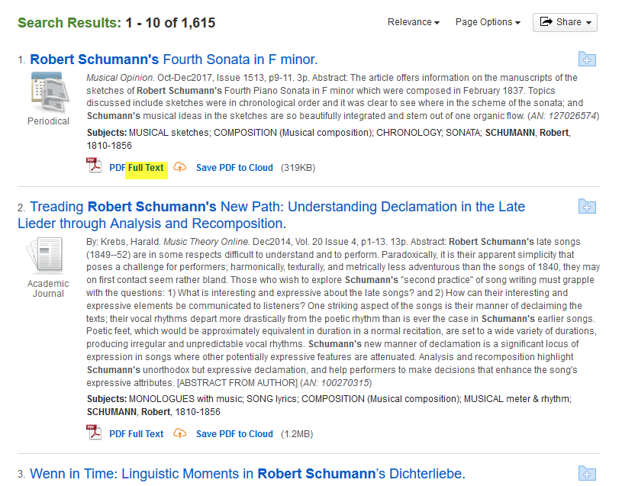
Click on Full Text to select an article.
Click here

Slide 49
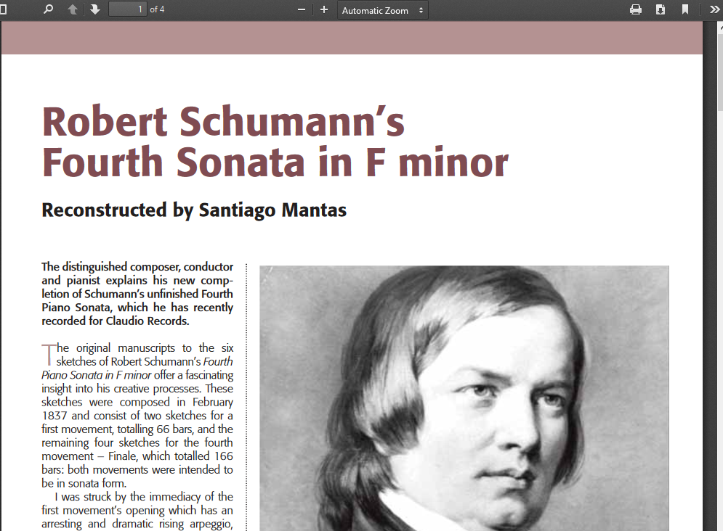
Read.

Slide 50

Click the Cite icon on the right side of the page to see the citations.
Click the icon to see the citation.

Slide 51
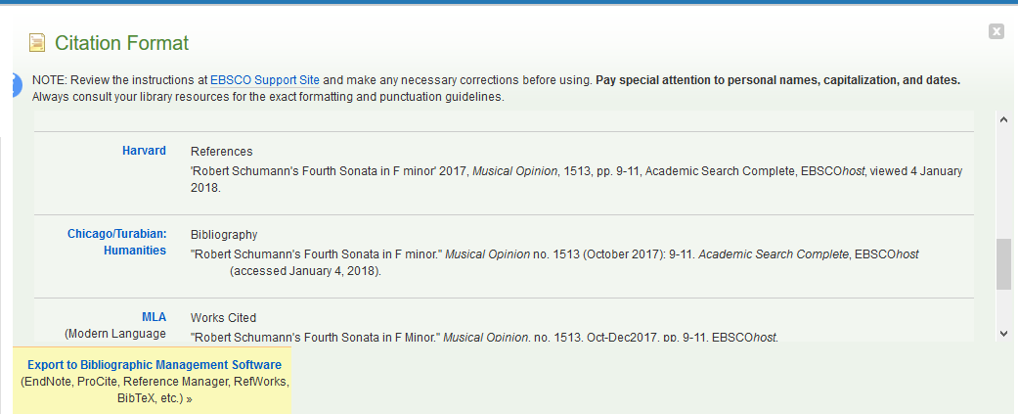
Scroll down to select the required format.

Slide 52
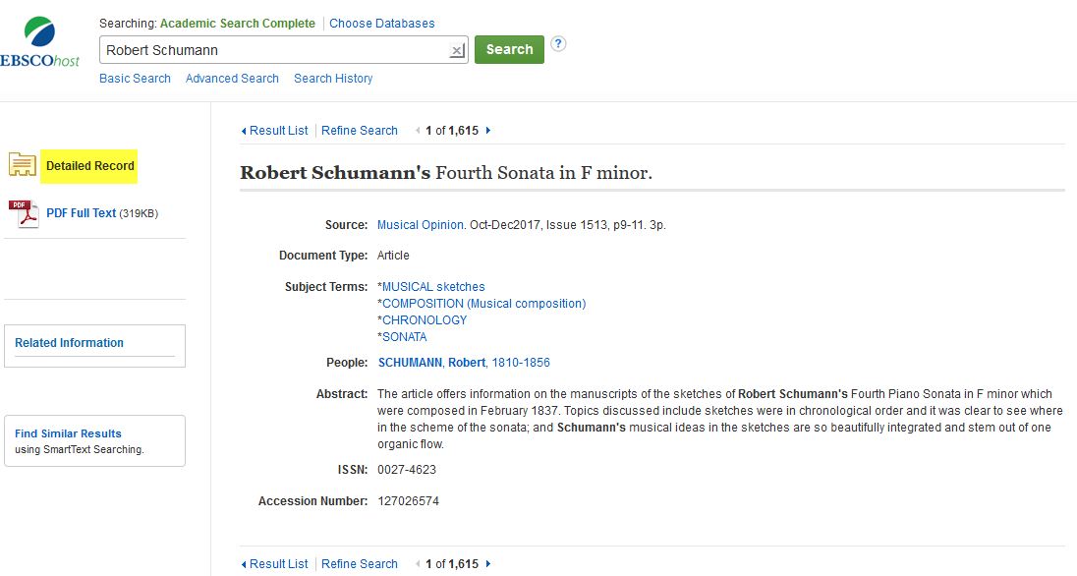
Or use the Detailed Record to create your own citation

Slide 53
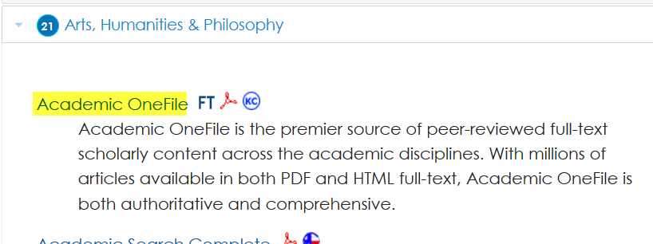
Academic OneFile
Click here

Slide 54
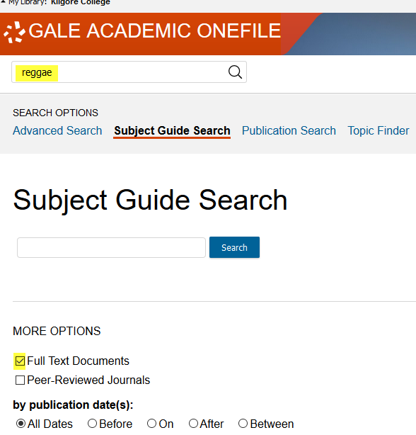
Enter search terms and search
Click here
Click the magnifying glass or hit Enter
Click here

Slide 55
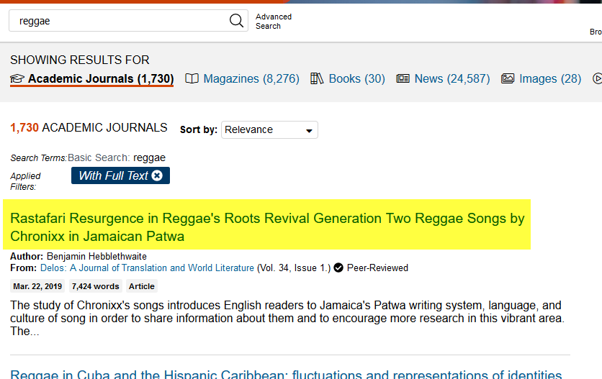
Click on a title to see the article.
Click here to read

Slide 56
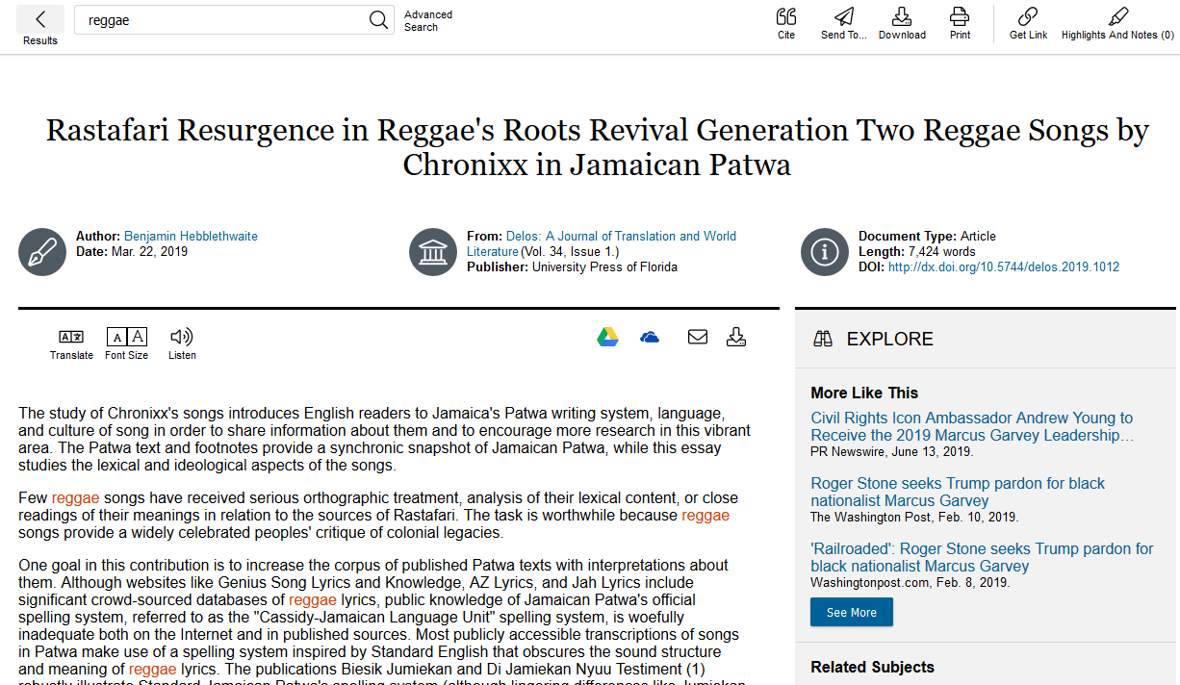
Read.

Slide 57
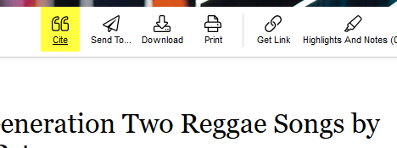
Click the Cite icon at the top of the page
Click here

Slide 58
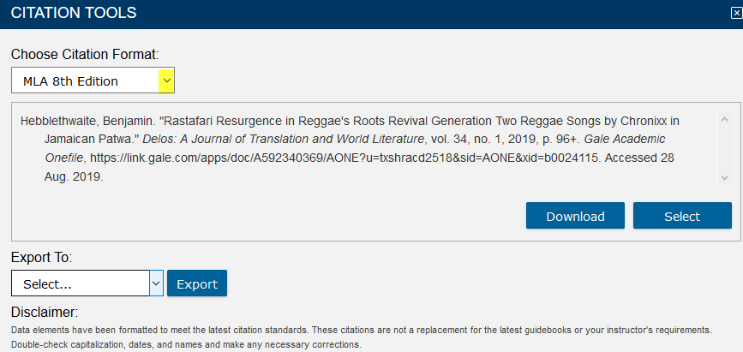
Click the arrow to change format.
Click here

Slide 59
Citations
Each time you use someone else’s words or ideas, you must provide a citation to give credit to that person.
For each citation, you will provide a corresponding bibliography.

Slide 60
If You Need Help with Research
Call the KC Library and speak to a librarian.
Come to the KC Library and speak with a librarian.
Use the Ask-A-Librarian email service from the home page.

Slide 61
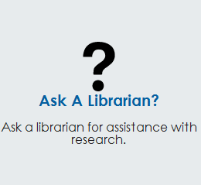
Ask-A-Librarian
Click here

Slide 62
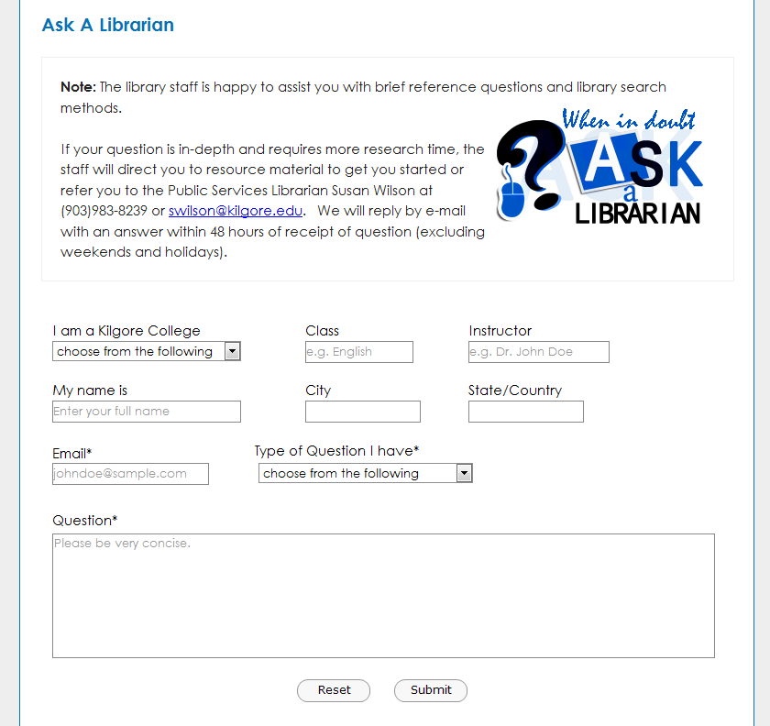
Ask-A-Librarian
Fill in the boxes
Click to Submit

Slide 63
Ask-A-Librarian
We get back to you as quickly as possible.
If it is a night, weekend or holiday, you will have to wait until the next working day.
We won’t do the work for you, but we can point you in the right direction.
  Recommend a database
  Suggest changes in search terms

Slide 64
Quiz
1. Click to see the complete article.
When can I access the library electronic resources?
What is the name of the library’s email reference service?
What citation format does my instructor require me to use?
What is an electronic version of a book called?
From where can I access the library electronic resources?
Give one reason not to rely on an Internet search.

Slide 65

Good Luck!

