Slide 1
Using the Kilgore College Library Online Resources
Psychology
Sociology
Social Work
Substance Abuse Counseling

Slide 2
Library Access 24/7
Did you know that you can do research without actually coming to the KC Library on campus?
You have access to our databases and ebooks:
As long as you are currently enrolled at KC
As long as you have Internet access

Slide 3
Randolph C. Watson Library Homepage
https://library.kilgore.edu

Slide 4
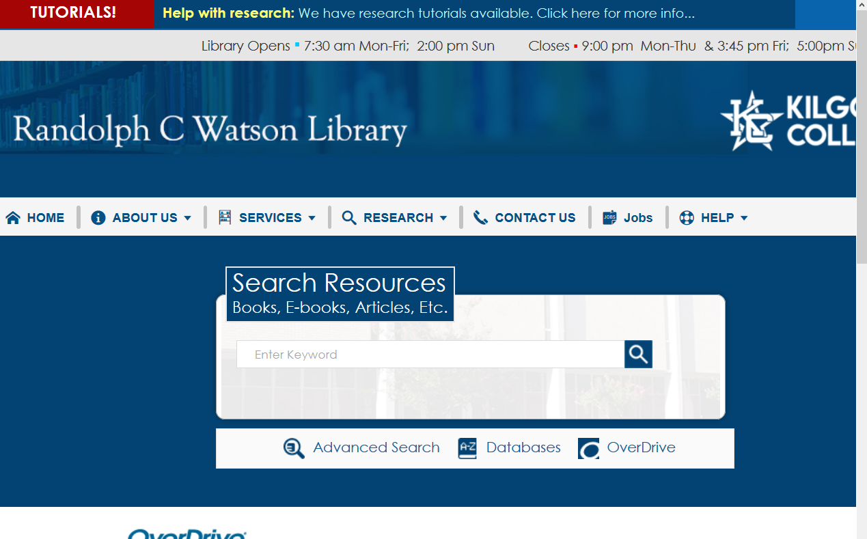
Randolph C. Watson Library Homepage

Slide 5
Logging in from Off-Campus
When logging in from off-campus, you will need a username and password.
Username: 1st four of your last name, 1st four of your first name, last four digits of your KC ID.
Password: The word “Student” with a capital S and your 4-digit month and day of birth.

Slide 6
Off-Campus Log In
So, if your name is Sigmund Freud, your KC ID is 123456789, and you were born April 15,your login will be:
KC ID: freusigm6789
Password: Student0415
Student with a capital S
Your 4-digit month and day of birth

Slide 7
Finding Resources
Books
Ebooks

Slide 8
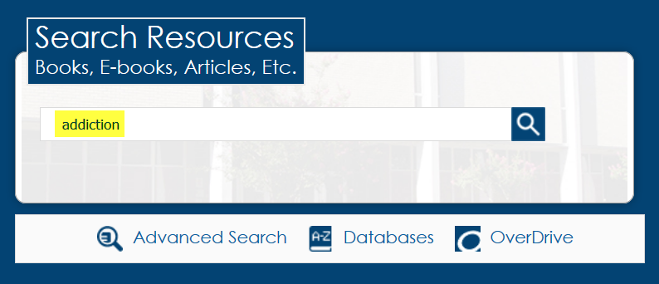
Enter search terms in the Search Resources box. Click Search.
Click the magnifying glass or hit Enter
Enter search terms here

Slide 9
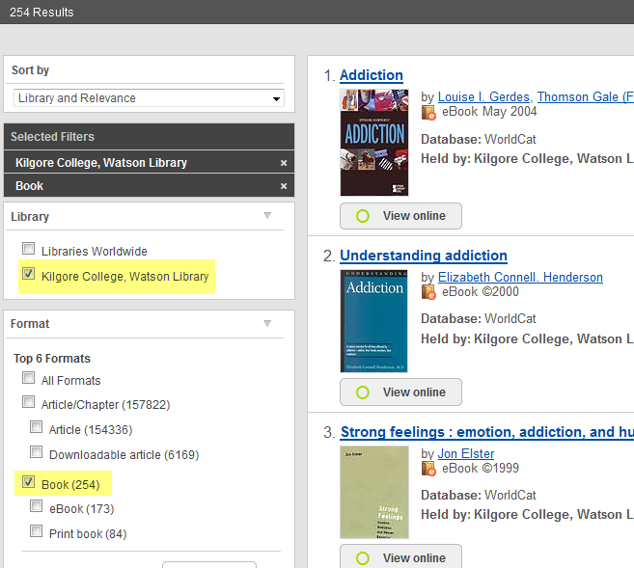
Click on Kilgore College and Book to narrow the search.
Click here
Click here

Slide 10
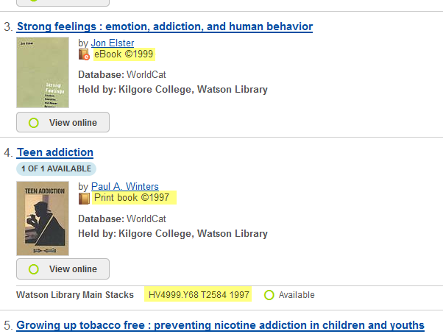
Books and eBooks
This is an eBook. Read it electronically.
This is a print book. Check it out.
Call numbers tell where the book is on the shelf.

Slide 11
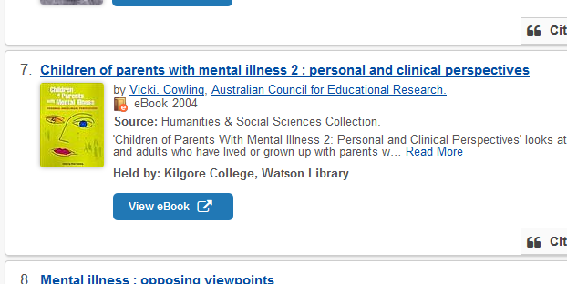
Click View eBook to open the book.
Click here

Slide 12
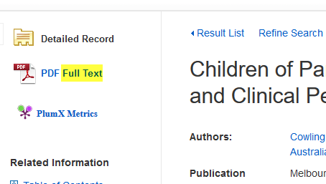
Click on Full Text to open the book.
Click here

Slide 13
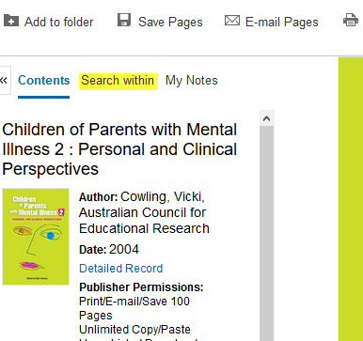
Click Search within to open the search box.
Click here

Slide 14
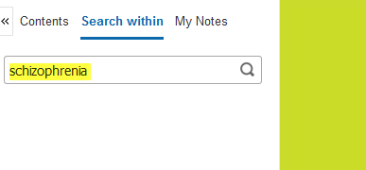
Enter search terms
Enter search terms here

Slide 15
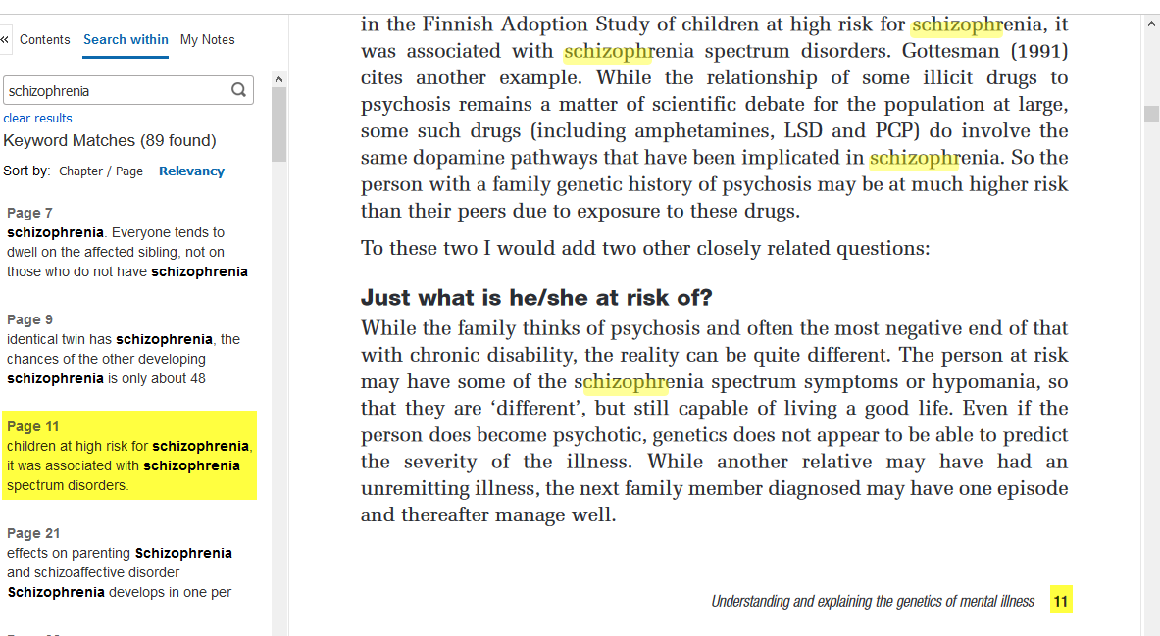
Click on the page number to go to the page.
Page 11
Click here to go to the page
Page 11

Slide 16
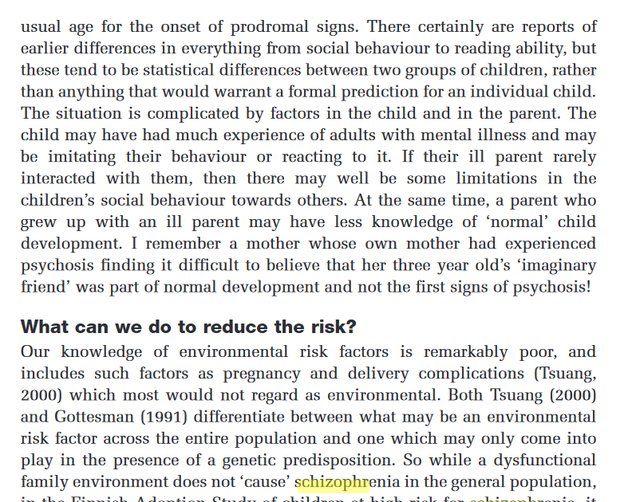
Read

Slide 17
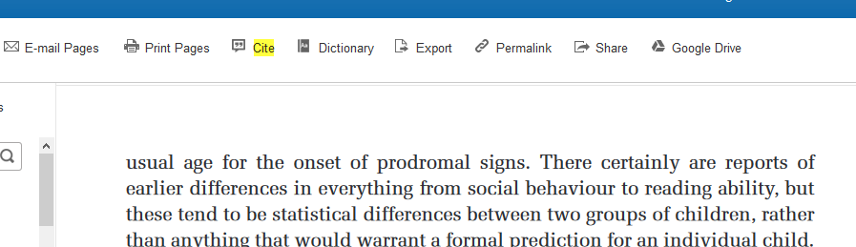
Click Cite to get the citation information.
Click here

Slide 18
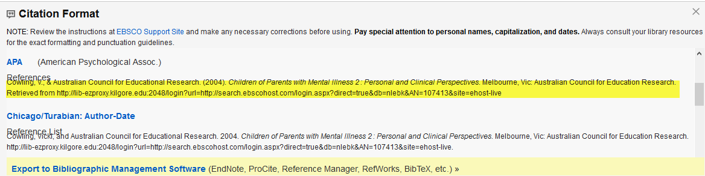
Scroll down to find your format. Copy and paste to your References page.
Be sure to get the right citation format!

Slide 19
Books
If you need something we do not have, you can request it through Interlibrary Loan.
Interlibrary Loan takes time, so don’t wait until the last minute!

Slide 20
Remember the citation information!
Use the Cite feature under Tools.
Use APA style to format your citations.
  APA is short for Publication Manual of the American Psychological Association
  APA is often used for research in the sciences
  See the APA tab in The Little Seagull Handbook

Slide 21
Why Use a Database?
Anyone can create an internet site.
  It can be true.
  It can be fake.
  You have to verify internet information.
  Who is the author?
  Does the site want to provide information, or sell something?
  When was it last updated?

Slide 22
Databases
Provide thousands of articles from journals, newspapers, or books.
The information is more accurate.
Many articles are peer-reviewed.
Your instructor may prefer database articles to internet sites.

Slide 23
Databases for research
Psychology and Behavioral Sciences
Psychology Collection
JStor
Academic OneFile
Academic Search Complete

Slide 24
Searching specific databases
The database you use will depend on the type of research you want to do.
Some databases are subject specific.
If you don’t find what you need in one database, try another.

Slide 25
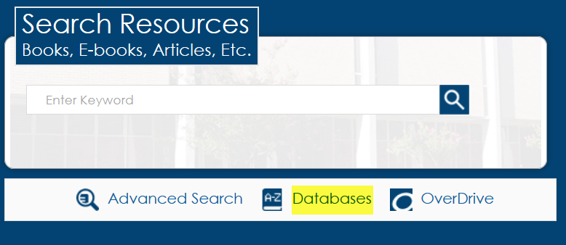
Click on Databases
Click here

Slide 26
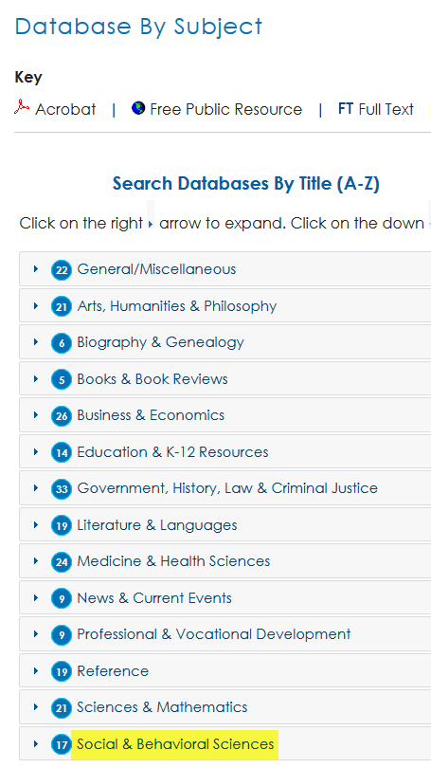
Click Social & Behavioral Sciences
Click here

Slide 27
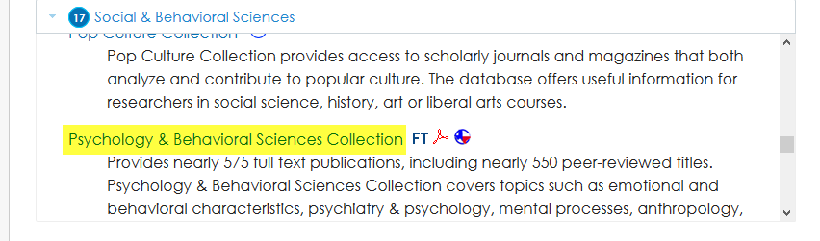
Scroll down and click Psychology & Behavioral Sciences Collection
Click here
Use this bar to scroll

Slide 28
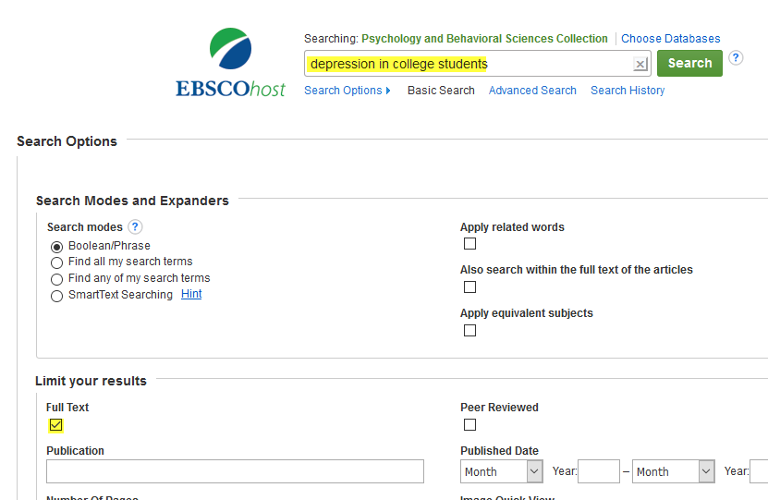
Enter search terms.
Check Full Text. Search.
Enter search terms here
Click here

Slide 29
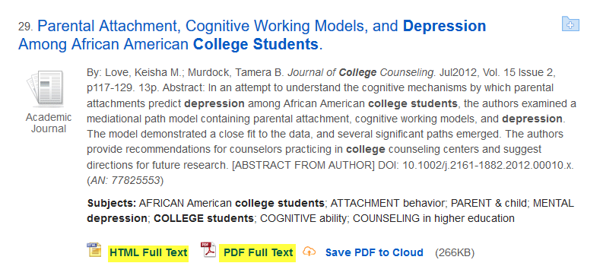
Click Full Text to view article.
Click here for HTML. An HTML means someone has typed the article into the database.
Click here for a PDF. PDF means someone has scanned the article into the database. It will look the same as it does in the actual journal.

Slide 30
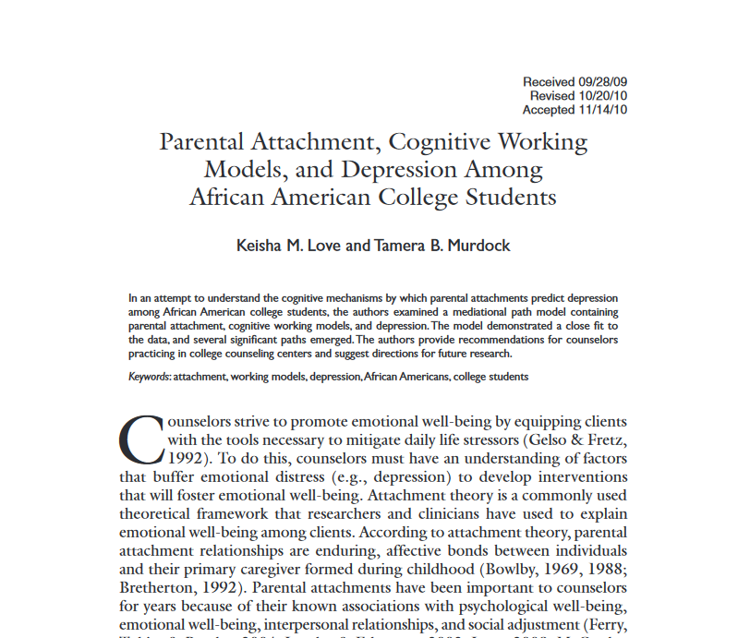
Read

Slide 31

To get the citation, click on the Cite icon on the right side of the page.
Click here

Slide 32
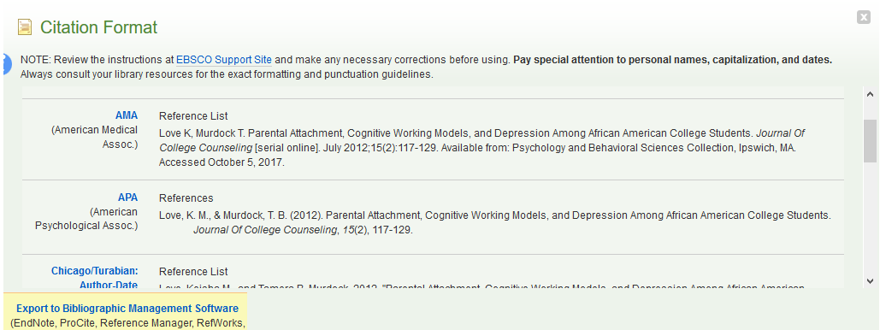
Scroll down to the required format.
Use the citation format required by your instructor.

Slide 33
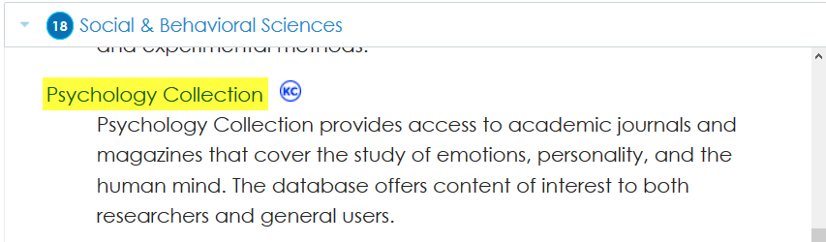
Psychology Collection
Click here

Slide 34
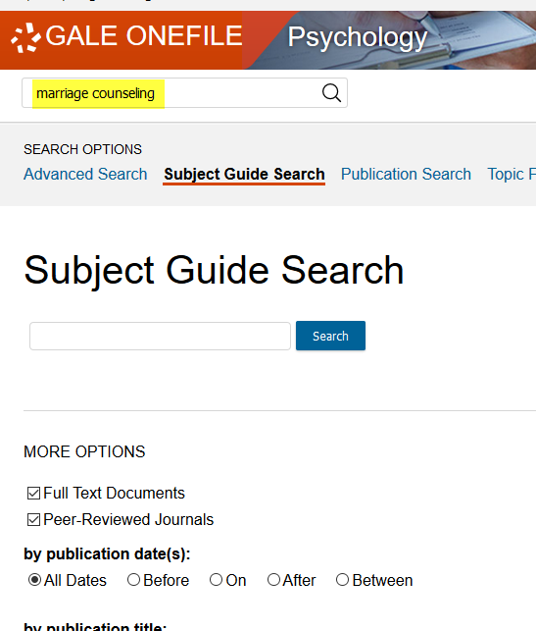
Enter search terms and hit Enter.
Enter search terms here
Click here
Click here if your instructor requires peer-reviewed articles

Slide 35
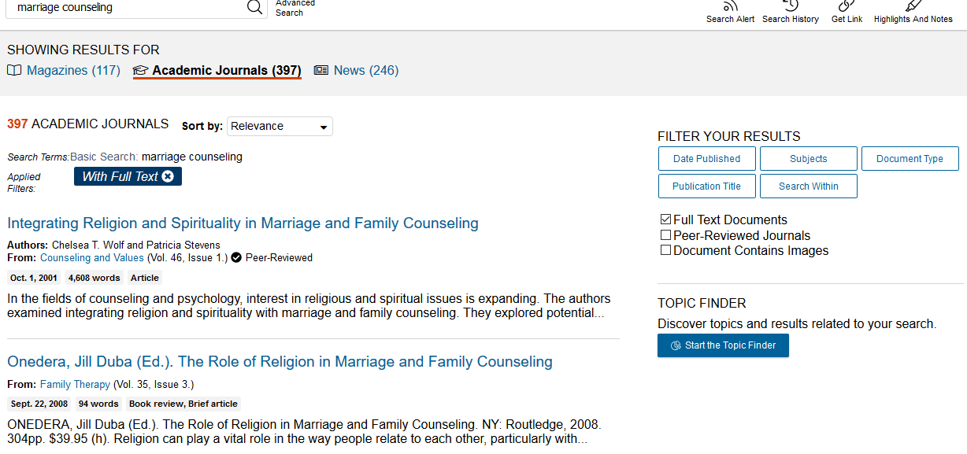
Select Academic Journals
Click here

Slide 36
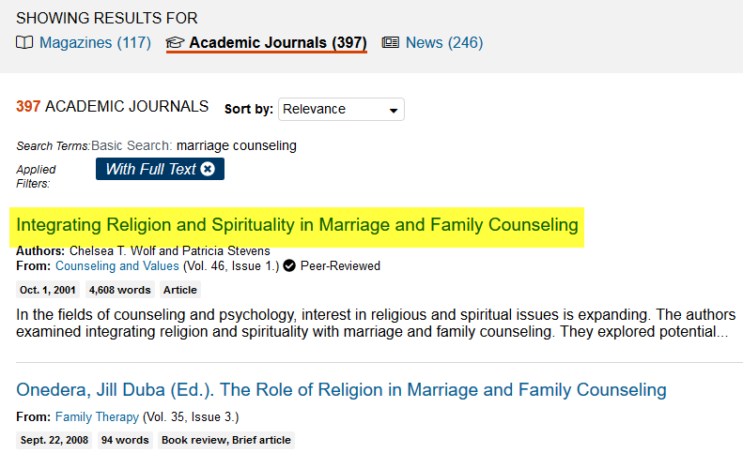
Click on title to view article
Click here

Slide 37
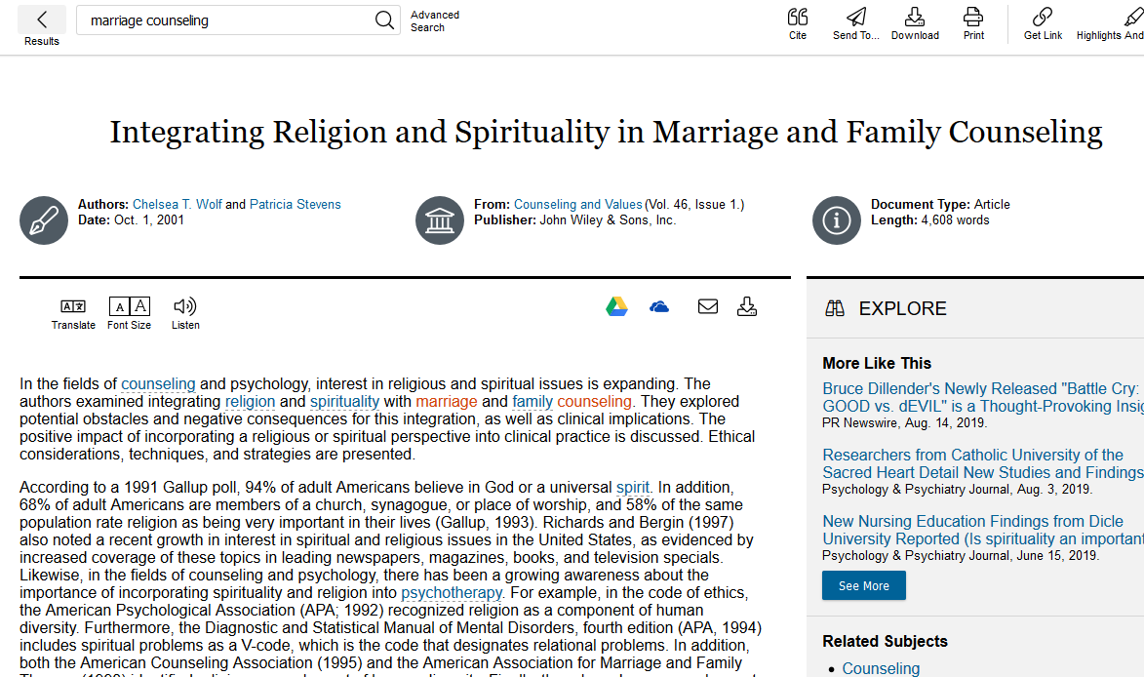
Read

Slide 38
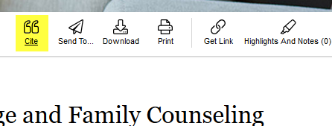
Click on Cite icon at the top of the page
Click here

Slide 39
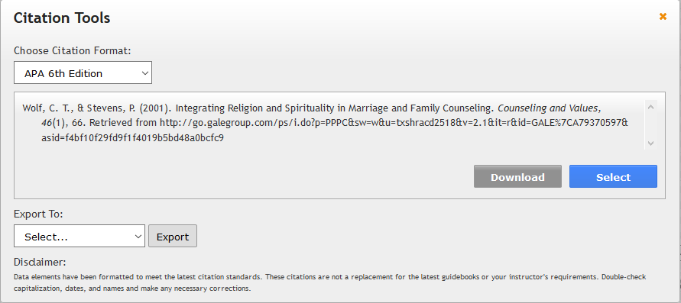
Use the arrow to select the required citation format.
Click the arrow

Slide 40
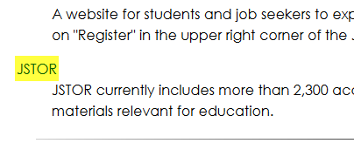
JStor
Click here

Slide 41
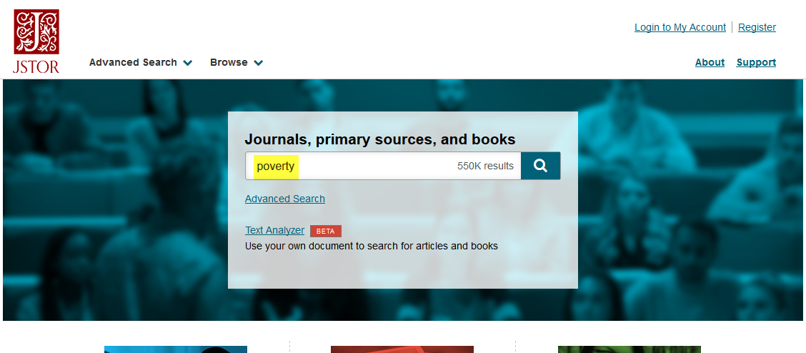
Enter search terms and hit Enter
Enter search terms here

Slide 42
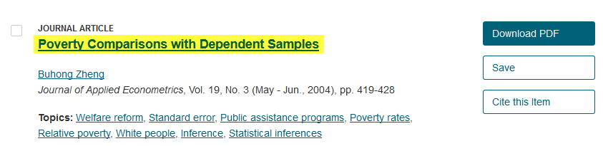
Click on a title to view the article.
Click here

Slide 43
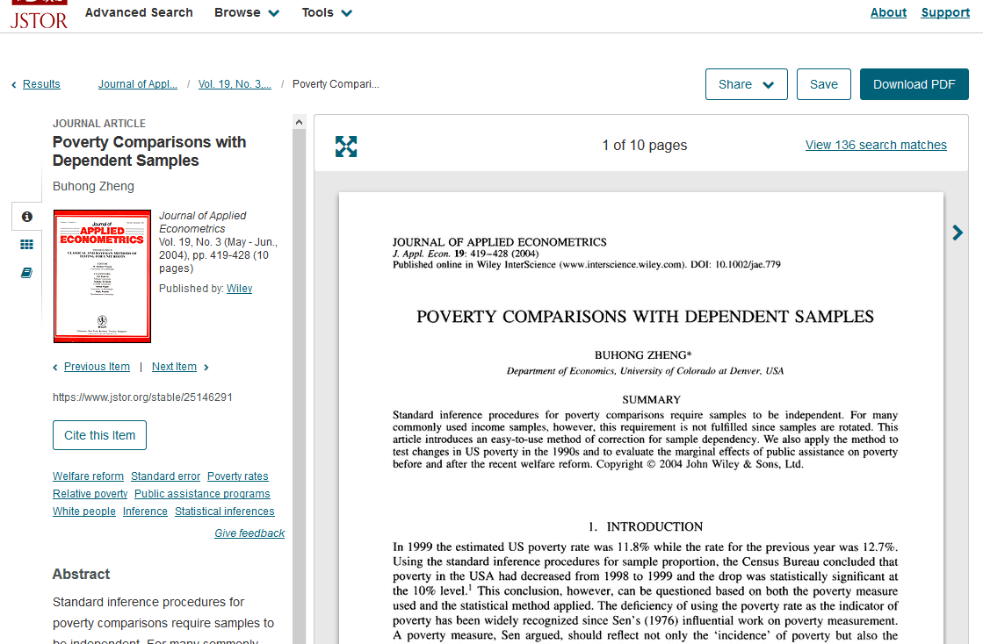
Read

Slide 44
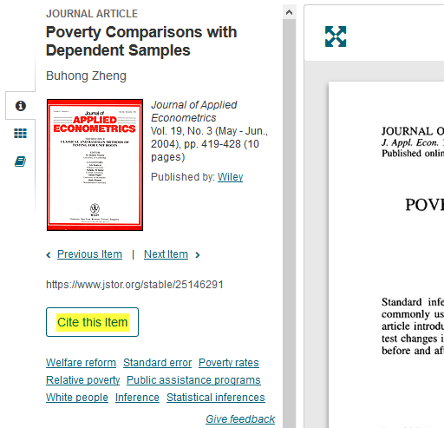
Click on Cite this Item next to the article, to get the citation.
Click here

Slide 45
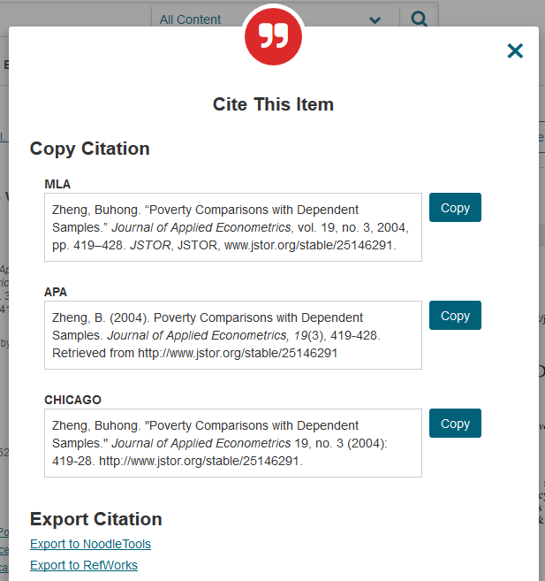
Use the correct format.

Slide 46
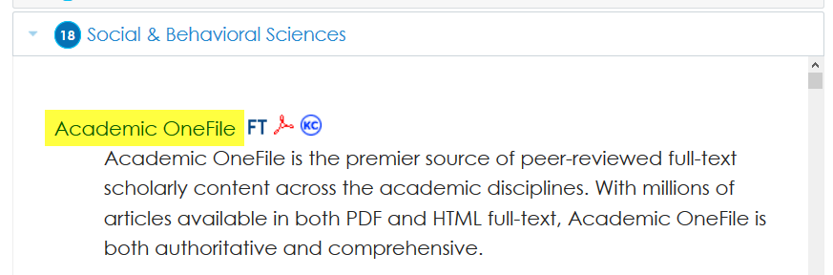
Academic OneFile
Click here

Slide 47
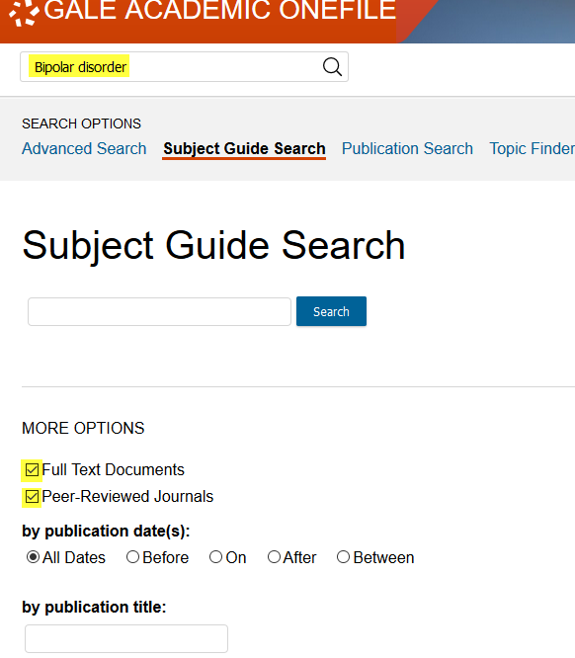
Enter search terms and select Full Text. Search.
Enter search terms here
Click here
Click here if your instructor requires peer-reviewed articles

Slide 48
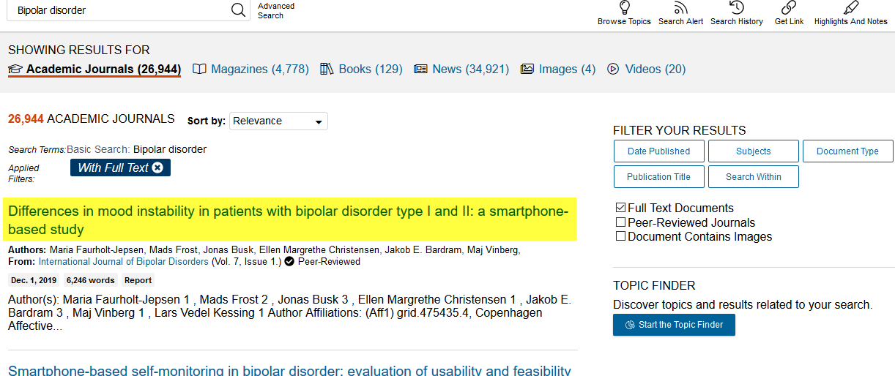
Click on title to view article.
Click on the title

Slide 49
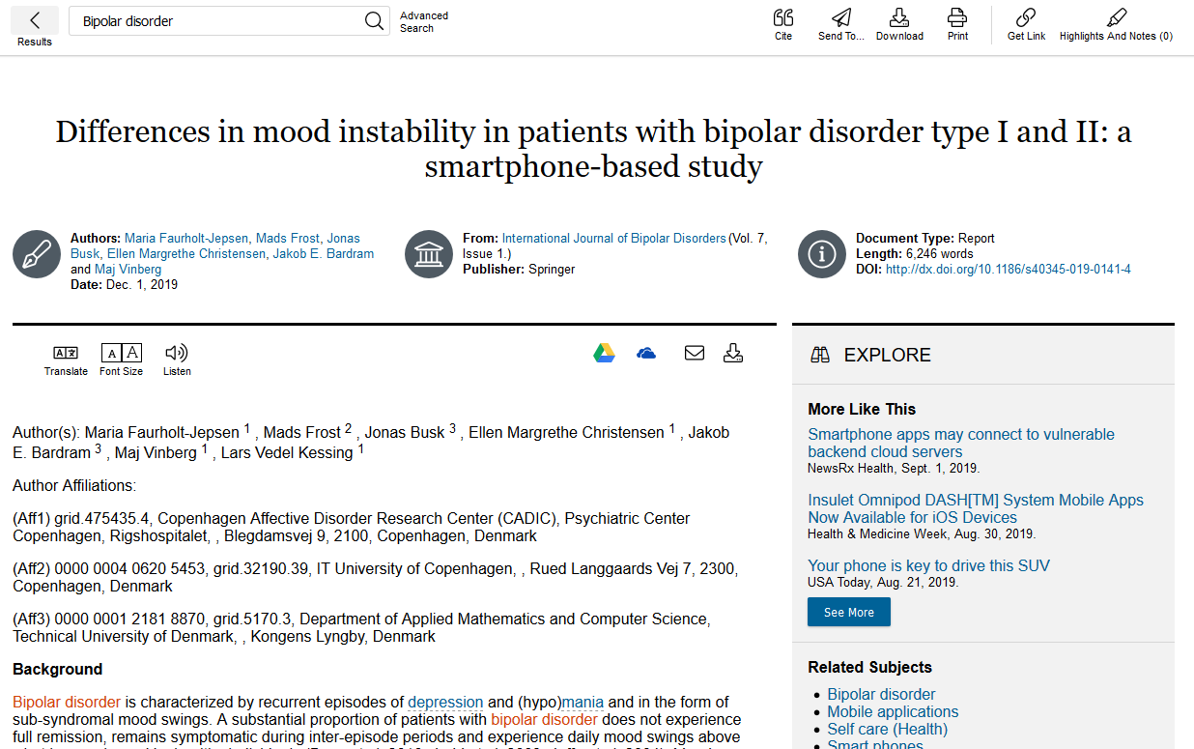
Read

Slide 50

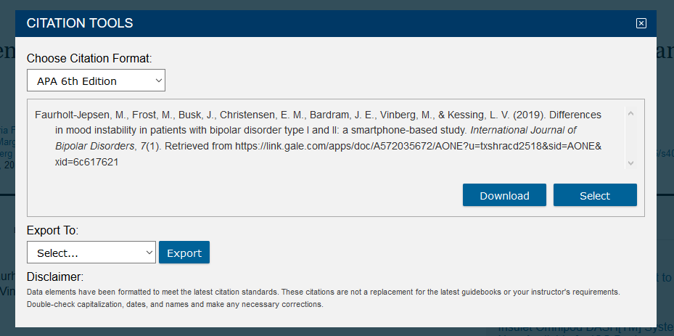
Remember the citation!
Click the Cite Icon
Click on the arrow to change the format

Slide 51
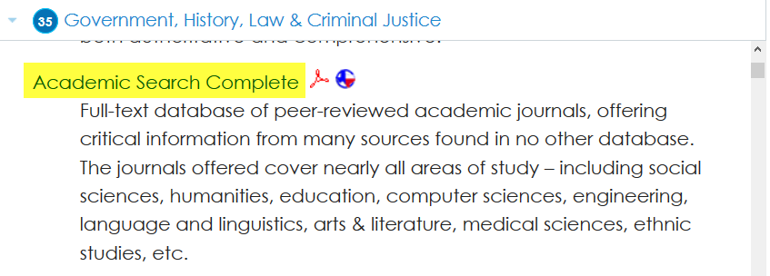
Click on Academic Search Complete
Click here

Slide 52
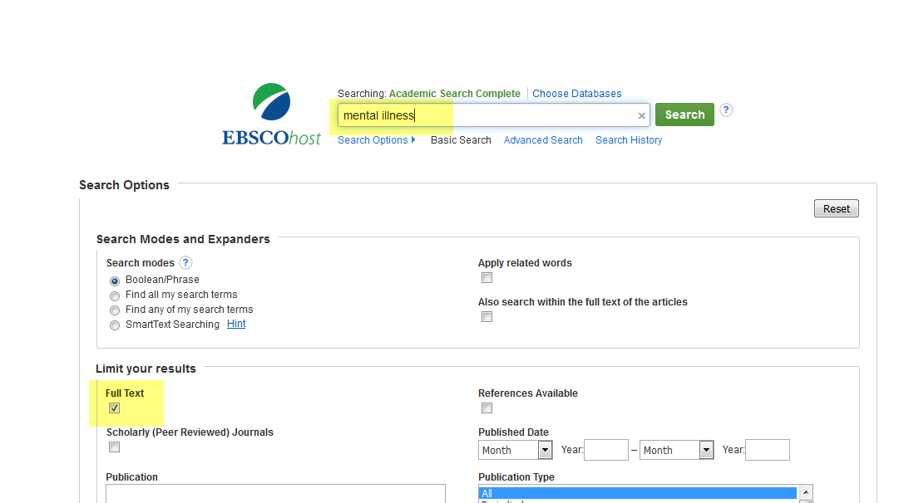
Type in your terms.
Remember to click on Full Text.
Enter Search terms
Click here

Slide 53
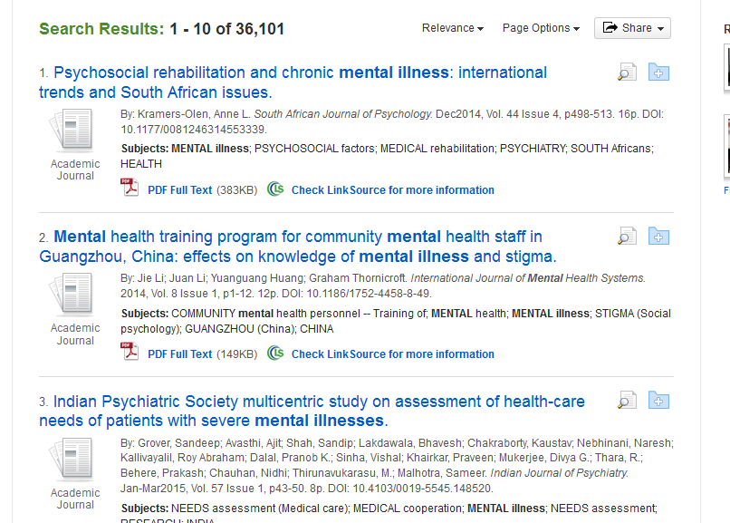
Results
Notes:
This is an overwhelming number of articles! Let’s try narrowing the search.

Slide 54
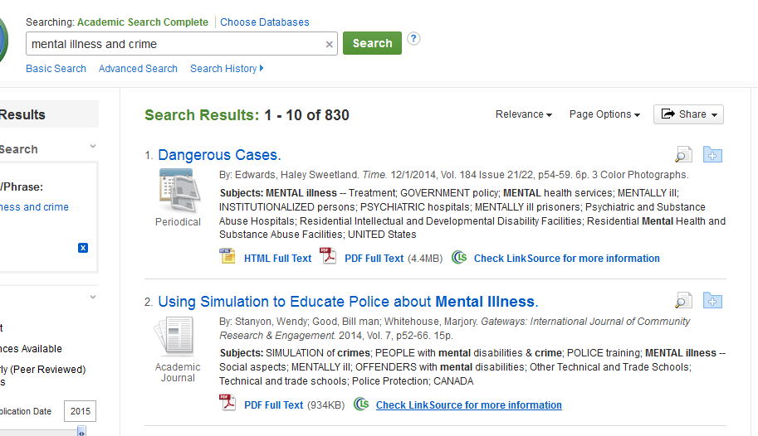
Narrow the Search by Adding Terms
Narrow the search by adding terms.
Notes:
This is still a lot of information. Let’s narrow some more.

Slide 55
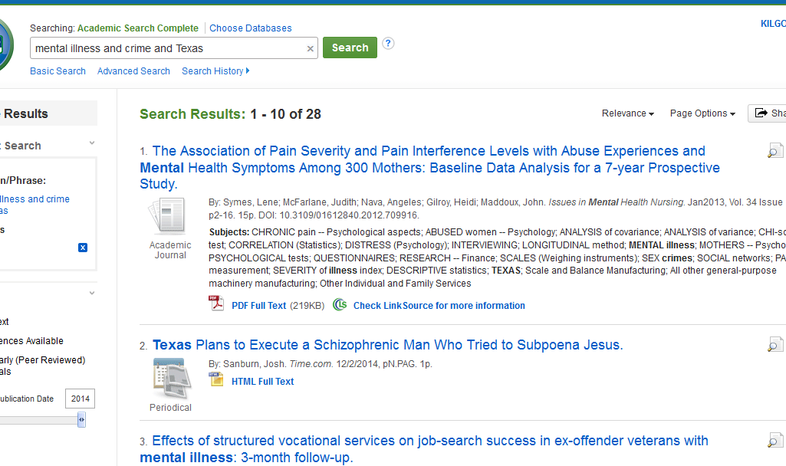
Even Narrower
Add more search terms.
Notes:
Use the word “and” as a limiter.

Slide 56
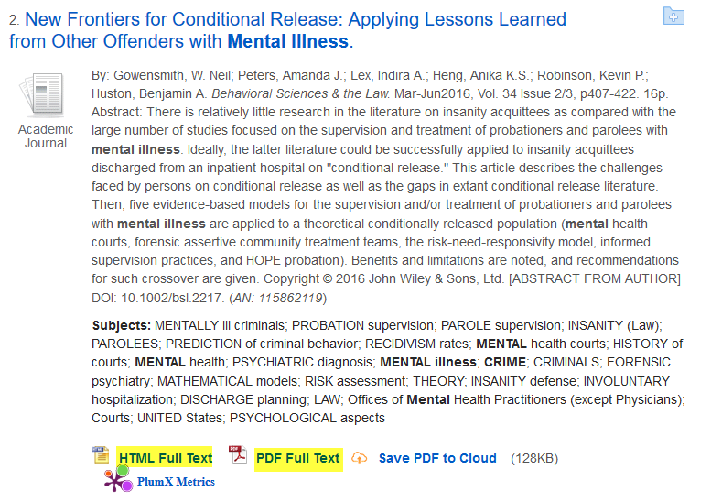
Click on Full Text to read an article
Click here for PDF. PDF has been scanned into the database. It will look the same as the actual journal.
Click here for HTML. HTML has been typed into the database.

Slide 57
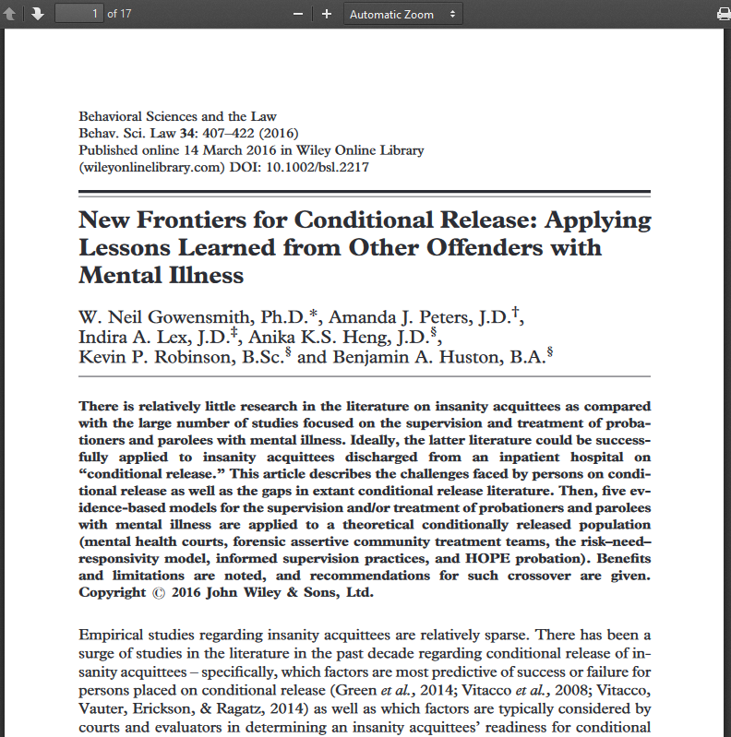
Read

Slide 58
If the article is a PDF….
The article has been scanned into the database and will appear the same as it appears in the print journal. One big difference is that a PDF will have page numbers, while an HTML does not.

Slide 59
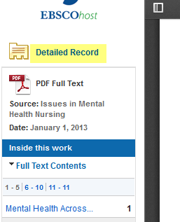

Don’t forget the citation!
Use the Detailed Record to create your citations.
OR
Click on Cite icon.

Slide 60
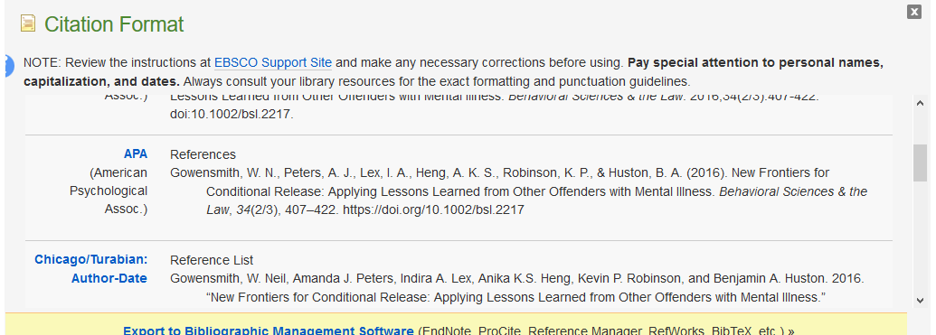
Scroll down to APA

Slide 61
Citations
Each time you use someone else’s words or ideas, you must provide a citation to give credit to that person.
As you type your paper, you will use an in-text citation, using the last name of the author of the article, and the page number, if given, in parentheses. Ex.: (Logan 214)
For each citation, you will provide a corresponding bibliography.

Slide 62
If You Need Help with Research
Call the KC Library and speak to a librarian.
Come to the KC Library and speak with a librarian.
Use the Ask-A-Librarian email service from the home page.

Slide 63
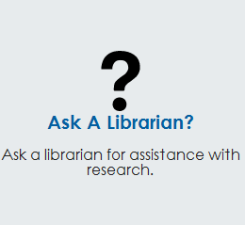
Ask-A-Librarian
Click here

Slide 64
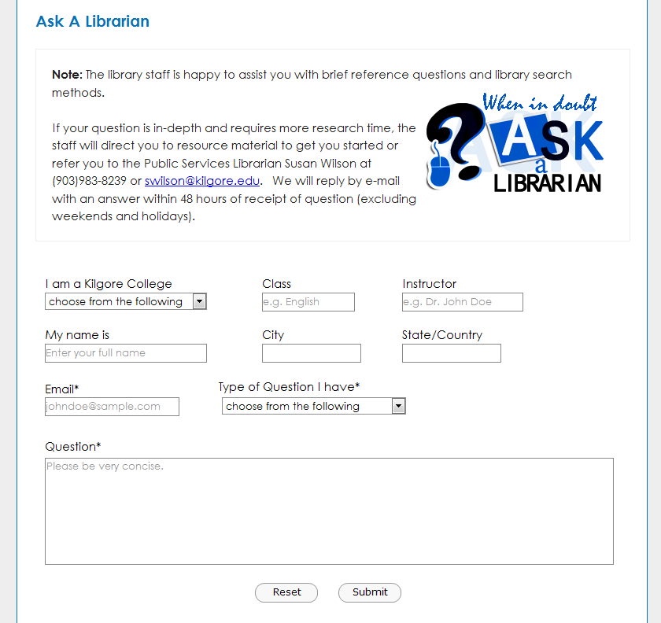
Ask-A-Librarian
Fill in the boxes
Click to Submit

Slide 65
Ask-A-Librarian
We get back to you as quickly as possible.
If it is a night, weekend or holiday, you will have to wait until the next working day.
We won’t do the work for you, but we can point you in the right direction.
  Recommend a database
  Suggest changes in search terms

Slide 66
Quiz
What is the email reference service called?
When can I access the databases?
What is the purpose of a call number?
What is an electronic version of a book called?
What is a reason to use databases instead of an Internet search?

Slide 67
Good Luck!

