Slide 1
Using the Kilgore College Library Online Resources
Nursing
Nurse Assistant
Physical Therapy
Radiologic Science

Slide 2
Library Access 24/7
Did you know that you can do research without actually coming to the KC Library on campus?
You have access to our databases and ebooks:
As long as you are enrolled in the current semester at KC
As long as you have Internet access

Slide 3
Randolph C. Watson Library Homepage
https://library.kilgore.edu

Slide 4

Randolph C. Watson Library Homepage

Slide 5
Logging in from Off-Campus
When logging in from off-campus, you will need your username and password.
Username: 1st four letters of your last name, 1st four letters of your first name, last four digits of your KC ID.
Password: StudentMMDD
Remember to capitalize the S
Your birth month
Your birth day

Slide 6
Off-Campus and Wireless Log In
So, if your name is Terrance Cather, you were born on June 6, and your KC ID is 123456789, your login will be:
Username: cathterr6789
Password: Student0606
“Student” with a capital S.
The month and day you were born, so that it is 4 digits.

Slide 7
Finding Resources
Books
Ebooks

Slide 8
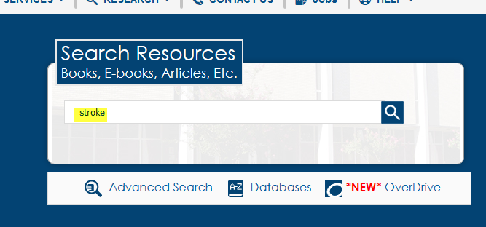
Enter search terms in the Search Resources box. Click Search.
Enter search terms here

Slide 9
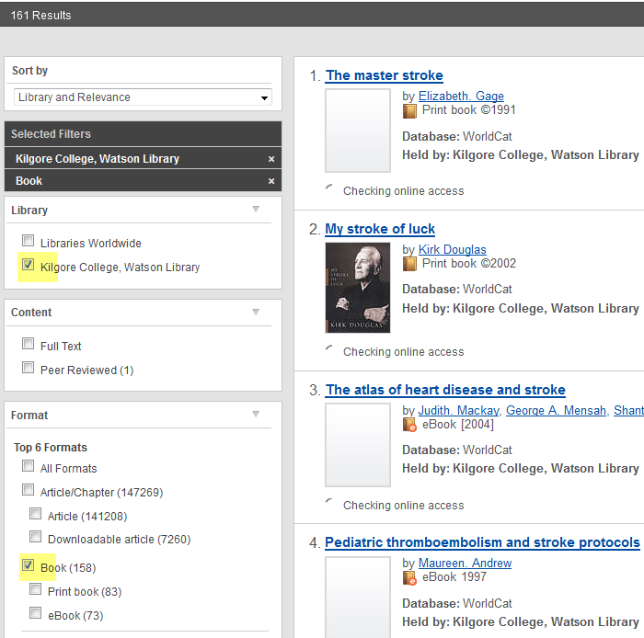
Click on Kilgore College and Book to narrow the search
Click here
Click here

Slide 10
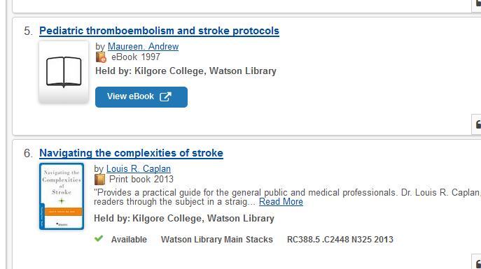
Books and eBooks
This is an electronic book. Read it from your computer or device.
This is a print book. You can check it out.
The call number tells you where to find the book on the shelf.

Slide 11
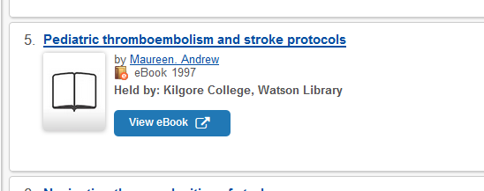
Click View eBook to read
Click here to view the ebook.

Slide 12
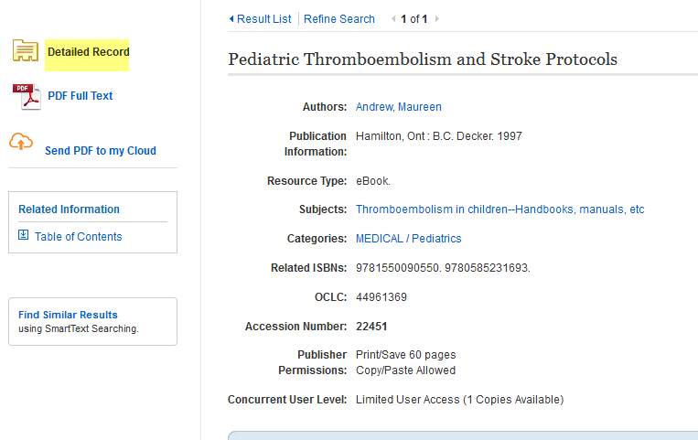
The Detailed Record can be used to create citations

Slide 13
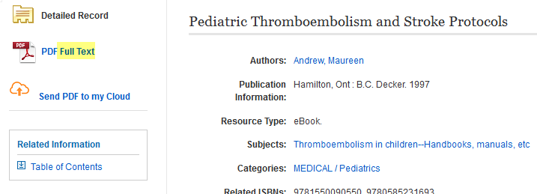
Click on Full Text to open the book
Click here

Slide 14

The thing you will see is either the cover or the title page of the book

Slide 15
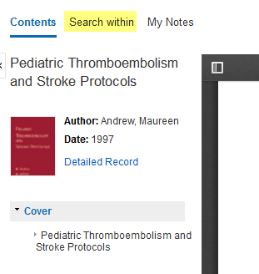
Click Search within to open the search box
Click here

Slide 16
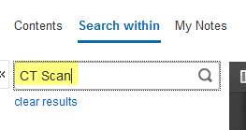
Type in search terms and hit Enter
Enter search terms
Click on the magnifying glass or hit the Enter key to perform the search

Slide 17
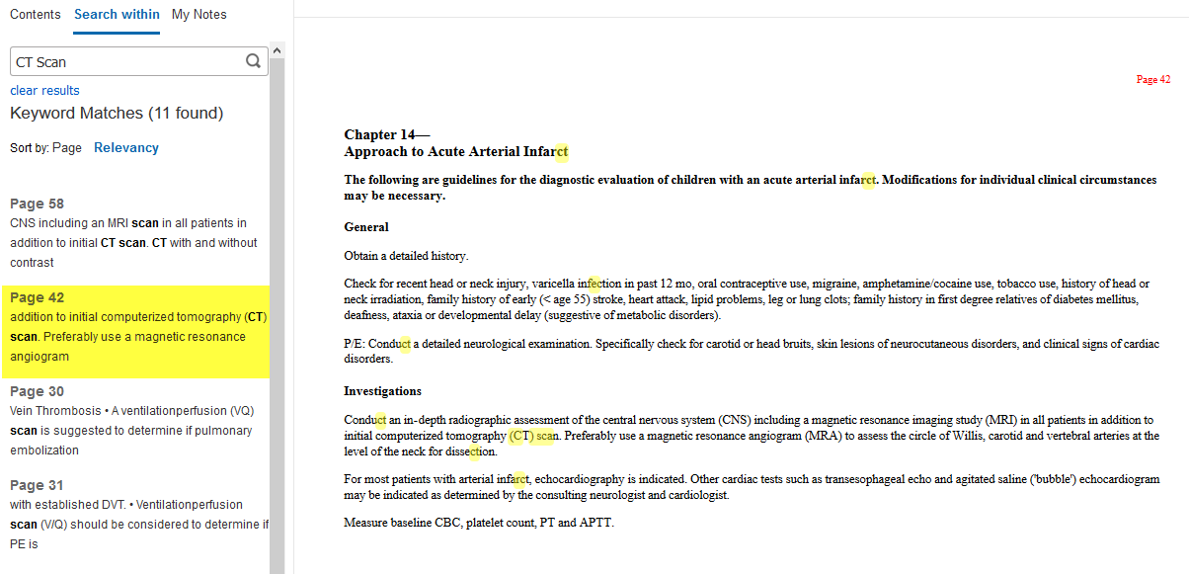
Click on the page number to go to the page
Page number matches the one you clicked.
Click here

Slide 18
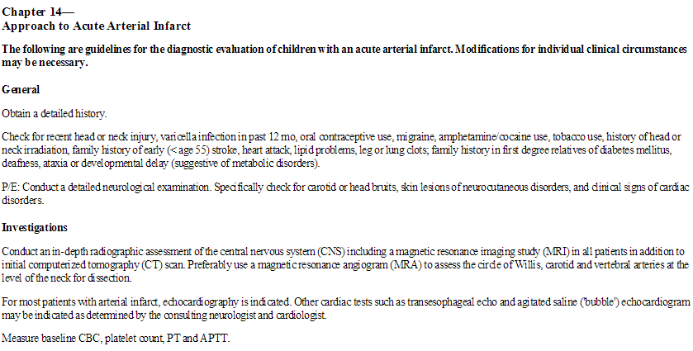
Read

Slide 19

Click Cite at the top of the page to get the citation information
Click here

Slide 20
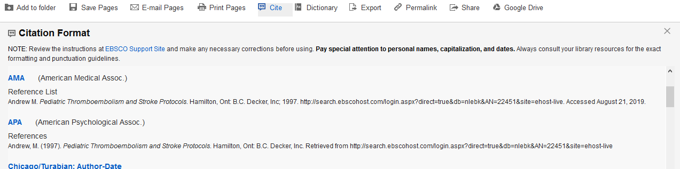
Scroll down to find your format. Copy and paste to your References page.

Slide 21
Books and Articles
If you need something we do not have, you can request it through Interlibrary Loan.
Interlibrary Loan takes time, so don’t wait until the last minute!

Slide 22
Remember the citation information!
Use the Cite feature under Tools.
Use the citation style required by your instructor.

Slide 23
Why Use a Database?
Anyone can create an internet site.
  It can be true.
  It can be fake.
  You have to verify internet information.
  Who is the author?
  Does the site want to provide information, or sell something?
  When was it last updated?

Slide 24
Databases
Provide thousands of articles from journals, newspapers, or books.
The information is more accurate.
Many articles are peer-reviewed.
Your instructor prefers database articles to internet sites.

Slide 25
The Best Databases for Your Research:
CINAHL
Gale Interactive: Human Anatomy
Medline (EBSCO)
Nursing & Allied Health Collection
Health Source: Nursing/Academic
Scientific and Medical Art Imagebase
Physical Therapy & Sports Medicine Collection
Academic Search Complete

Slide 26
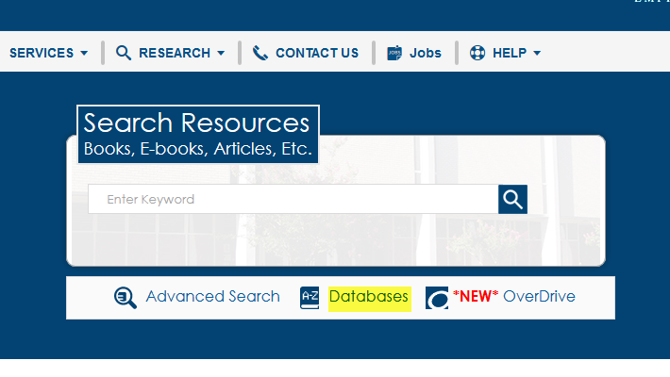
Click on Databases
Click here

Slide 27
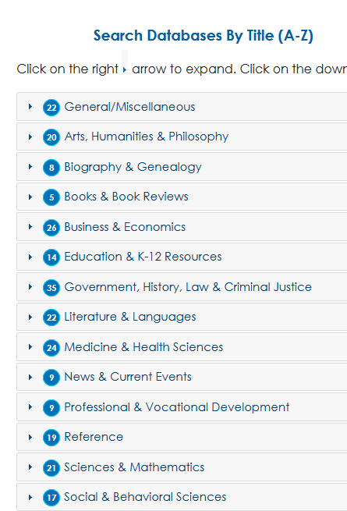
Choose by subject
Click here

Slide 28
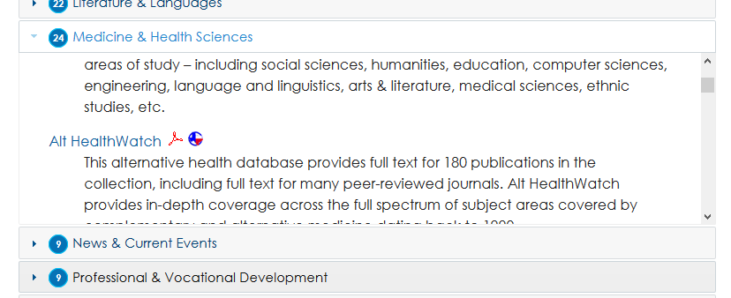
Scroll to find review databases and click on a title
Move the box to see what titles are listed.
Click on the title to open the database.

Slide 29
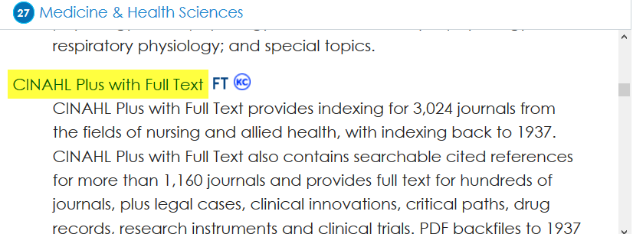
Click on CINAHL
Click here

Slide 30
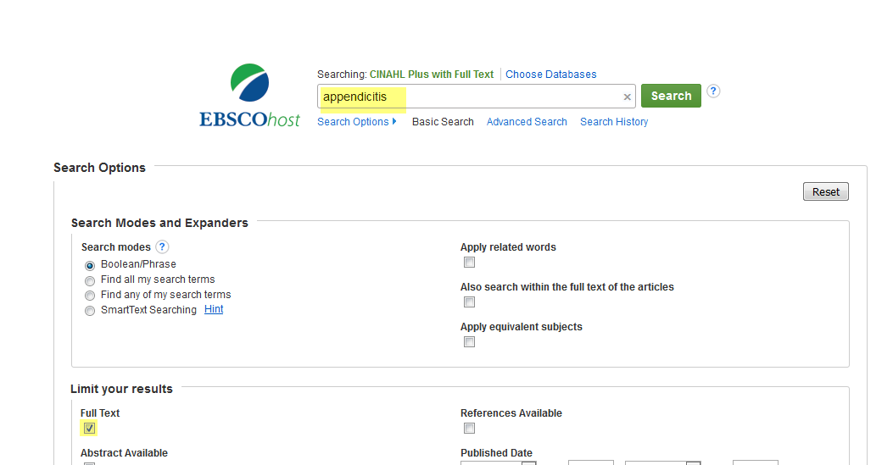
Enter search terms. Select the box for Full Text. Search.
Enter search terms
Click here

Slide 31
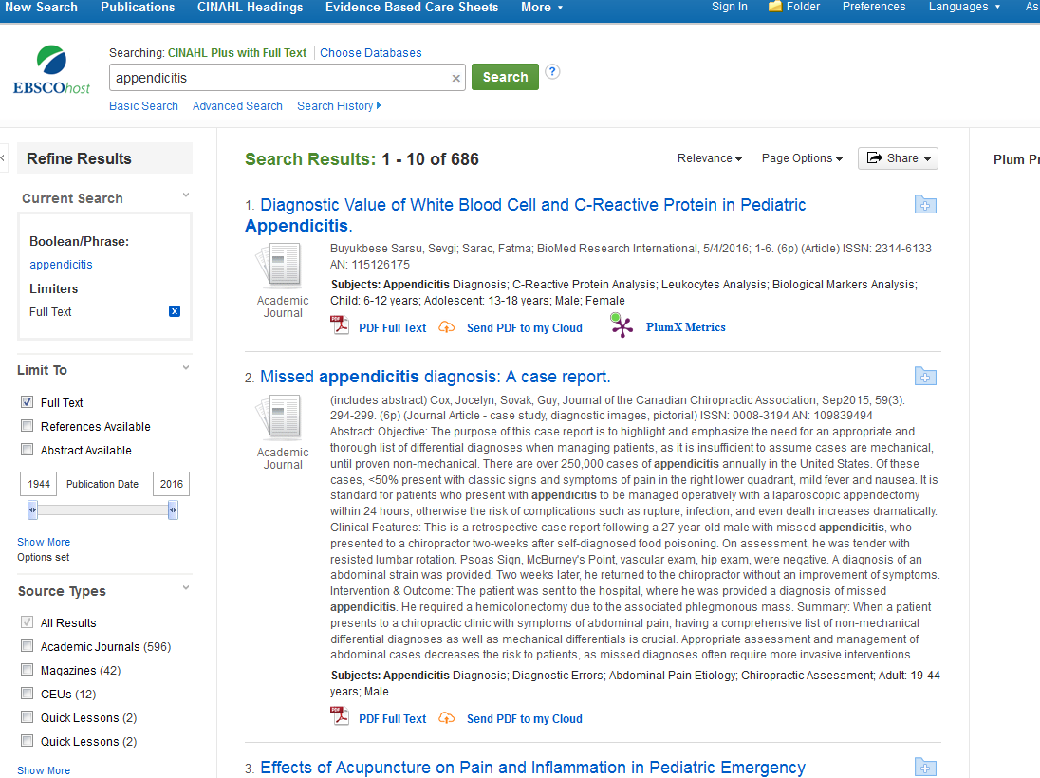
Results page

Slide 32
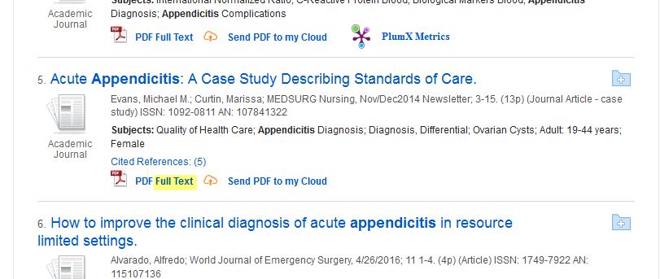
Click on Full Text to read the article
Click here

Slide 33
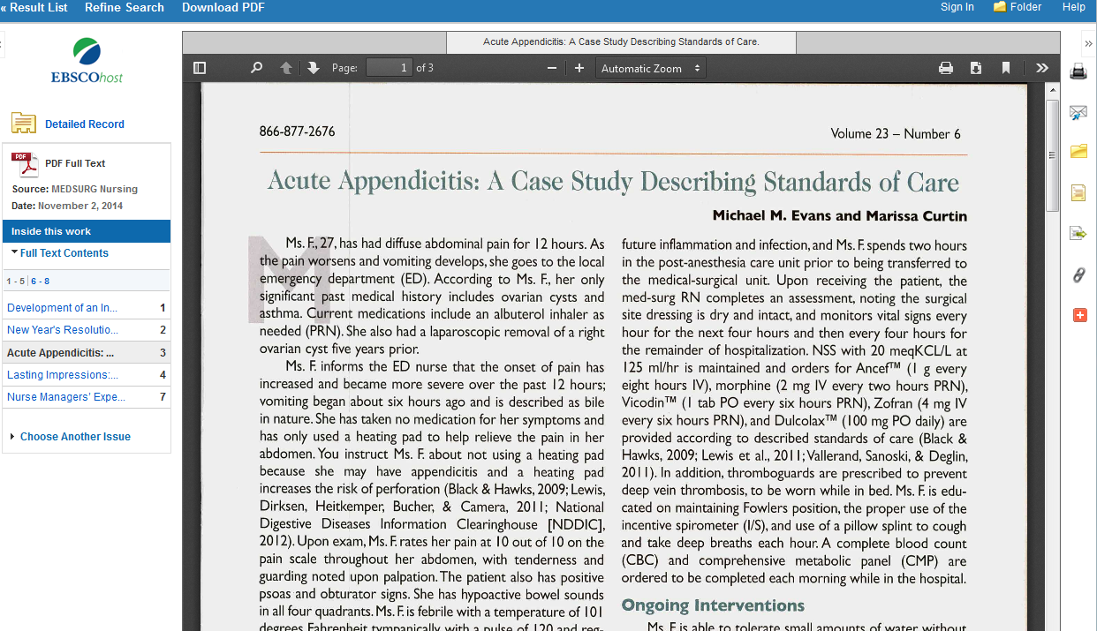
Read

Slide 34
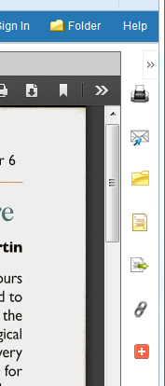
Click the cite icon to get the citation
Click here

Slide 35
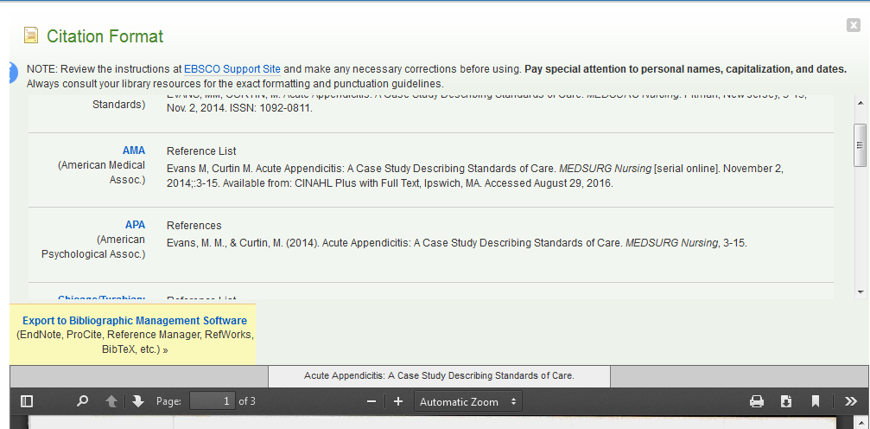
Scroll down to the format required by your instructor. Place this on your References page.

Slide 36
Extra Resources in CINAHL
Evidence-Based Care Sheets
Quick Lessons

Slide 37
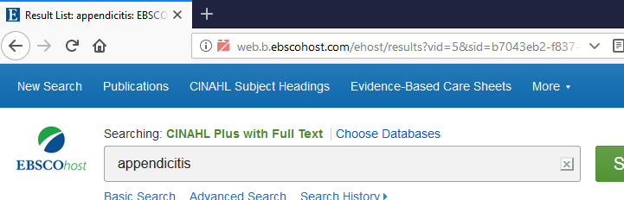
Click on Evidence-Based Care Sheets
Click here

Slide 38
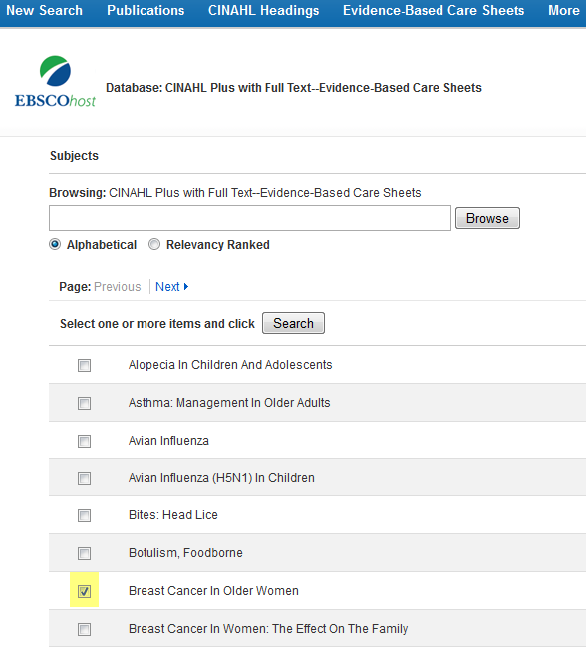
Select a box and click Search
Click here to begin the search
Click here to select

Slide 39
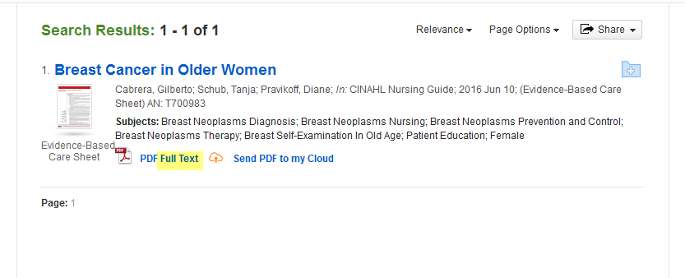
Click on Full Text
Click here

Slide 40
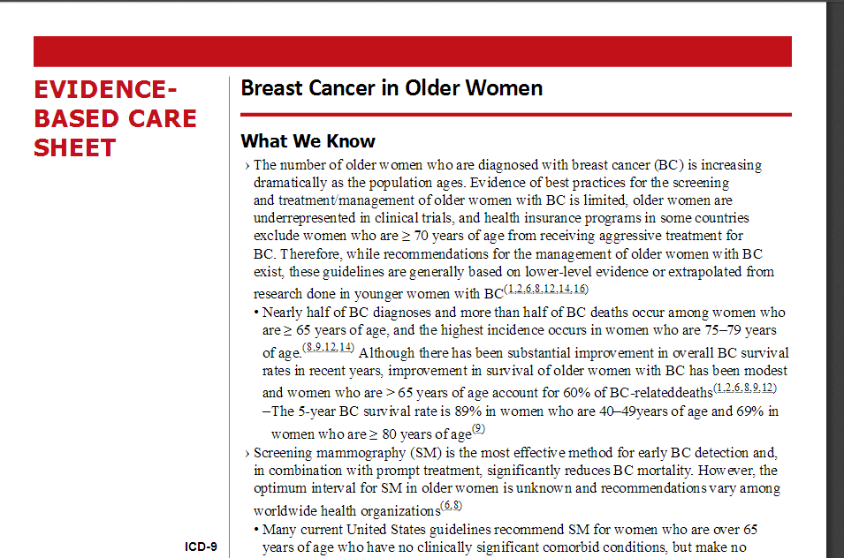
Use the Care Sheet in your studies

Slide 41
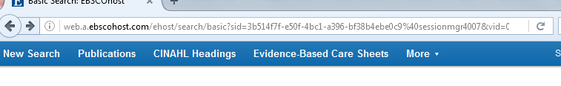
Click More and go to Quick Lessons
Click here. Select Quick Lessons

Slide 42
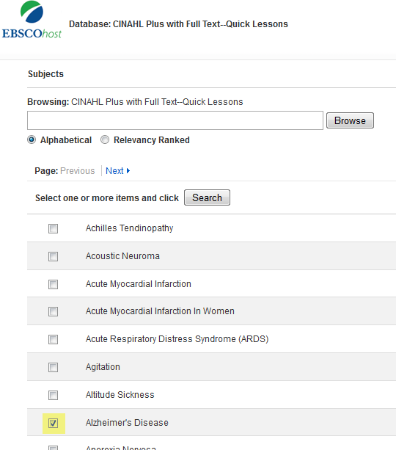
Click on a box to select a topic and click Search
Click to search after selecting a topic
Click here

Slide 43
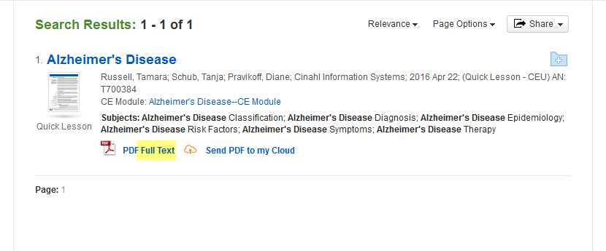
Click Full Text
Click here

Slide 44
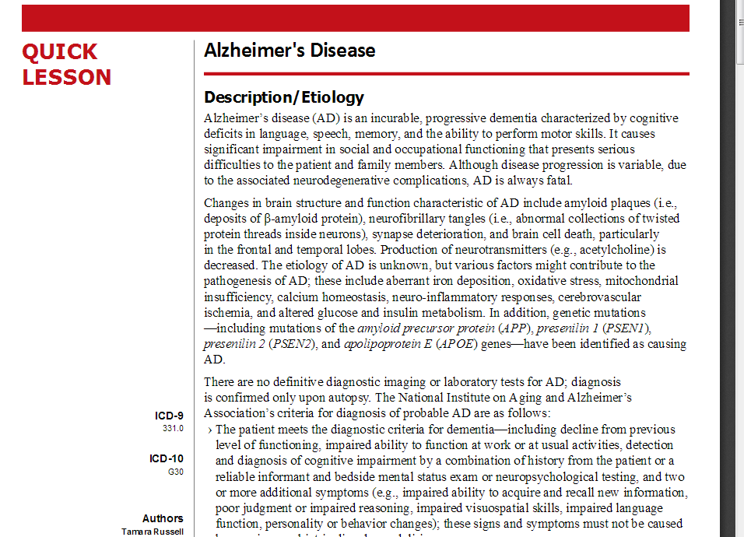
Quick Lesson
There is much more information than seen in this partial screen shot.

Slide 45
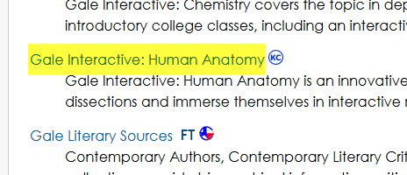
Gale Interactive: Human Anatomy
Click here

Slide 46
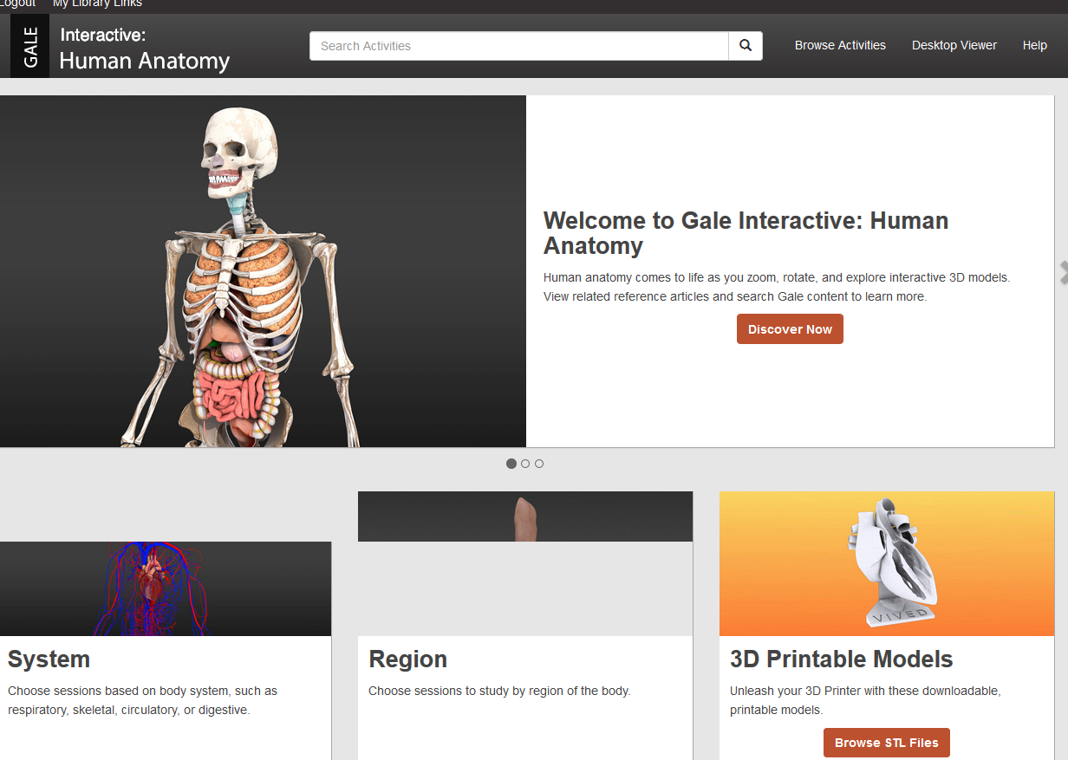
Enter search terms or click on one of the sections to begin
Click here

Slide 47
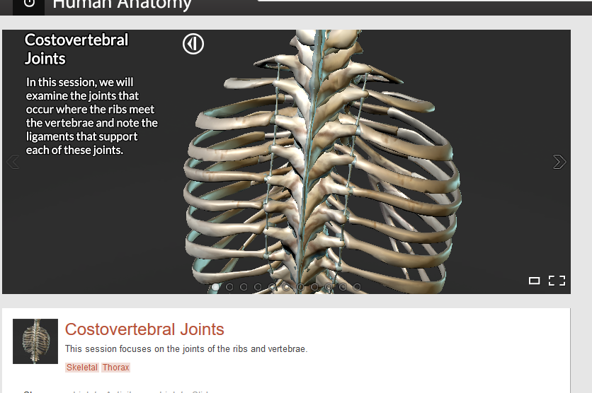
Begin the session
Click arrow to rotate the image.

Slide 48
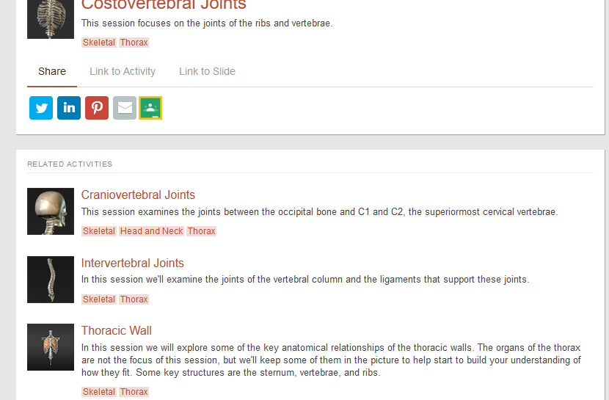
Or, select another session to view

Slide 49
Gale Interactive: Human Anatomy
This is a great tool to learn the various parts of the human body.

Slide 50

Nursing & Allied Health Collection
Click here

Slide 51
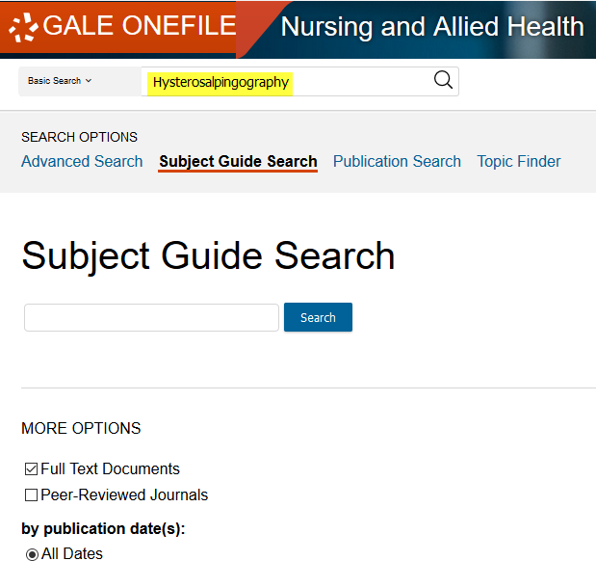
Enter search terms and Hit Enter
Enter search terms here

Slide 52
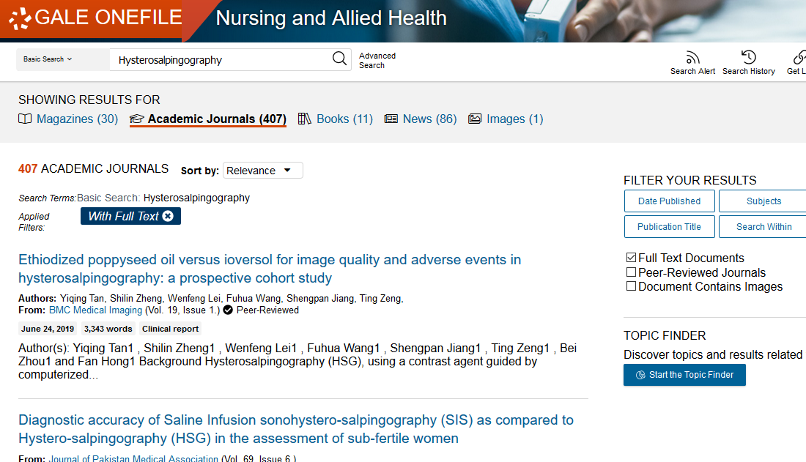
Select Academic Journals & Full Text
Click the tab to select it
Be sure Full Text is selected
Your instructor may require Peer-Reviewed Journals

Slide 53
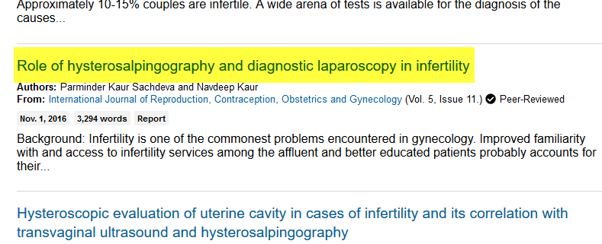
Click on a title to read
Click here

Slide 54

Read

Slide 55
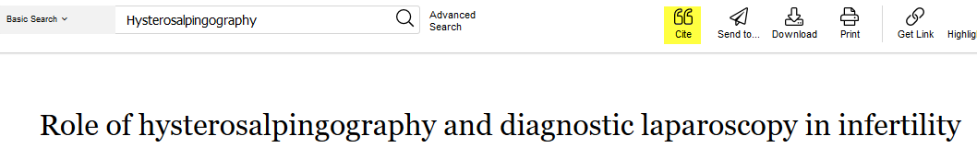
Click the Cite icon at the top of the page
Click here

Slide 56
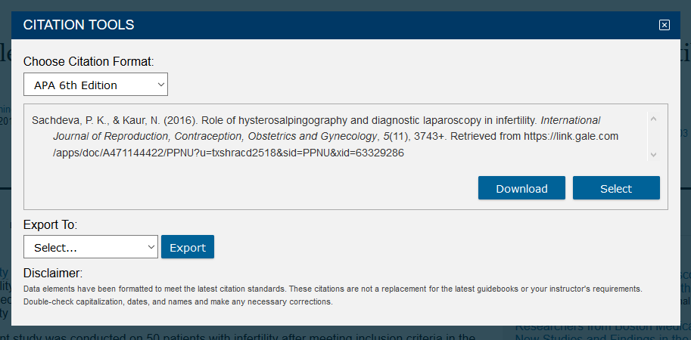
Click the arrow to change the format
Click the arrow to change

Slide 57
The way you word a search determines the results.
If you don’t find enough information in your search, try rewording your terms.
The following example uses Academic Search Complete.

Slide 58
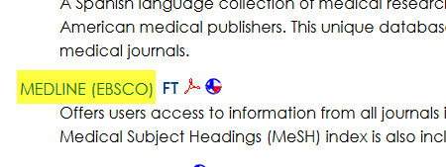
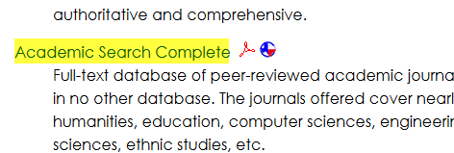
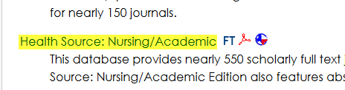
Medline (EBSCO), Academic Search Complete,
Health Source: Nursing/Academic
Searching will be the same for each of these databases. Select one to begin.
Click here
Click here
Click here

Slide 59
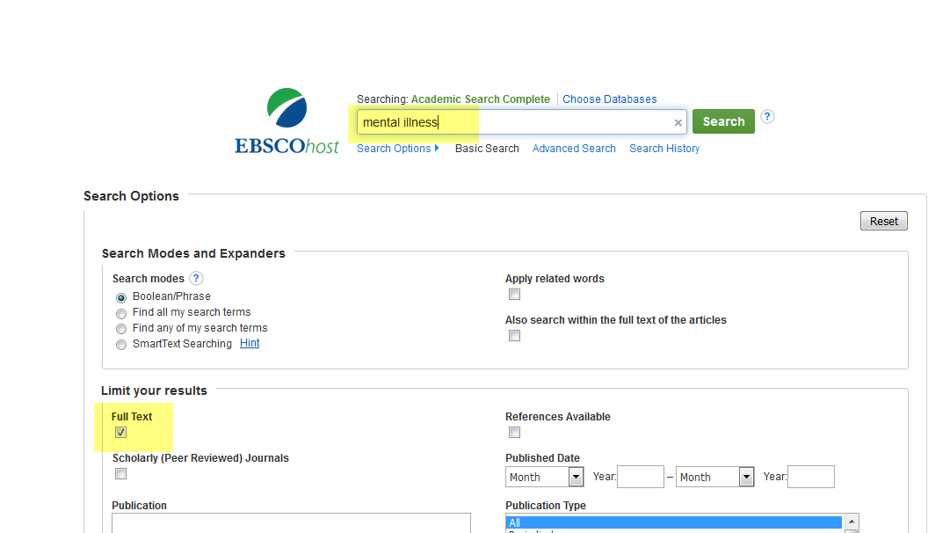
Type in your terms.
Remember to click on Full Text.
Enter Search terms
Click here

Slide 60
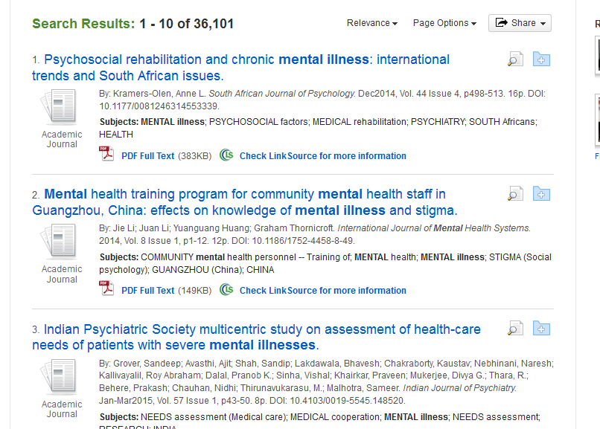
Results
That’s a lot of articles!
Notes:
This is an overwhelming number of articles! Let’s try narrowing the search.

Slide 61
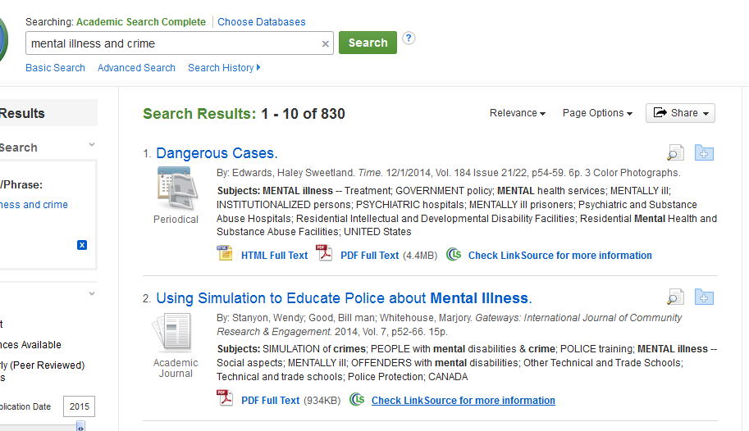
Narrow the Search by Adding Terms
Narrow the search by adding terms. The word AND acts as a limiter.
Better, but still too many.
Notes:
This is still a lot of information. Let’s narrow some more.

Slide 62
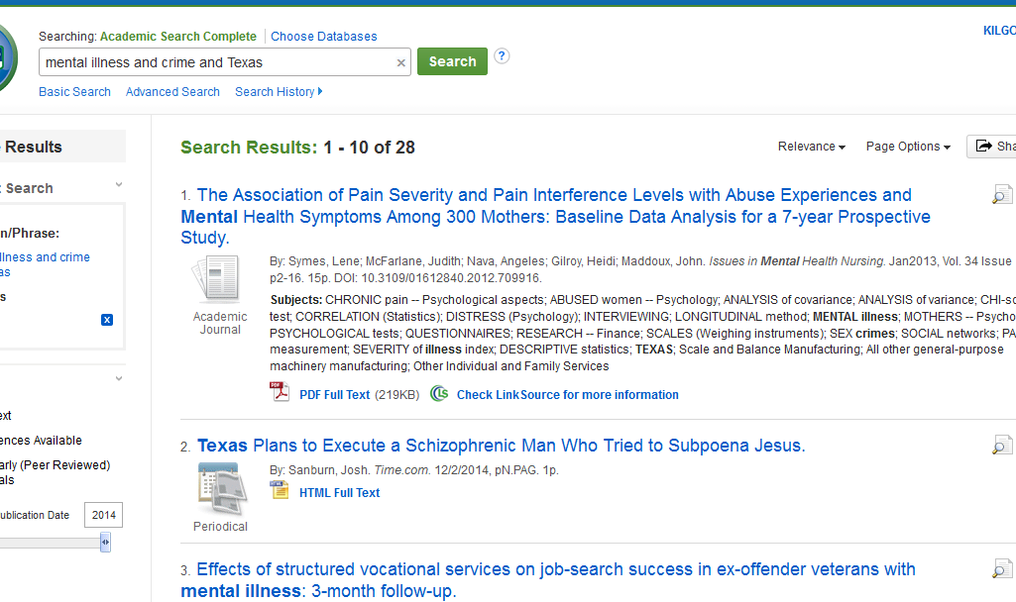
Even Narrower
Add more search terms.
Much less overwhelming!
Notes:
Use the word “and” as a limiter.

Slide 63
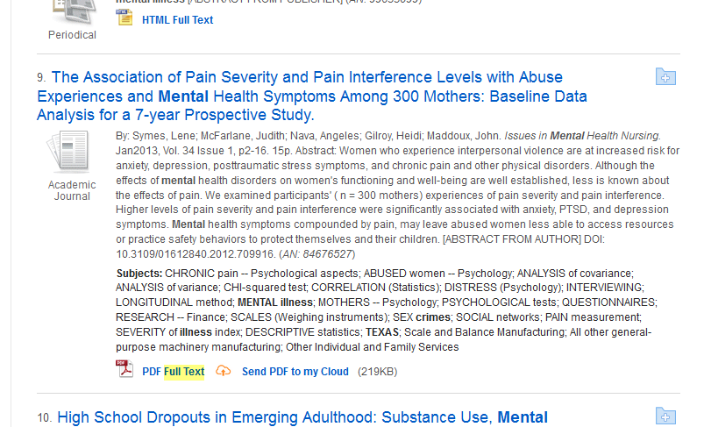
Click on Full Text to read an article
Click here

Slide 64

Read

Slide 65
If the article is a PDF….
The article has been scanned into the database and will appear the same as it appears in the print journal.

Slide 66
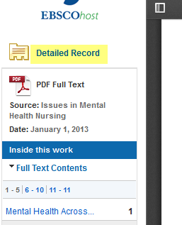

Don’t forget the citation!
Use the Detailed Record to create your citations.
OR
Click on Cite icon.

Slide 67
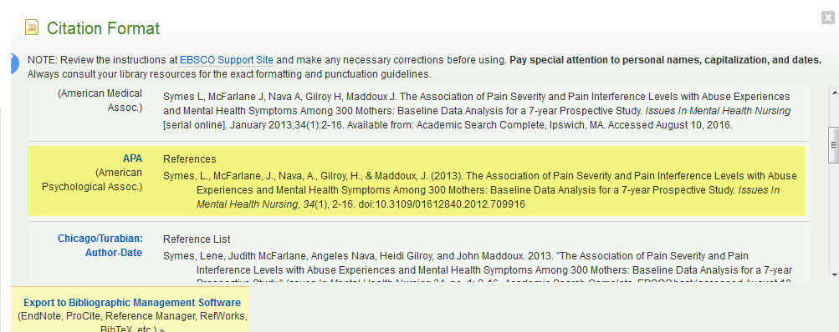
Scroll down to the format required by your instructor
Copy and Paste to your References page.

Slide 68
More about Citations
If you are using APA, your paper will contain in-text citations.
You will list the bibliographies for the sources you used on a separate sheet of paper titled References.

Slide 69
Citations
Each time you use someone else’s words or ideas, you must provide a citation to give credit to that person.
As you type your paper, you will use an in-text citation, using the last name of the author of the article, and the page number, if given, in parentheses. Ex. (Logan 214)
For each citation, you will provide a corresponding bibliography.

Slide 70
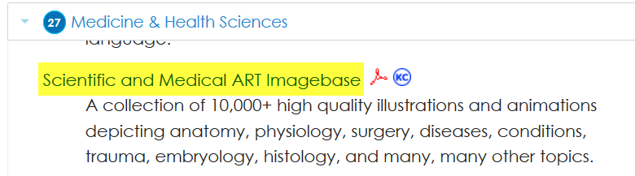
Scientific and Medical ART Imagebase
Click here

Slide 71
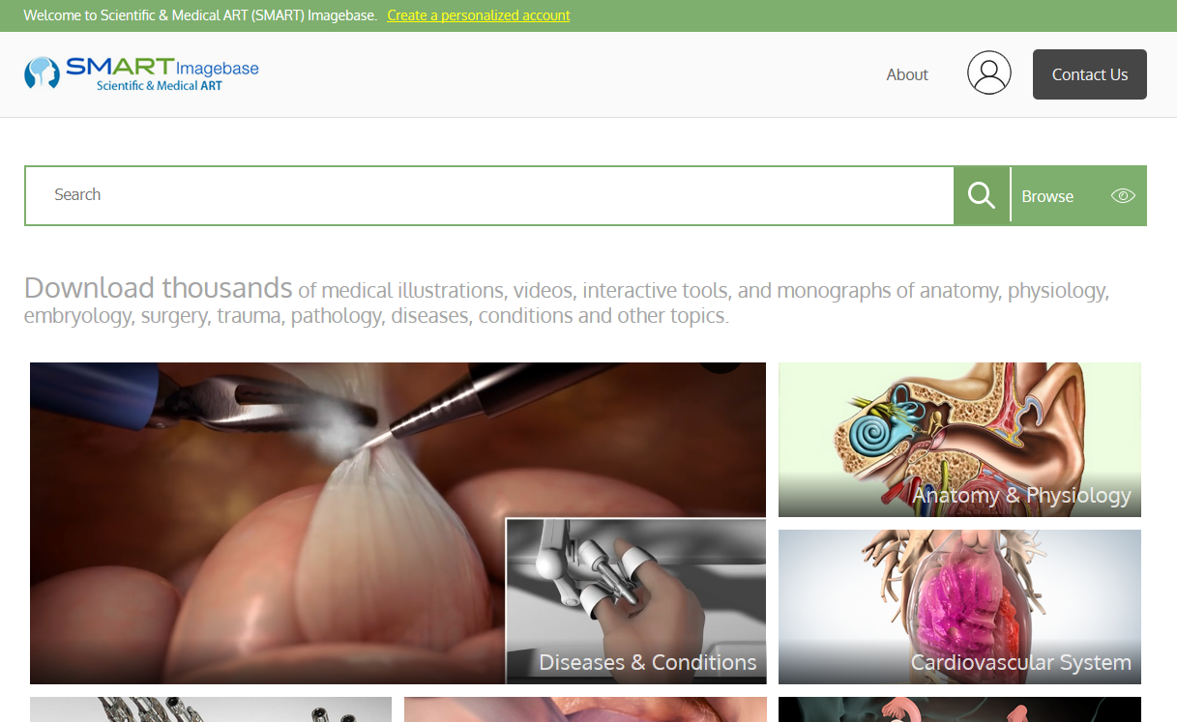
Scientific and Medical ART Imagebase

Slide 72


SMART Imagebase
Charts of body systems and organs.
Helpful with A&P.
Medical animation lets you see procedures to help you prepare for them.

Slide 73

Enter search terms
Click here or hit Enter
Enter search terms

Slide 74

Click on an image to View Item
Click here

Slide 75

Don’t forget the citation
Click here

Slide 76

Choose the Citation Format
Copy and paste to your Bibliography page

Slide 77

Physical Therapy & Sports Medicine Collection
Click here

Slide 78

Physical Therapy & Sports
Medicine Collection

Slide 79

Enter search terms and hit Enter
Enter search terms
Click the magnifying glass or hit Enter

Slide 80

Narrow search and select an article
Click here
Click here
Click here if your instructor requires peer-reviewed articles
Click to open article

Slide 81

Read

Slide 82

Click the cite icon above the article
Click here to get the citation

Slide 83

Select the Citation format
Click the arrow to change format

Slide 84
If You Need Help with Research
Call the KC Library and speak to a librarian.
Come to the KC Library and speak with a librarian.
Use the Ask-A-Librarian email service from the home page.

Slide 85

Ask-A-Librarian
Click here

Slide 86

Fill in the form and Submit
Fill in the boxes. Make sure your email is entered correctly so that you will get a response.
Click to Submit

Slide 87
Ask-A-Librarian
We get back to you as quickly as possible.
If it is a night, weekend or holiday, you will have to wait until the next working day.
We won’t do the work for you, but we can point you in the right direction.
  Recommend a database
  Suggest changes in search terms

Slide 88
Quiz
1. Click to see the complete article.
When can I access the library electronic resources?
What is the name of the library’s email reference service?
What citation format does my instructor require me to use?
What is an electronic version of a book called?
From where can I access the library electronic resources?
Give one reason not to rely on a Google search.

Slide 89

Good Luck!

