Slide 1
Using the Kilgore College Library Online Resources
Speech

Slide 2
Library Access 24/7
Did you know that you can do research without actually coming to the KC Library on campus?
You have access to our databases and ebooks:
As long as you are enrolled in the current semester at KC.
As long as you have Internet access.

Slide 3
Randolph C. Watson Library Homepage
https://library.kilgore.edu

Slide 4
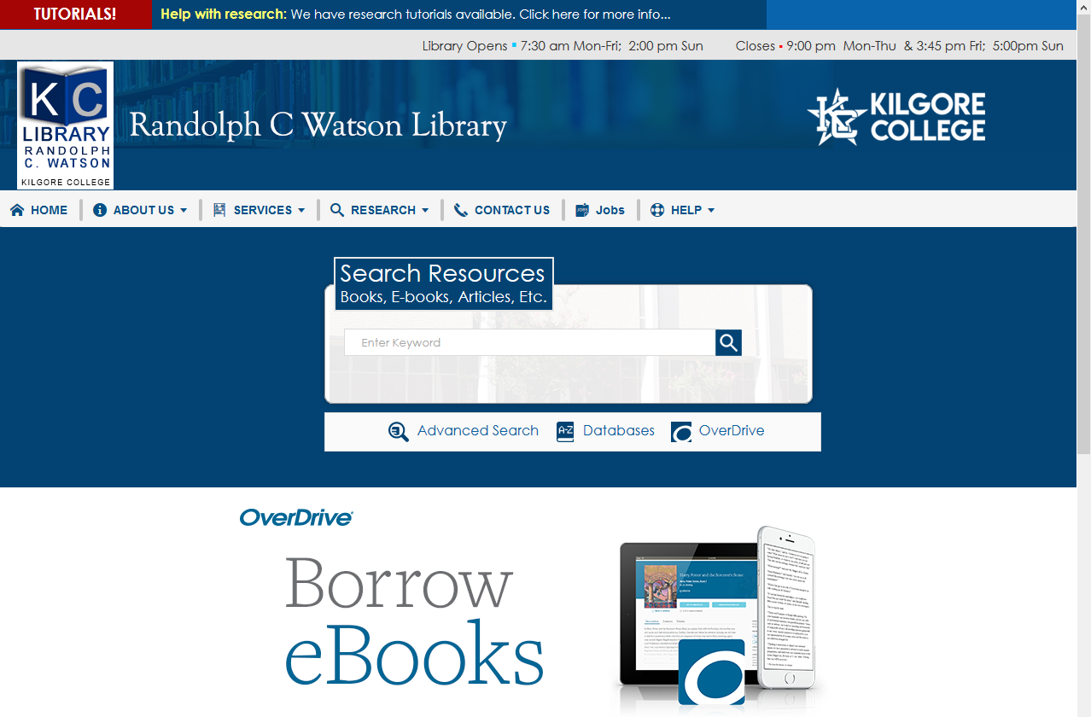
Randolph C. Watson Library Homepage

Slide 5
Logging in from Off-Campus
When logging in from off-campus, you will need your username and password.
User name: 1st four letters of your last name, 1st four letters of your first name, last four digits of your KC ID.
Password: StudentMMDD
“Student” Capitalize the S
Month and Day of your birth so that it is 4 digits.

Slide 6
Off-Campus Log In
So, if your name is Frivolous Frog, your KC ID is 123456789, and you were born on January 15, then:
KC ID: frogfriv6789
Password: Student0115

Slide 7
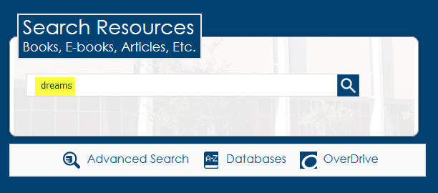
Books and eBooks:
Enter your search terms
Click the magnifying glass or hit the Enter key
Enter search terms here

Slide 8
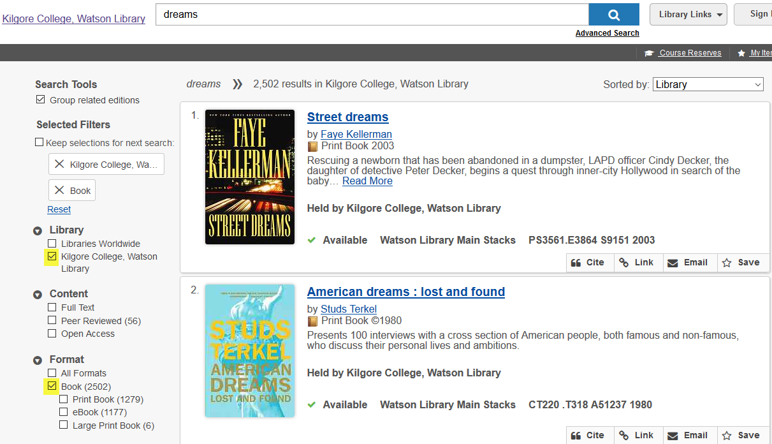
Narrow the search by selecting
Kilgore College and Book
Click here
Click here

Slide 9
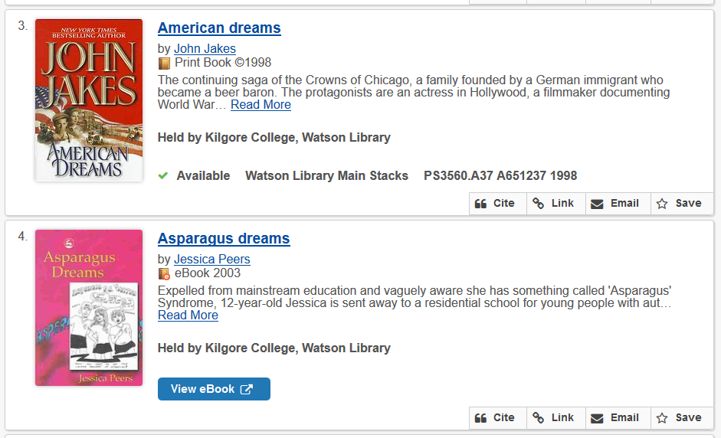
Books and eBooks
Print books can be checked out for two weeks
Print books have call numbers to tell where to find them on the shelf.
Ebooks can be read from your screen

Slide 10
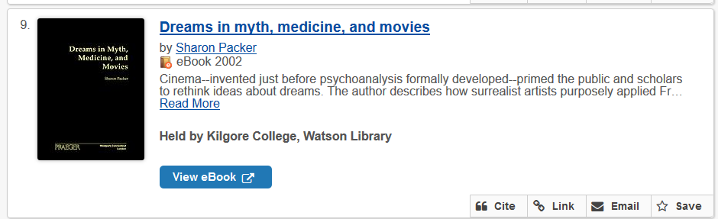
Click View eBook to open
Click here

Slide 11
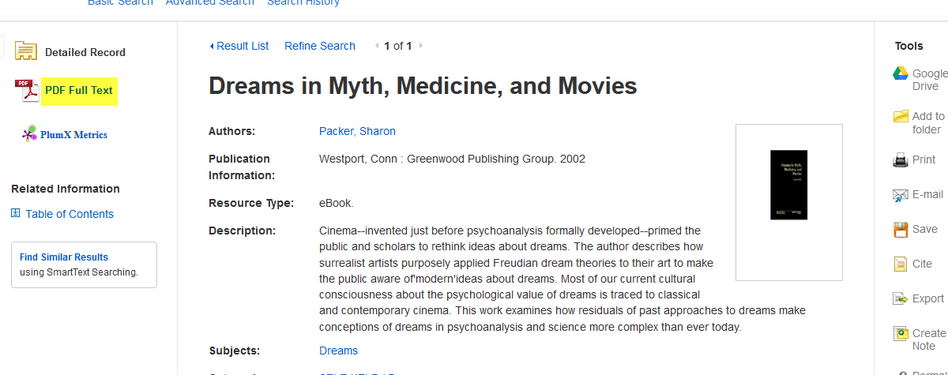
Click Full Text to read the book
Click here

Slide 12
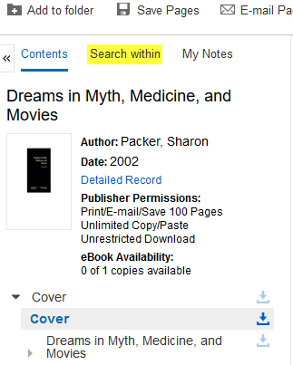
Click Search within
Click here

Slide 13
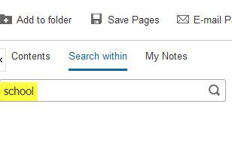
Enter search terms
Enter search terms here

Slide 14
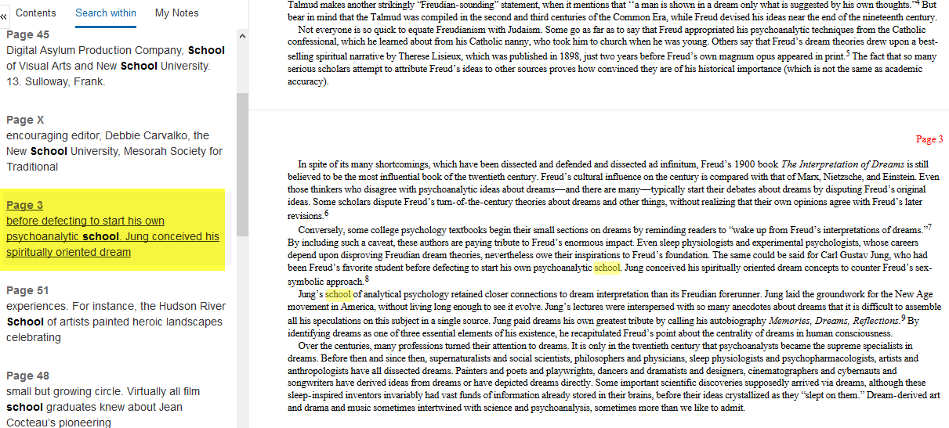
Click on the page number to go to that page
Page 3
Page 3
Click here

Slide 15
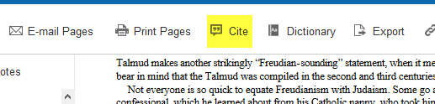
Click on Cite to get the citation information
Click here

Slide 16
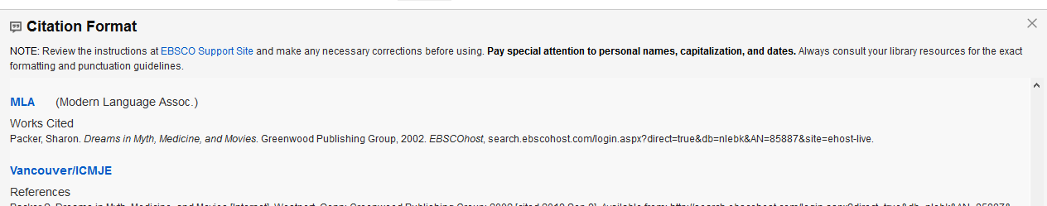
Scroll down to the format you need.

Slide 17
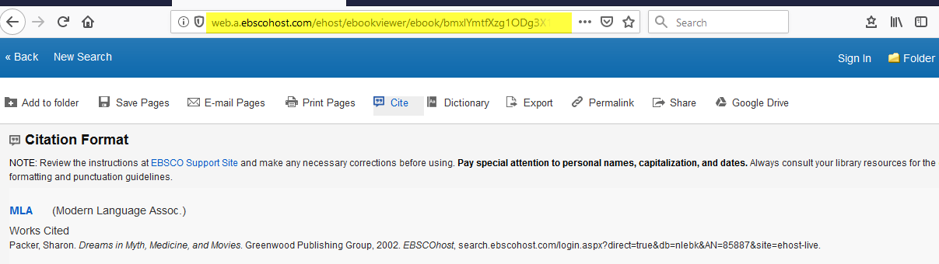
If your instructor requires a URL but there isn’t one listed, copy the information in the address bar and paste it to the end of the citation
Right click on the URL, then paste it to the end of your citation

Slide 18


To keep the page, you can:
Print it off, or
Email the article to yourself.

Slide 19
Why Use a Database?
Anyone can create an internet site.
  It can be true.
  It can be fake.
  You have to verify internet information.
  Who is the author or sponsor?
  Does the site want to provide information, or sell something?
  When was it last updated?

Slide 20
Databases
Provide thousands of articles from journals, newspapers, or book chapters.
The information is more accurate.
Many articles are peer-reviewed.
Your instructor prefers database articles to internet sites.

Slide 21
You can search specific databases
Each database may offer different articles than those found in others.
If you don’t find what you need in one database, try another.
Some databases are subject specific.
The database you choose will depend on what type of information you seek.

Slide 22
Topic/Database Suggestions
Etiquette: Academic Search Complete
Biography: Biography in Context, US History (Gale in Context), Gale Virtual Reference Library
American Heritage/Patriotic: US History (Gale in Context), Credo Reference
Science and Technology: Science and Technology Collection
Art: Oxford Art Online, JStor

Slide 23
Topic/Database Suggestions
Public Relations: Look for information related to your PR subject.
Final Speech: Opposing Viewpoints
  This is your longest speech.
  The more information you have, the longer you can speak.
  Try an argumentative topic.

Slide 24
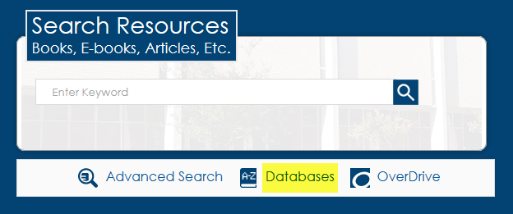
Finding Databases
Click here

Slide 25
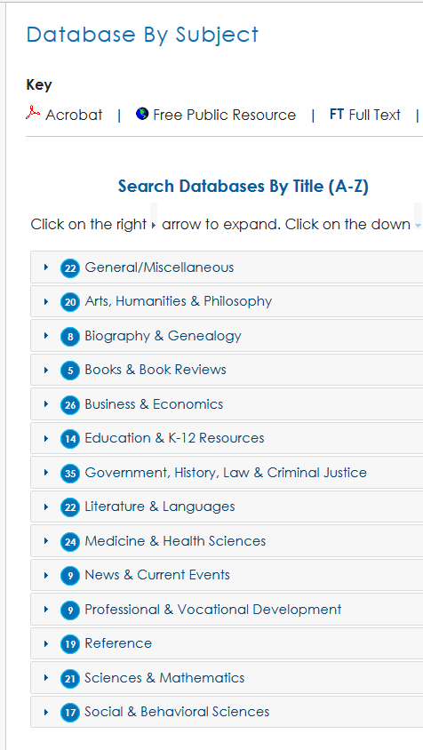
Click on a subject area to select it

Slide 26
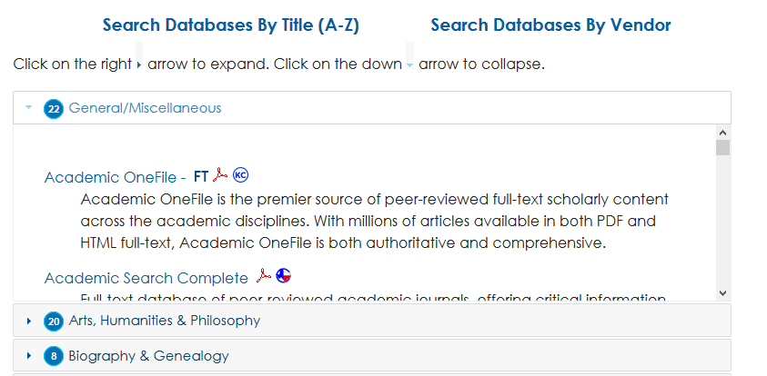
Scroll to see the databases listed
Move this box to see the databases in this subject area.

Slide 27
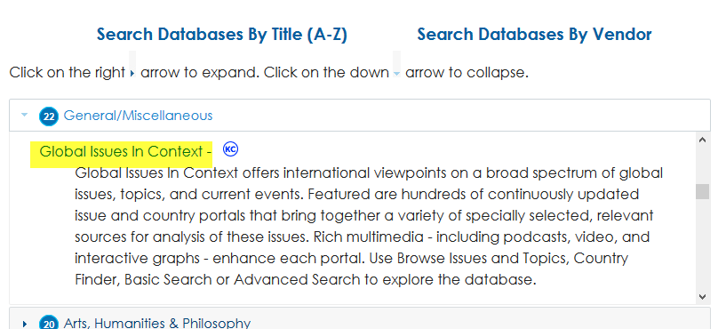
Click on the title to open the database
Click here

Slide 28
Let’s look at some specific databases for your speech
subject areas

Slide 29
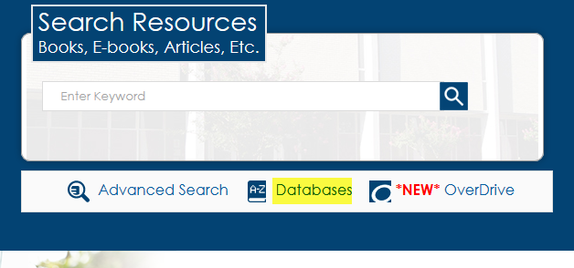
Etiquette

Slide 30
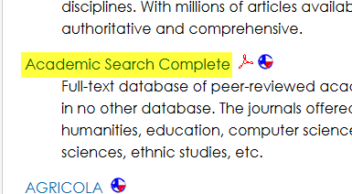
Click Academic Search Complete
Click here

Slide 31
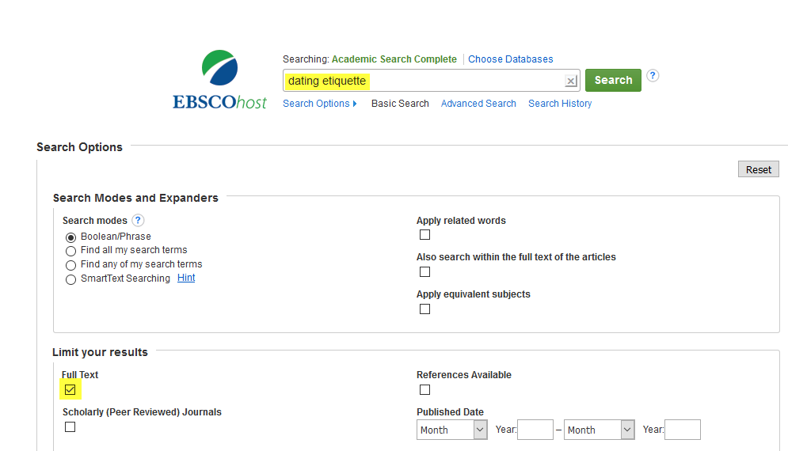
Enter search terms. Select Full Text. Search.
Enter search terms here
Click here

Slide 32
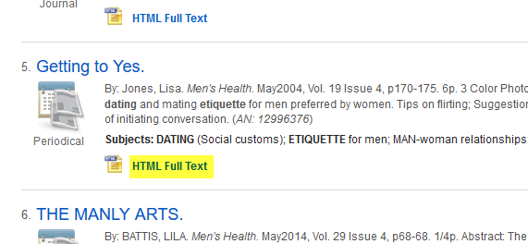
Click Full Text to view article
Click here

Slide 33
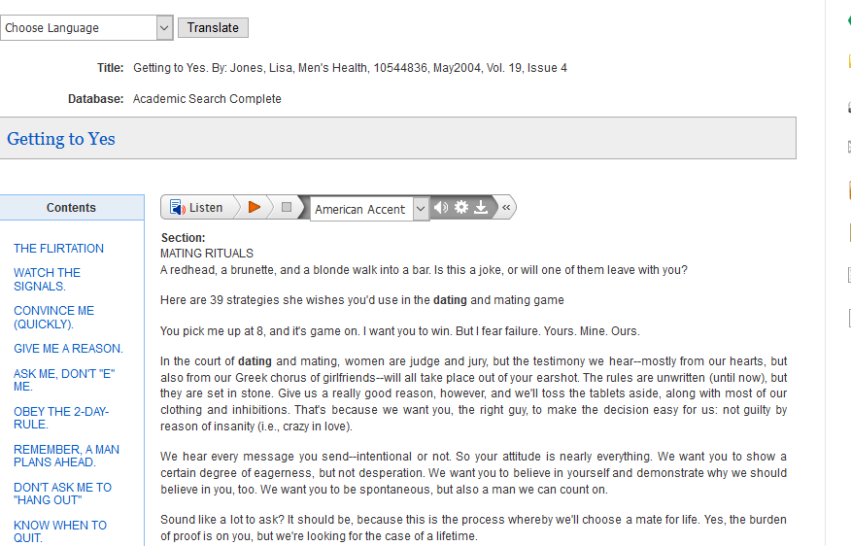
Read

Slide 34
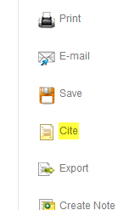
Click Cite on the right side of the page
Click here

Slide 35
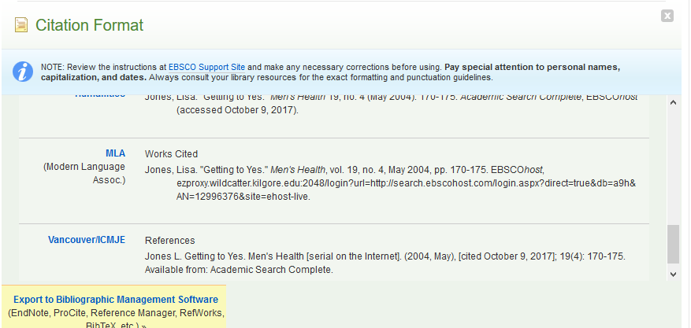
Scroll down to the correct format.
Copy and paste to your bibliography page.

Slide 36
Art
Use Books/ebooks
Use Databases:
Oxford Art Online
Academic Search Complete

Slide 37
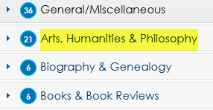
Go to Art, Humanities & Philosophy
Click here

Slide 38
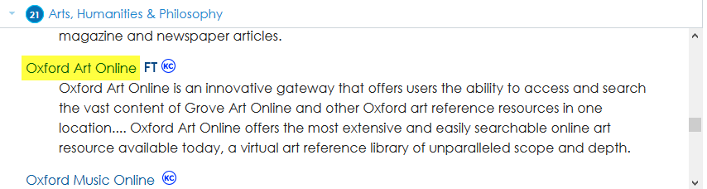
Click on Oxford Art Online
Click here
Move the gray box to scroll

Slide 39
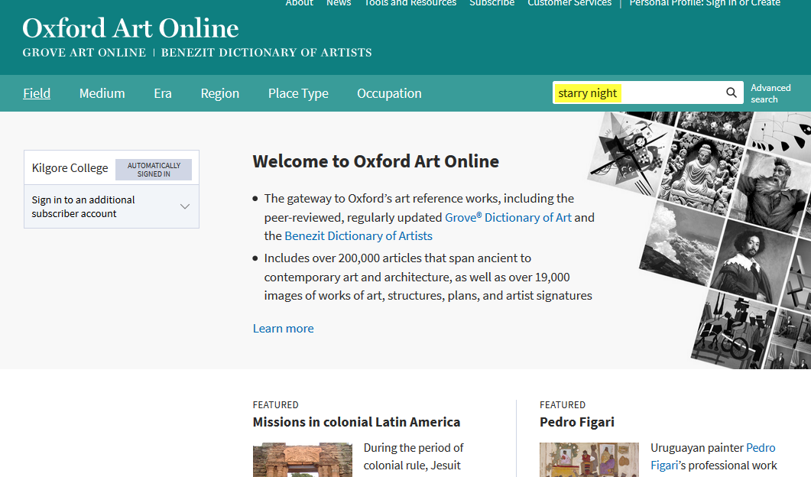
Enter Search Terms
Enter search terms here

Slide 40
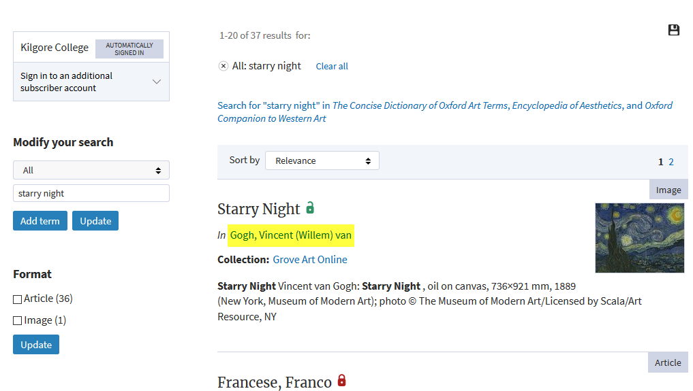
Click on a Title
Click here

Slide 41
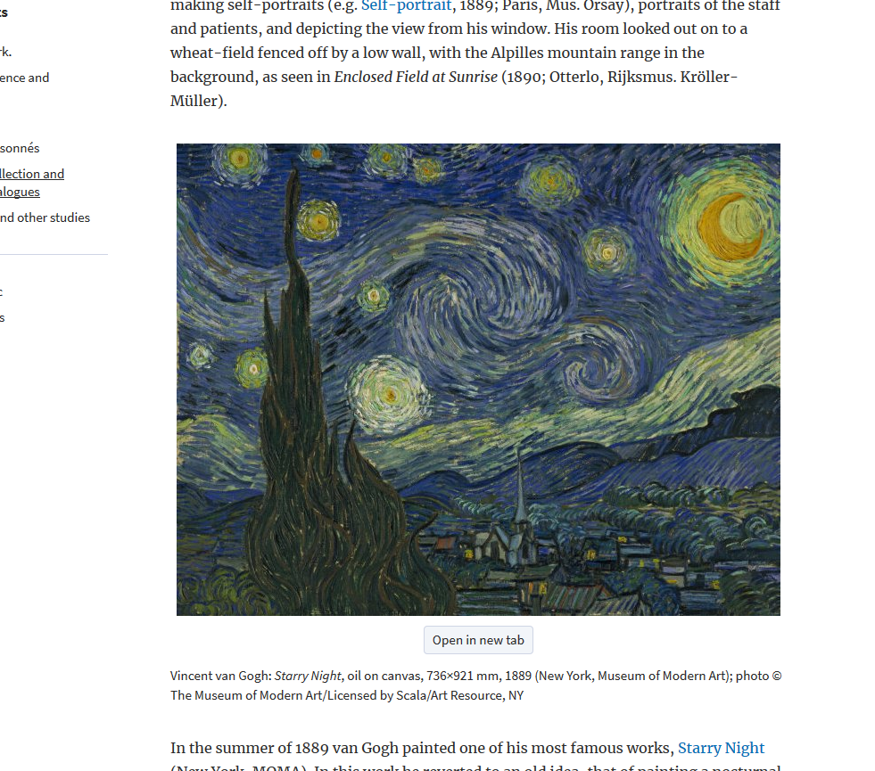
Scroll down to the Image and click Open in a new tab
Click here

Slide 42
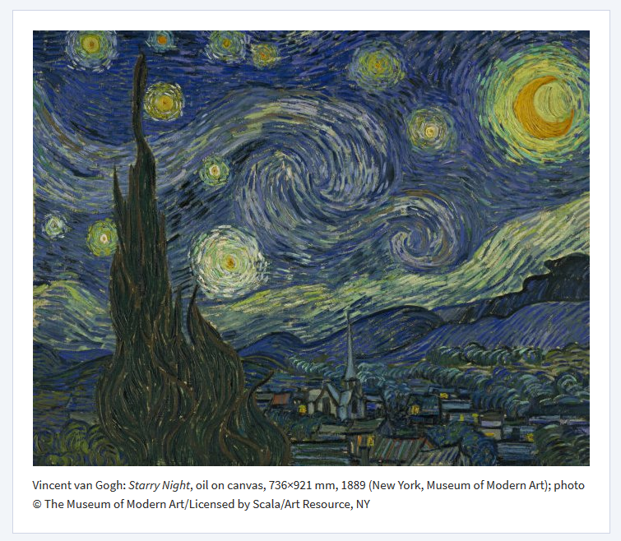
Use the image as a Visual Aid

Slide 43
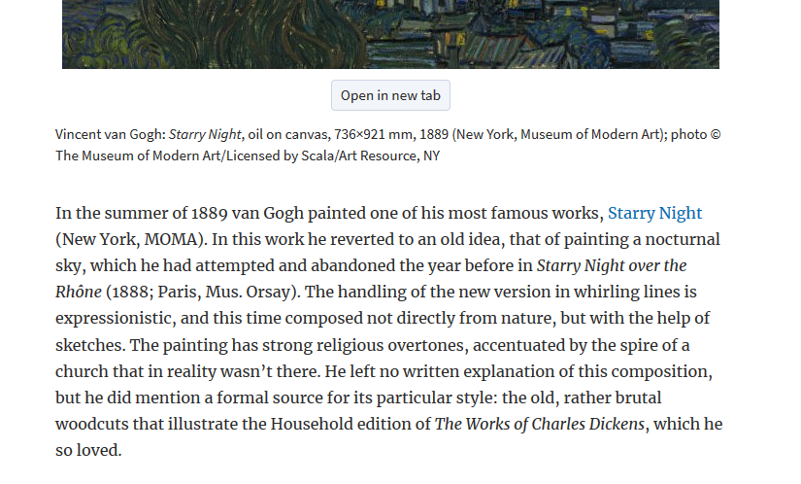
Go back to the page and read the biography for information

Slide 44
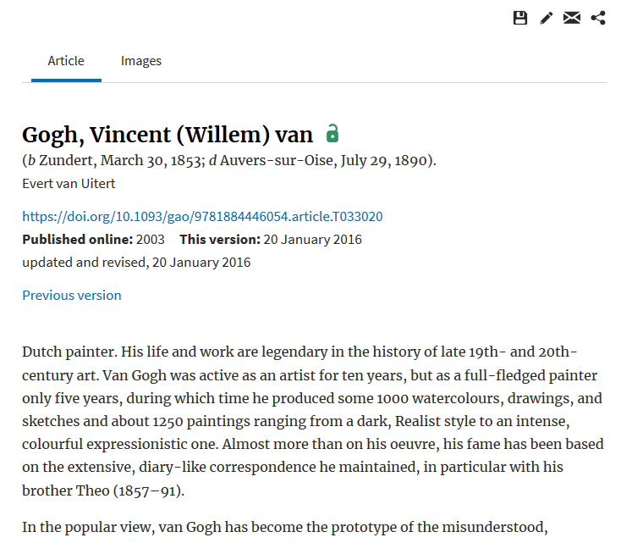
The biography may provide information on the artist’s techniques

Slide 45
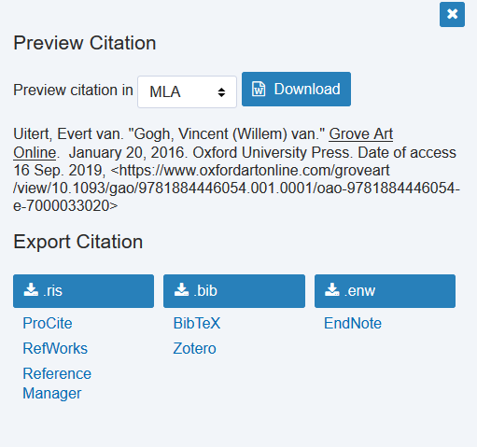

Click on the cite icon for the bibliography
Click on the arrows to change format
Click here

Slide 46
Art: Also try
Academic Search Complete
JStor

Slide 47
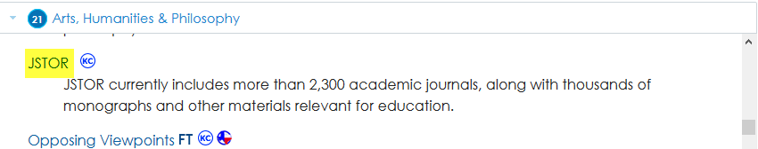
JSTOR
Click here

Slide 48
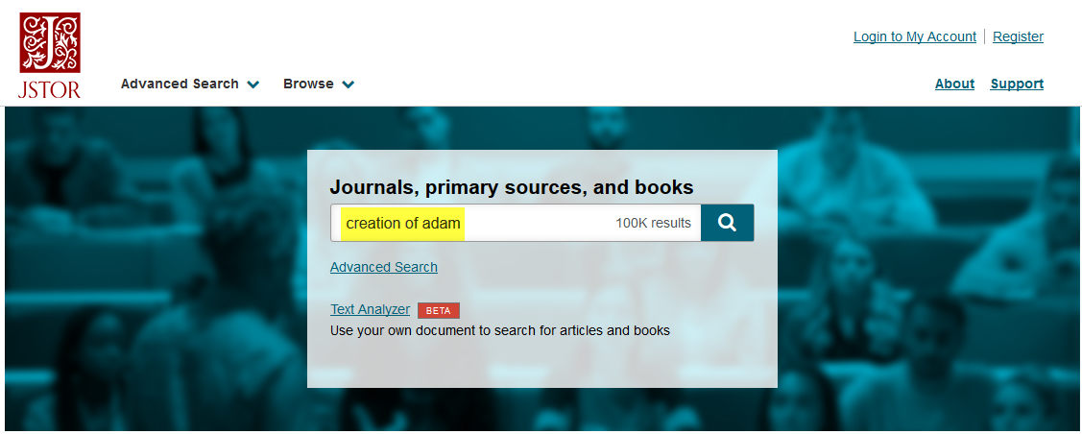
Enter search terms
Enter search terms here

Slide 49
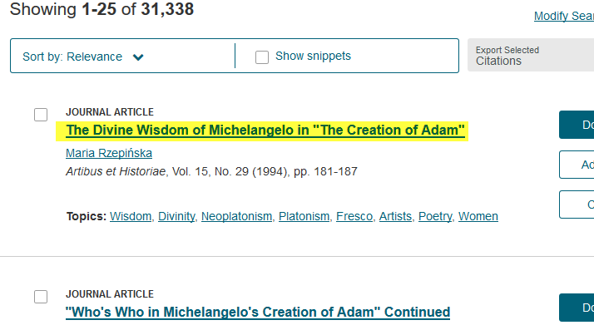
Click on the title you want to read
Click here

Slide 50
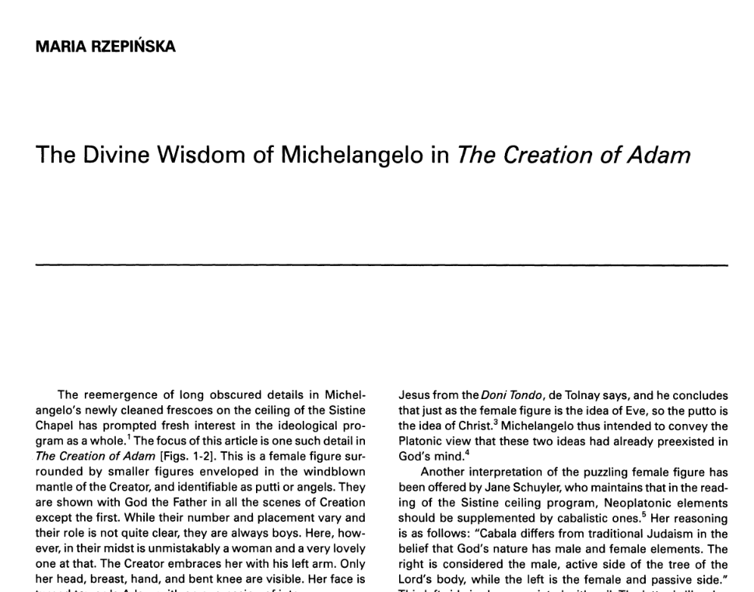
Read

Slide 51
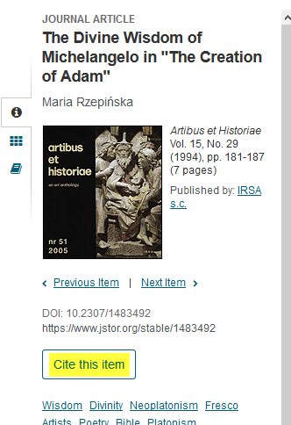
Get the citation info by clicking on Cite this Item on the left sidebar
Click here

Slide 52
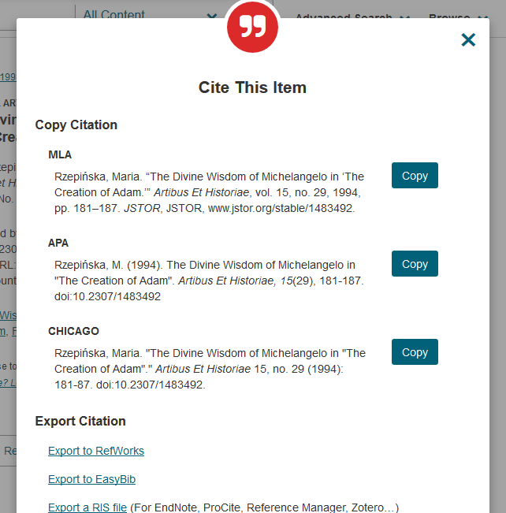
Copy and paste the citation to your Bibliography page

Slide 53
Biography
Databases to Use:
Gale Virtual Reference Library
Musicians/Singers/Inventors
US History (Gale in Context)
Historical Figures
Biography

Slide 54
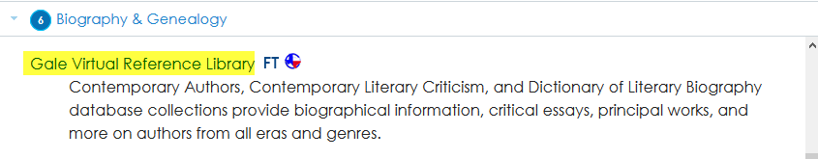
Gale Virtual Reference Library
Click here

Slide 55
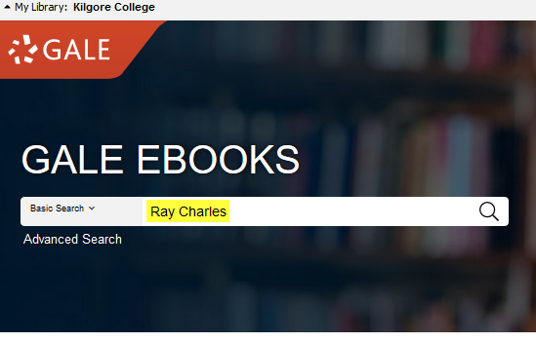
Enter Search Terms
Enter search terms here

Slide 56
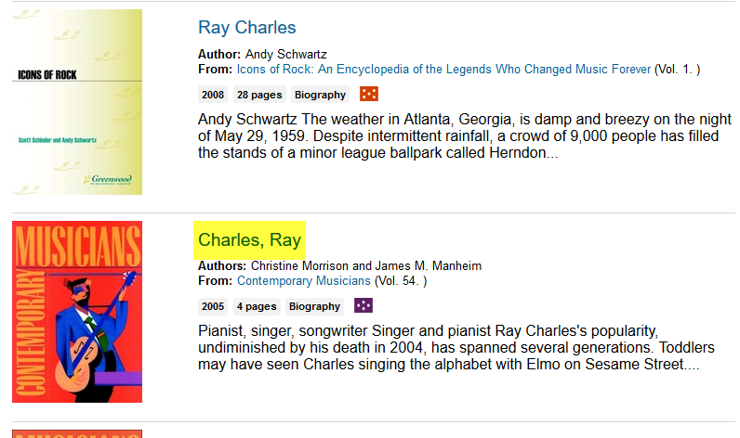
Click on a Title
Click here

Slide 57
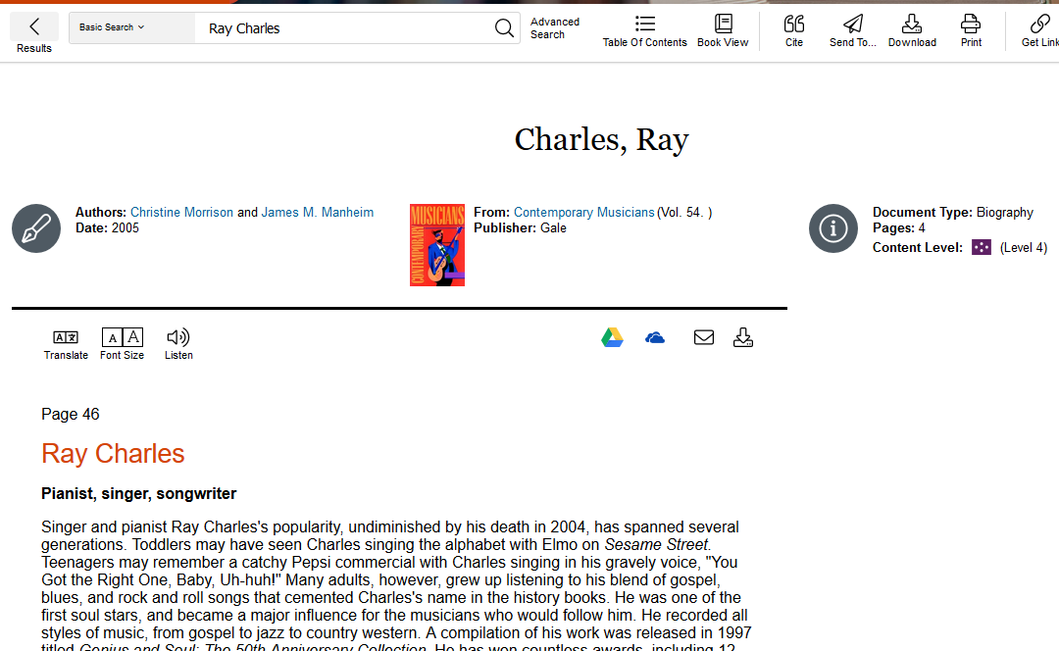
Read

Slide 58
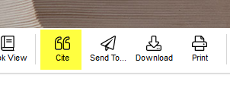
Click on the Cite icon at the top of the page
Click here

Slide 59
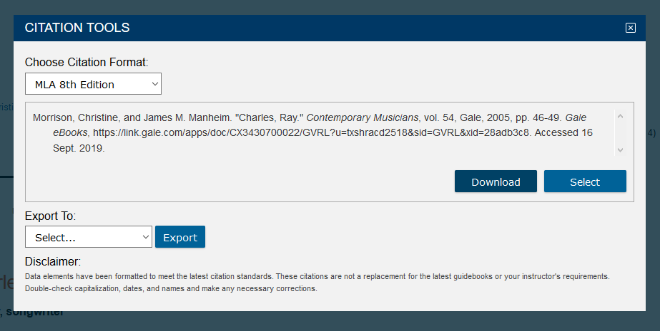
Use the arrow to select the correct format.
Click on the arrow to change format

Slide 60
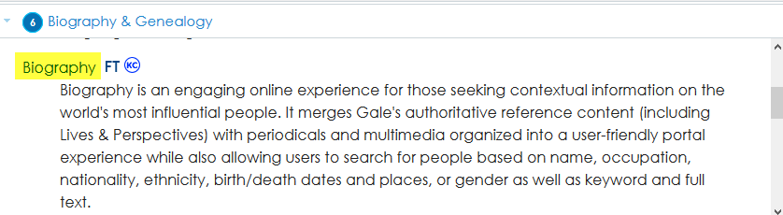
Biography
Click here

Slide 61

Enter search terms and hit Enter
Enter search terms here
Click the magnifying glass or hit the Enter key

Slide 62
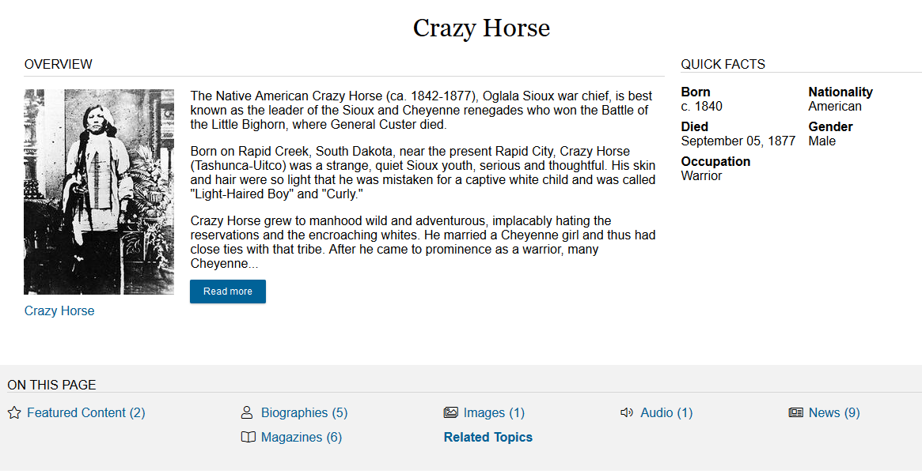
Biography

Slide 63
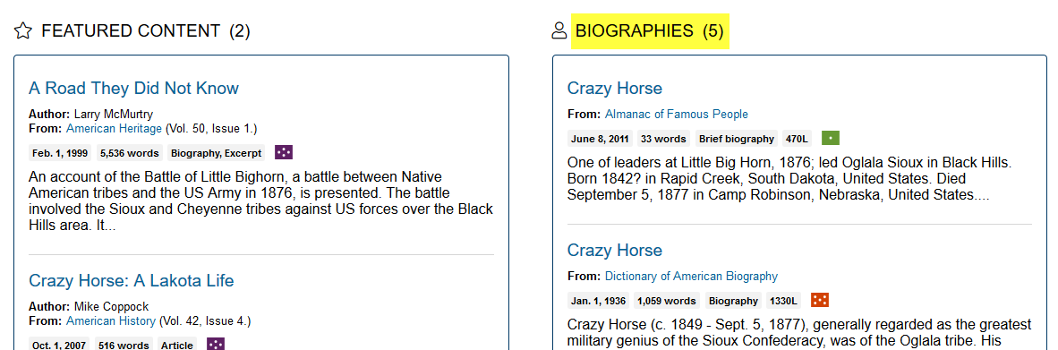
Click on a section heading to show more titles
Click here

Slide 64
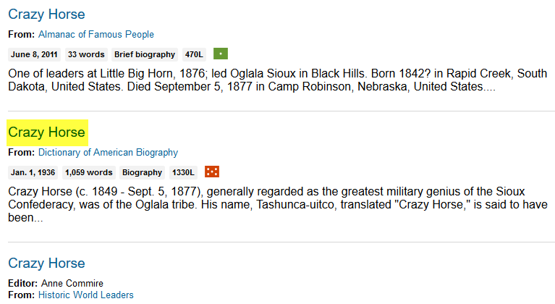
Click on a title to view the article
Click here

Slide 65
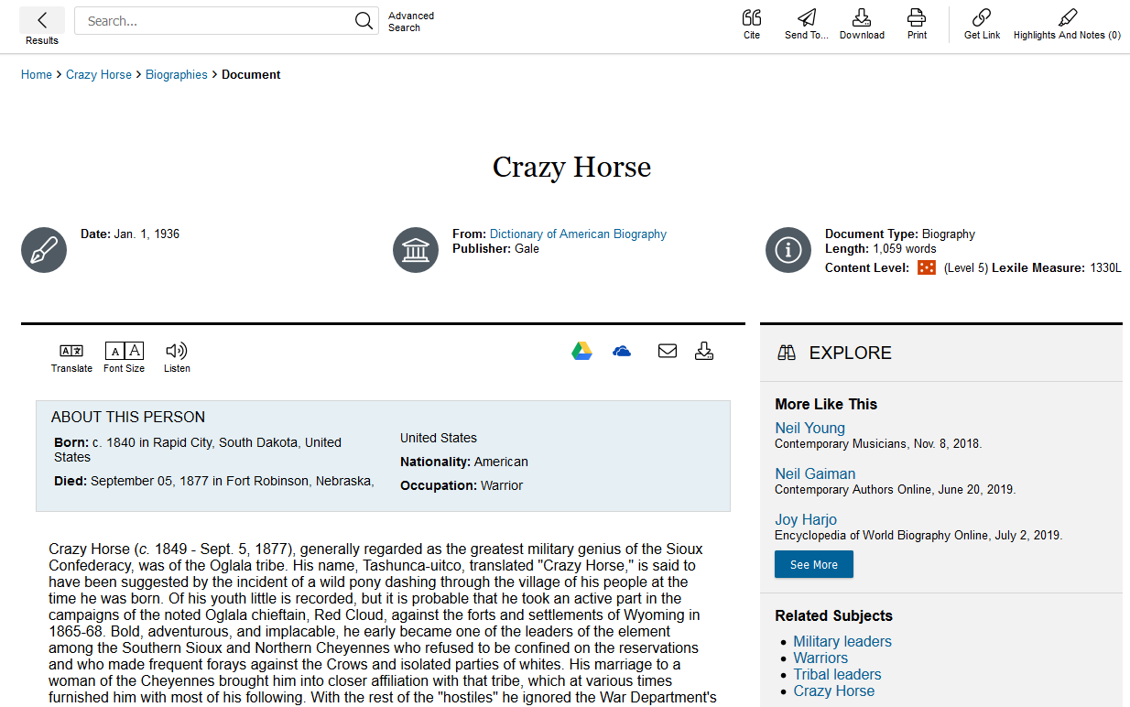
Read

Slide 66

Click the Cite icon at the top of the page
Click here

Slide 67
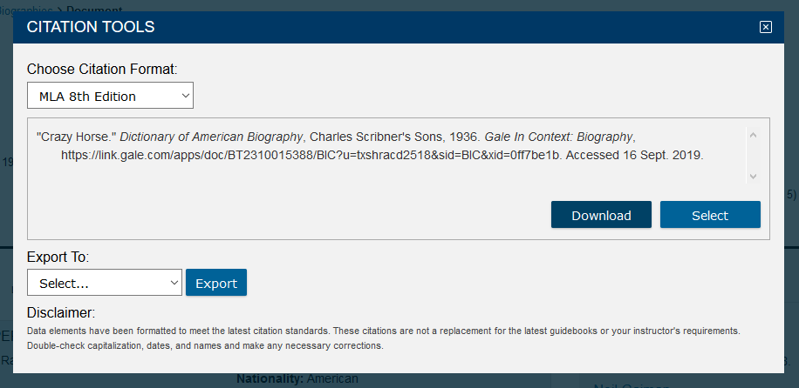
Click arrow to change citation format
Click the arrow to change format

Slide 68
American Heritage/Patriotic
Databases to Use:
U.S. History (Gale in Context)
Academic Search Complete

Slide 69

U.S. History (Gale in Context)
Click here

Slide 70

Enter search terms
Enter search terms here
Click the magnifying glass or hit the Enter key

Slide 71

Or scroll down to browse topics

Slide 72

Click on subject area or number to see more titles
Click here

Slide 73

Click on a Title to view the article
Click here

Slide 74

Read

Slide 75

Click on the cite icon at the top of the page
Click here

Slide 76

Use the format required by your instructor
Click the arrow to change the format

Slide 77
Science & Technology
Databases to Use:
Science & Technology Collection
  Works Like Academic Search Complete
Academic Search Complete
Gale Virtual Reference Library

Slide 78

Science & Technology Collection
Click here

Slide 79

Enter search terms. Click on Full Text.
Enter search terms
Click here

Slide 80

Click on Full Text to view
Click here

Slide 81

Read

Slide 82

Click the cite icon on the right side of the page
Click the icon

Slide 83


Scroll down to your citation format. Add the URL to the end of the citation, if required by your instructor.
Get the URL

Slide 84
Public Relations
Interviews
Research a Topic Related to Your Organization
Opposing Viewpoints
Academic Search Complete

Slide 85
A few ideas for researching an organization
If it is a large or national organization, you can get information from their web page.
Visit the Chamber of Commerce for printed information.
Speak with someone who volunteers with the organization.
Speak with someone who has been helped by the organization.

Slide 86

Final: Opposing Viewpoints
Click here

Slide 87

Opposing Viewpoints

Slide 88

Scroll down to browse issues

Slide 89

Click on the title or number to see more topics within a subject area
Click here

Slide 90

Click to choose a topic

Slide 91

Or, type in your topic
Enter search terms here

Slide 92

Click on the title to read an article
Click here

Slide 93

Read

Slide 94

The citation information will be at the bottom of the article

Slide 95


Or use the cite icon at the top of the page

Slide 96
Some things to consider
Use Opposing Viewpoints for argumentative topics.
Opposing Viewpoints gives you information on more than one side of an issue.
If you can’t get into the database, wait a while, then try again.

Slide 97
If you need help
Call the KC Library and speak to a librarian.
Come to the KC Library and speak with a librarian.
Use the Ask-A-Librarian email service from the home page.

Slide 98

Ask-A-Librarian
Click here

Slide 99

Complete the form and Submit
Fill in the boxes.
Submit your question.

Slide 100
Ask-A-Librarian
We get back to you as quickly as possible.
If it is night time, a weekend, or a holiday, you will have to wait until the next working day to get your answer.
We won’t do the work for you, but we can point you in the right direction.
  Suggest different ways to word the search terms.
  Suggest databases to use.

Slide 101
Quiz
When can you use the Library databases?
What is the email reference service called?
What must you provide if you use someone else’s words or ideas?
What do you click to see the complete article?
Give one reason why you should use databases instead of Internet sources.

Slide 102

Good Luck!

